Slide 1
Offensive technologies Fall 2015
Lecture 0- Administrative Details
Fabio Massacci
https://securitylab.disi.unitn.it/doku.php?id=course_on_offensive_technologies

Slide 2
Course Objective
Myths:
Hackers are social outcast with “deviant” skills and do this out of bravery and spite for society
Bad things only happens to people who mess up and, as I’m not incompetent, this won’t happen to me.
Reality (concise version)
Hacking is a professional activity performed by a wide varieties of actors
Reality (extended version)
’80s: hacker → security expert
Curiosity-driven, Interested in the technical aspects of the vuln
’90s: hacker → “script kiddie”
“How do I install linux to become an hacker”, Batch attacks from a tool (e.g. se7en)
‘00s: hacker → financially motivated criminal
Economic model and incentives behind exploit engineering
‘10s: hacker → State actors
somewhere in between politics and theft
Course Objectives
Offensive technologies are a permanent characteristics of a technological society. It cannot be eliminated as it uses the very same “features” that make our society advanced.
The course guides students to understand the main economic, social and technological drivers behind malware development by governamental actors. Understanding them allows us to better identify methods to defend ourselves.

Slide 3
Course Structures
Learning:
Introduction
Black markets
Understanding how buffer overflow work
A“taster” to understand the intrinsic complication of modern software → Security Testing course
Data analysis, qualitative “coding”
Governamental Malware
General introduction, lectures from external experts
Legal aspects
Presentations
Each of you present its intermediate findings to the class
Investigating
Documents and email analysis and report for government malware, reporting statistics and “qualitative coding” of data (up to 15/30 grade points)
Designing:
Structuring knowledge describing a Government hacking as a business environment (up to 10/30 grade points)
Producing:
Redeployment of a government malware in the lab protected environment (up to 15/30 grade points)
Feedback:
Bonus 4 points if you addressed the feedback given to your team in intermediate presentations

Slide 4
Lecturers
Main lecturers
Prof. Dr. Fabio Massacci
Office hours by appointment in class
Can try your luck by email
Dr. Luca Allodi
Office hour by appointment via email
Others
Ms Martina De Gramatica
Qualitative research
Dr Cesar Bernardini
Buffer overflow tutorial
Industry guest speakers

Slide 5
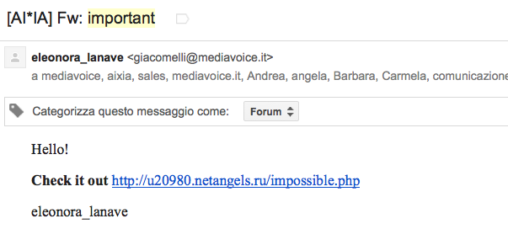
Rules of Engagement
Asking questions in class is always the best policy
Your colleagues may be interested in the answer
Things are easier to explain
The prof gets hundreds email per day…
Today 9am – 14 am (66 emails and counting)
Do your homework first
“I can’t bother to find the answer, I will ask the prof.”
Q: “I don’t remember to whom the deliverable should be submitted”
A: “read my slides”
Write with “[OffTech-2015]” in the subject
“important” is a no go
Got 57 in the last months
“urgent” is not better

Slide 6
Overarching Learning Objectives
The course should develop and evaluate your abilities in
Making value judgement
Decide which parts are important and which are not (this should be an important part of understanding which decisions are important to consider when security attacks are mounted by a varieties of actors).
Creativity
How to solve problems when not all steps are completely specified (this what you should try to replicate the deployment of the malware)
Ethics
Self explanatory?

Slide 7
Material used the course
MalwareLab
The dump is downstairs in Povo 2 for you to analyse
Dump of emails → insights on internal procedures of gov malware development
Who was the hacking team dealing with? What problems did their products have?
Dump of bills → insight on actual clients and malware deployment.
Is your own motherland government involved? If yes, how much and for what?
Dump of source code → insights on malware operations
Can you spot malware functionalities declared in the documentation in the actual code?
Malware dump → actual malware you can try to install and test on the lab machines

Slide 8
Responsible Study
Material in the MalwareLab is sensitive
Its content might be offensive to you (pornographic pictures, racist comments, disrespectful of your religious beliefs etc..)
It may create embarrassment or slander of individuals
Malware is advanced tech
Nobody really knows what it does (most advanced one even detect they are analyzed)
There are mechanisms in place to prevent you from exfiltrating the data outside of lab
You must agree to the terms and conditions of this course before having access to the data
Mlab is isolated from rest of infrastructure
You work only in the lab
You are not allowed to disclose information about any individual that you find during the analysis
Your final deliverable, as approved by the professor is the only public deliverable you are allowed to disclose to third parties

Slide 9
Offensive technologies Fall 2015
Lecture 1
Introduction
Fabio Massacci

Slide 10
Question
Will be offensive technologies there to stay?
Hacking “expires” the idea “stays”
Well old things are still there…
Attacker style is importance for defense
If there is something that can be abused it will be abused
Motivation is important – cost has to be feasible – engineering
Same problem may apply for protection mechanism

Slide 11
Do you trust these organisations?
S-TRUST Authentication and Encryption Root
Deutscher Sparkassen Verlag GmbH, Stuttgart, Baden-Wuerttemberg (DE)
NetLock Kozjegyzoi Tanusitvanykiado
Tanusitvanykiadok, NetLock Halozatbiztonsagi Kft., Budapest, Hungary
TÜRKTRUST Elektronik Sertifika Hizmet Sağlayıcısı
Bilgiİletişim ve Bilişim Güvenliği Hizmetleri A.Ş. ANKARA, Turkey
CA 沃通根证书
WoSign CA Limited, China
To guarantee that a website is really what it claims to be?

Slide 12
What’s this?
ONE webpage
Plenty of ads
Process
We DON’T look at the ads
Only click on mail
And download the program of the infosec conference

Slide 13
What’s this?
ONE PDF file, essentially an image
What happens if we open it?
Nothing
Acrobat Reader shows the image on the monitor

Slide 14
What’s this?
A photocopier
A printer
You send a file, and it prints

Slide 15
What really is this? Just like that!
Xerox computer to just print a file:
Intel Celeron - 733 MHZ – 128MB
NASA computer to land Apollo 16 to the Moon
AGC – 1 MHz – 4KB RAM

Slide 16
What really is this?
That’s a program containing
at least 1682 instructions
What happens when we open it?
All instructions are executed
Not necessarily true that the result is displayed
PDF language is Turing Complete
ANY function can be written in PDF language
Opening a PDF file can seamlessly display an image and simultaneously solve small Fermat’s theorem

Slide 17
What really is this?
When we type www.libero.it on the browser, YOUR computer will:
Execute
186 local functions
15 functions from external sites
Aggregate static contents from
676 websites of which
370 external websites
193 may be just images
Aggregate dynamic content from
8 advertisers (at least)
Are all of these actions “good” ones?

Slide 18
Who trusts these? Everybody.
S-TRUST Authentication and Encryption Root
Deutscher Sparkassen Verlag GmbH, Stuttgart, Baden-Wuerttemberg (DE)
NetLock Kozjegyzoi Tanusitvanykiado
Tanusitvanykiadok, NetLock Halozatbiztonsagi Kft., Budapest, Hungary
TÜRKTRUST Elektronik Sertifika Hizmet Sağlayıcısı
Bilgiİletişim ve Bilişim Güvenliği Hizmetleri A.Ş. ANKARA, Turkey
沃通根证书
WoSign CA Limited, China

Slide 19
Question - discussion
Even with the basic assumption
What’s from inside is trusted
What’s from outside is untrusted
BUT in todays Internet this is not true
Comes from inside→ Goes out → Comes back
Visualise a webpage = HTTP GET
HTTP GET = go out, deliver what you find, and what you find is an executable (for convenience)
E-mails come from outside etc. etc.
We have too many powerful things that make our life nice, too powerful to control and lock them down and lock them out

Slide 20
Attack delivery
Type of infection is a function of attacker’s goal:
Botnet creation → simple form of control for limited functionalities
Virus/keylogger → credential theft /spoofing/ spam/ remote control
Full-fledged backdoors → monitoring / remote control
Ransomware → direct monetisation & low profile
Regardless of what the attacker wants to do, he/she must have some level of access to the machine
Remote control = long term avenue for the attacker to “valorize" the infection

Slide 21
How does the infection happen?
Human vector (social engineering) → user vulnerability
The attacker convinces the user on doing something for him/her (e.g. install a virus masked as an anti-virus → fakeAV)
Tecnological vector → software vulnerability
Principal cause is that most systems are not capable of distinguishing “legitimate” input from “rogue” input (e.g. as provided by the attacker)
The system executes whatever’s in memory.
Virtually any software has bugs that the attacker can exploit to deviate the execution of the software towards actions in his own agenda.
Mixed: e.g. link on social network, link clicked by a user on a document, opening an email with a malware, IP connected camera with pre-loaded malware etc.

Slide 22
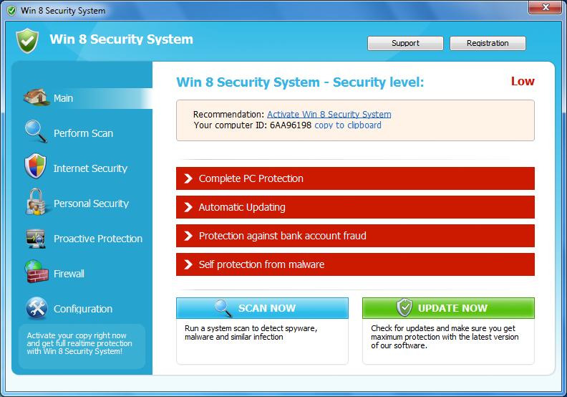
Human vector: social engineering
Attacker convinces the user to install a virus masked as a legitimate application
The example here is a fake antivirus product called “Win 8 Security System”
User thinks it’s actual AV
In reality it infects the system

Slide 23
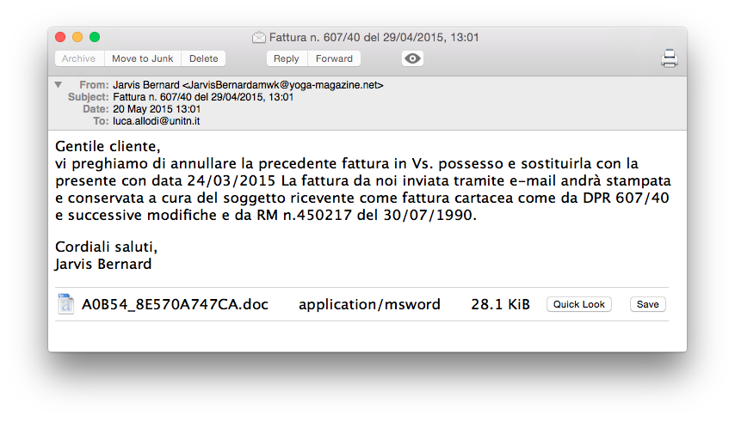
Example of attempted infection

Slide 24
Technological vector
The attack usually exploits some vulnerability in software
System is fed with computationally valid codes in input to a vulnerable software → code is executed
Several types of vulnerabilities
XSS
Buffer overflow
SQLi
Privilege escalation
…
More exercises and details in
Network Security Course
Security Testing Course

Slide 25
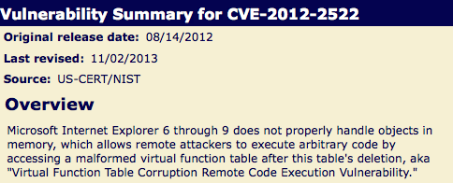
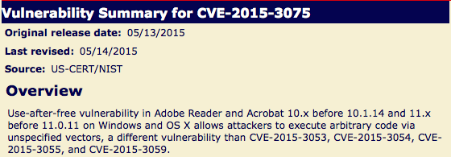
Vulnerability examples

Slide 26
Not all vulnerabilities are equal
Publicily disclosed vulnerabilities → knowledge about the vuln is in the public domain
Responsible disclosure
Vuln disclosed first to vendor
Vendor releases patch
Vulnerability is disclosed
“Not responsible” disclosure
Vuln is disclosed
Vendor gets to know it (word-of-mouth, sec researcher..)
Vendor (eventually) patches
Privately disclosed vulnerabilities
Somebody found the vuln
keeps info for him/her self
OR sells it to a few costumers
Privately disclosed vulns also called “0-day”
0-day exploit is “Defined as computer language code written to take advantage of a particular vulnerability, which has been discovered but is not publicly known.”
First definition in academic literature by Arkin in 2002.

Slide 27
Public vs private
Two separate markets
Public vulns → vendor pays researcher for finding it
Private vulns → rich player pays researcher to own exclusive information
Vulnerabilities are information
In theory: once the info is out, vuln is “replicable”
Private vuln → no value if disclosed
Public vuln → no value after publication
Not really true but disclosure still changes game
Engineering exploits is difficult → Black market tools only use an handful of disclosed vulns
High profile victims might be alerted by security → low profile victims may remain vulnerable

Slide 28
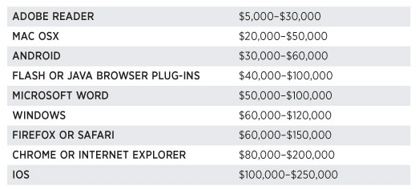
Alledged (1st time) price list for 0-days
http://www.forbes.com/sites/andygreenberg/2012/03/23/shopping-for-zero-days-an-price-list-for-hackers-secret-software-exploits/

Slide 29
Who buys into these markets?
Allegedly (2nd time), mostly governments
Ok, but from whom?
Allegedly (3rd time), from private agencies that sell malware and exploits to governments
Which governments?
Mostly oppressive ones (yes, allegedly, 4th time)
Sample of agency names
VuPEN (used to be in France)
Gamma International (UK/Germany)
Hacking Team (Italy)

Slide 30
Research on “private” tech
Security “hacktivists” conducted research on “phishy” activities by these agencies
Most research done by CitizenLab
2015 EFF (Electronic Freedom Foundation) Pioneer award
An example is FinFisher by Gamma International
https://www.gammagroup.com
Headquaters in UK (Gamma group) / Munich (Gamma GmbH)

Slide 31
Gamma international GmbH
FinFisher is a line of software products
remote intrusion
surveillance
Typical “beach head” diffused through email campaign
Sold exclusively to law enforcement and governments
“Official” use
surveillance of criminals/prevention
Actual deployment (instance of)
surveillance of political dissidents in Bahrain
Notes:
Material: https://citizenlab.org/2013/03/you-only-click-twice-finfishers-global-proliferation-2/#1

Slide 32
Gamma international (GmbH)
FinSpy gathers information from the infected computer
passwords
Screenshots
Skype calls
Sends the information to a FinSpy command & control server.
Researcher @ Rapid 7 traced C&C fingerprint
Binary analysis of malware samples → all belong to same family
https://www.virustotal.com/en/file/cc3b65a0f559fa5e6bf4e60eef3bffe8d568a93dbb850f78bdd3560f38218b5c/analysis/
Notes:
https://community.rapid7.com/community/infosec/blog/2012/08/08/finfisher

Slide 33
FinSpy
Disguises itself as a picture
Filename has Unicode Right-to-Left Override char (U+202e in unicode)
Real name gpj.1bajaR.exe
Displayed name: exe.Rajab1.jpg
An executable disguised as a picture
Different pictures for different samples

Slide 34
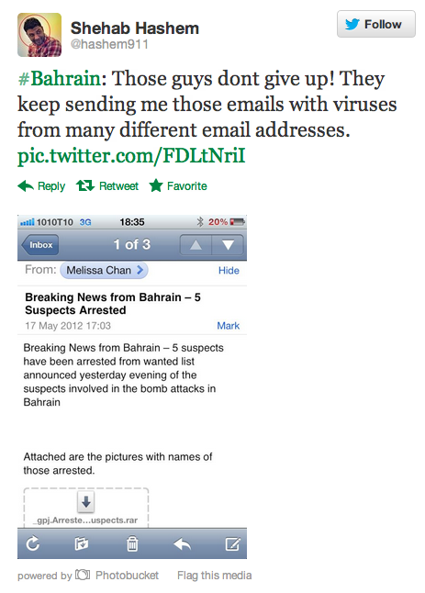
FinSpy - delivery
Notes:
Left <- email of equivalent attack
Right <- displayed picture when opening exe

Slide 35
FinSpy – Execution (1)
Creates random dirname
C:\DOCUME~1\User\LOCALS~1\Temp\\TMP44D8C9F9
Drops copy of itself and launches
C:\DOCUME~1\User\LOCALS~1\Temp\\driverw.sys
Driver already seen in other samples of FinFisher malware
Functionality unknown
New random dir to store screenshots, logs, etc. to send to C&C

Slide 36
FinSpy – Execution (2)
Actual malware functionality upon reboot
Injects itself in winlogon
Spawns legitimate processes and then replaces code image with malicious one (process hollowing)
Hooks on several system functions
Catches call and sends data to C&C
Notes:
https://community.rapid7.com/community/infosec/blog/2012/08/08/finfisher
https://github.com/mieleke/Process-Hollowing

Slide 37
Notes:
FinSpy C&C servers

Slide 38
Disclaimer
Malware attribution is a very complicated problem
Can be based solely on
Binary features
Behavioral analysis / implementation of techniques
Hence the “allegedly this”, “allegedly that”.
Problem → malware analysis is hard because they are made to be understood by computers
What if we had something made to be understood by humans?

Slide 39
The Hacking Team (HT) case
The Italian group Hacking Team exposed
Significant player in the market
Main product: Galileo RCS
remote control system
400 GBs of exfiltrated data
Malware samples (computer can parse)
Source code in GIT repos (human can sort of parse)
Billing and emails (human can fully parse)
Key question:
what technology were they using, and to whom where they selling it?
Is the technology any good really?

Slide 40
Governmental malware: is it that sophisticated?
FinSpy malware is not particularly complex
No polymorphism
Delivery mechanism == email attachment
What is the actual sophistication of the technology developed and deployed by these players?
From the HT dump:
“Good” guy distracts the victim while other guy whitelists the malware
.. Lame
Is this really the nature of the game, or is there more to it?
Notes:
https://wikileaks.org/hackingteam/emails/emailid/19213

Slide 41
Additional Readings
First academic paper mentioning 0-days (that I know of)
O. Arkin. “Tracing Hackers: Part 1.” Computers and Security, 2002.
Insight in the market
C. Miller. The Legitimate Vulnerability Market. Workshop on Economics of Information Security, 2006.
Some different perspectives on cybercrime
Nick Nykodym et al. “Criminal profiling and insider cyber crime.” Digital Investigation, 2005.
D. Florencio et al. “Sex, Lies and Cybercrime Surveys”. Workshop on Economics of Information Security, 2006.
J. Franklin. “An Inquiry into the Nature and Causes of the Wealth of Internet Miscreants”. ACM Conference on Computer and Communication Security, 2007
A tutorial on the difficulty of attribution
M. Marquis-Boire. Big Game Hunting: The Peculiarities of Nation-State Malware Research. BlackHat USA, 2015.

