Slide 1
Cyber Security Risk Assessment Fall 2016
Lecture 9
Corrective Controls

Slide 2
Sample of Controls (reminder)
Functional Classification
Preventive
System Hardening → reduce opportunities
Software Patching → remove vulnerabilities
Detective
Intrusion Detection Systems → reduce likelihood
Likelihood (of exploit going unnoticed), may reduce impact (if corrective actionss taken)
Audit Trails (as before, for humans)
Corrective
Back-up → it is done before the incident but it doesn’t forbid the incident to happen → reduce impact
File Recovery → recover from impact
Conceptual Classification
Procedural → organization level, related to humans operating system
Technical → system and software level
Physical → related to facilities

Slide 3
Corrective Controls
Countermeasures reduce risk and loss
Reduce Threats
Reduce Chances and Vulnerabilities
Reduce impact of loss
Threat
Vulnerability
Incident
Impact
Remove Threats
Remove
Vulnerabilities
Remove Impact
Reduce Opportunity
Reduce Likelihood
Reduce Impact
Recover from
Impact

Slide 4
What Type of Correction?
Three Typical Organizational Components
Business Continuity Plan (BCP)
Disaster Recovery Plan (DRP)
Computer Emergency (Security) Response Team (CERT o CISRT)
Purpose of Corrective Controls is to make sure that business continues
Includes procedural, human, IT and physical resources
Recovery is not necessarily IT related
A disaster recovery plan might also include a good Public Relation manager
“We experienced security breaches in the corporate network in 2010 which were not sufficiently reported to Management.
In 2010, the Company faced several successful attacks against its corporate network in which access was gained to information on a small portion of our computers and servers. We have investigated and do not believe these attacks breached the servers that support our Domain Name System (“DNS”) network. Information stored on the compromised corporate systems was exfiltrated.
The Company’s information security group was aware of the attacks shortly after the time of their occurrence and the group implemented remedial measures designed to mitigate the attacks and to detect and thwart similar additional attacks. However, given the nature of such attacks, we cannot assure that our remedial actions will be sufficient to thwart future attacks or prevent the future loss of information.[…]
Management was informed of the incident in September 2011 and, following the review, the Company’s management concluded that our disclosure controls and procedures are effective.
Who said it?

Slide 5
Elements of a BCP
Purpose, scope, assumptions
System description and architecture of impacted tangible assets
Responsibilities
Implementation
Phases
Technical Instruments
Typically through individual DRPs
Plan training, testing, and exercises
Plan maintenance

Slide 6
Purpose and Scope
Not everything is essential for the operation to keep going
No Landing at airport might be acceptable if planes can be re-routed to a nearby one
If laser guided landing not possible, visibility landing might be neeeded
BCP scope identifies what is essential (and how much does it cost to keep it running)
Typically achieved through a Business Impact Analysis
Identify critical business functions (CBFs)
Identify critical processes supporting the CBFs
Identify critical IT services supporting the CBFs, including any dependencies
Determine acceptable downtimes for CBFs, processes, and IT service
BIA qualitative so far, it can be also quantitative → forthcoming lectures

Slide 7
Netflix example
“Our metric of interest is customer engagement, which we measure as the number of video plays that start each second.”
Exercise of disruption
“most of our attention stays focused on the top row.”
In the bottom row, you can clearly see traffic evacuate from the west region.
The east region gets a corresponding bump in traffic as it steps up to play the role of savior.
As long as the aggregate metric follows that relatively smooth trend, we know that our system is resilient to the failover.”
http://techblog.netflix.com/2015/09/chaos-engineering-upgraded.html
Then this needs to be passed over to the technical infrastructure

Slide 8
Identification of Tangible Assets
Identify all critical components for the system
Identify all equipment ~ servers, switches, routers
Include databases hosted on the system
Include files ~ documents or spreadsheets
Include necessary supplies
Notes:
The BCP should list all the critical components for the system.
There are two reasons for including this data:
First, it makes it clear which components are needed for the critical business functions (CBF).
Second, it provides a list that you can use to restore the system from scratch.
This list includes any equipment, such as servers, switches, and routers.
The servers may need to be rebuilt from scratch. Therefore, the BCP should list the operating system and any applications needed to support the system.
If an image is used to rebuild servers, it will list the version number.
Data can include a database hosted on the system.
It can also include any type of files, such as documents or spreadsheets.
Last, the list can include any needed supplies:
This can be simple office supplies, such as printer paper and toner.
For some systems, it can include technical supplies, such as special oils for machinery or tools needed for maintenance.

Slide 9
Typical Data To Be Protected
Business IT Organization
Accounting and payroll functions
Critical IT hardware
Software required for operations
Customer record in hard copy
Emergency loan information
Financial operations data
Emergency data
Call trees for emergency response
List of DRP team members
Emergency data as important as the Business Data
if you don’t know whom to call for help, how are you going to be rescued?
Remote Tower Case Study?

Slide 10
BCP Roles and Responsibilities
Key Roles
BCP program manager or coordinator
BCP teams
Emergency Management Team (EMT)
If nobody is charge things cannot be fixed
Avoid → “Oh my…, everything broke, whose fault is that?”
Damage Assessment Team (DAT)
If nobody knows what is broken how you can fix it?
Technical Recovery Team (TRT)
Things don’t get fixed by themselves
From teams to “instruments”
Each team must have instruments (human, IT, physical) to perform the required steps

Slide 11
Phases within a BCP Plan
Notification/activation phase
Recovery phase
Reconstitution phase

Slide 12
Implementation through DRPs
What is a Disaster Recovery Plan?
A plan to restore a critical business process or system to operation after a disaster
A component of the overall BCP
Other names:
Contingency planning, Business resumption planning, Corporate contingency planning, Business interruption planning, Disaster preparedness
DRP key terms:
Critical business function (CBF)
Maximum acceptable outage (MAO)
Recovery time objectives (RTO)

Slide 13
BCP vs DRP
BCP
Focused on business function recovery as a whole
Covers all functional areas of business
Includes a business impact analysis (BIA)
May include DRPs of subparts
DRP
Typically Focused on IT function recovery
Function of the IT department
Recovery from a declared disaster
Notes:
BCP
Covers all functional areas of a business, it ensures the entire business can continue to operate in the event of a disruption.
Includes a BIA, and also address other non-technical elements of the event.
Focused on getting the overall business functions back to normal.
DRP
Is a function of the IT department,
Includes the elements necessary to recover from a disaster, once one is declared.
Involves copying the critical data to media or online and then, if required, moving the IT operations off site to recover, if required.
Focused on restoring and recovering IT functions.

Slide 14
Technical Instruments
Ex-ante: Backups of data
Off-site copies
Electronic vaulting
Remote journaling
Ex-ante: Replication of services
Hot, warm and cold sites
Ex-post: Recovery services or data restore services
It is not enough to have the backup.
You also need a procedure/infrastructure to get the data or the service back

Slide 15
Cold, Hot, and Warm Sites
Cold Site
Available building
Hot Site
Equipment and data necessary for business functions
Able to assume operations within hours or minutes
Warm Site
Compromise between cold and hot sites
Operational equipment
Capable of updating and going live
Electricity, running water, and restrooms
No equipment or data
May support a server environment
Personnel on location 24/7
Usually no data
Notes:
Cold Site
A cold site is an available building.
It has electricity, running water, and restrooms, but none of the equipment or data needed for critical operations.
It may have raised floors if needed to support a server environment, however, it does not include any equipment, data, or applications.
Hot Site
A hot site includes all the equipment and data necessary to take over business functions.
A hot site will be able to assume operations within hours and sometimes within minutes. It usually has personnel at the location 24 hours a day, 7 days a week.
Warm Site
A warm site is a compromise between a cold site and a hot site.
It includes most or all of the equipment needed, but data is not usually kept up to date. The equipment is maintained in an operational state.
If a disaster occurs, the systems are updated with current data and brought online.

Slide 16
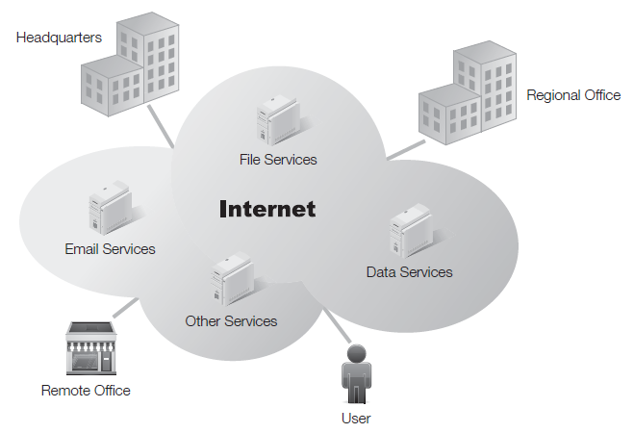
Cloud Computing Alternatives
Not location dependent

Slide 17
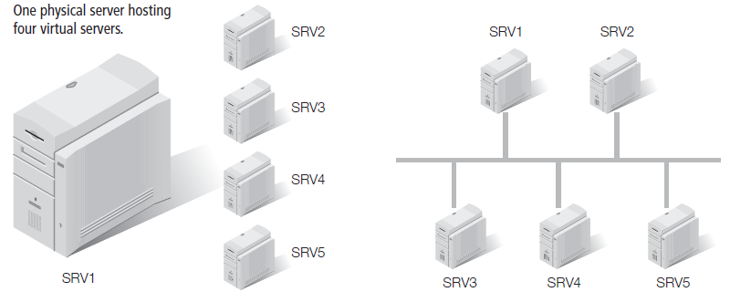
Virtualization Alternatives
Servers hosted as files
Files can be copied to another host

Slide 18
Cloud Computing != Immortal
Failures can be due to software errors
“It is very rare that an AWS Region becomes unavailable, but it does happen. This past Sunday (September 20th, 2015) Amazon Dynamo DB service experiences an availability issue in their US-EAST-1 Region. That instability caused more than 20 additional AWS services that are dependent on DynamoDB to fail. Some of the Internet’s biggest sites and applications were intermittently unavailable during a six- to eight-hour window that day.”
… natural disasters
In 2011, European cloud services of Amazon EC2 and Microsoft's BPOS were down for a some days after a lightning strike caused power failure at the data centers in Dublin (took off the main power supply and affected phase control system that synch with the back-up generation)
… human errors
“On November 18th [PST] (November 19th [UTC]) Microsoft Azure experienced a service interruption that resulted in intermittent connectivity issues with the Azure Storage service in multiple regions.[…] we developed a software change to improve Azure Storage performance by reducing CPU footprint of the Azure Storage Table Front-Ends. […] The engineer fixing the Azure Table storage performance issue believed that because the change had already been flighted on a portion of the production infrastructure for several weeks, enabling this across the infrastructure was low risk.
… malicious activity
See Akamai give up for Krebs on Security DDoS

Slide 19
BCP Best Practices
Complete the BIA early
Exercise caution when returning functionality from alternate locations
Restore least critical functions first
Review and update the BCP
Test all individual pieces of the plan
Conduct test exercises of the plan
Conduct live test of the plan
Notes:
Complete the BIA early—Ensure the BIA is done early in the process for the BCP.
Without the BIA, you won’t know what systems are critical.
Exercise caution when returning functionality from alternate locations—When restoring functionality from an alternate location to the primary location, consider these best practices:
Restore least critical functions first to the primary location—This allows you to get the bugs out of the process without affecting critical functions.
Review and update the BCP regularly—The BCP coordinator should review and update the BCP at least annually.
If critical systems are changed or modified between annual reviews, the BCP should be reviewed when those changes or modifications occur.
Test all the individual pieces of the plan—This includes basic procedures, such as recalls.
Exercise the plan—Verify the plan works by performing test exercises.
These exercises should not affect normal operations.

Slide 20
Conduct Live Test of Plan
Doable for Cloud IT systems → Netflix Chaos Monkey
“We have found that the best defense against major unexpected failures is to fail often. By frequently causing failures, we force our services to be built in a way that is more resilient. […]
Chaos Monkey is a service which runs in the Amazon Web Services (AWS) that seeks out Auto Scaling Groups (ASGs) and terminates instances (virtual machines) per group. […]
Within an ASG, Chaos Monkey will select an instance at random and terminate it.
The ASG should detect the instance termination and automatically bring up a new, identically configured, instance.”
Acceptable for Netflix, Gmail, Microsoft, etc.
Consequence for Netflix if live tests actually fail?
People won’t see “House of cards” tonight.
For Microsoft failure’s
“We reverted the change globally within 30 minutes of the start of the issue […] a subset of Virtual Machines that required manual recovery”
Close to impossible to do life test on a physical production systems
Can’t “revert”, nor “manually restart” a crashed aircraft
Chernobyl Nuclear Disaster was an example of a test on a production system
Uberlingen Air disaster

Slide 21
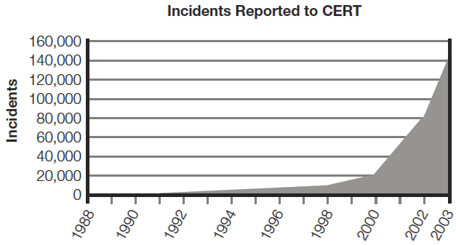
Growth of (Malicious) Incidents
Computer Incidents
1988 – one incident was news
2003 – 137,529 incidents
2013 – Off the chart

Slide 22
Growth of Incidents in Perspective
Computer Incidents
1988 – one incident was news
2003 – 137,529 incidents
2013 – Off the chart
BUT
Deaths in car accidents
1990 – 1.1 million
2013 – 1.4 million

Slide 23
Computer Security Incident
Violation, or imminent threat of a violation of a security policy or security practice
Examples
Denial of service (DoS) attack
Malware code
Unauthorized access
Inappropriate usage
Multiple component

Slide 24
What Is a Computer Incident Response Team Plan?
Computer incident response team (CIRT)
A group of people that will respond to incidents
AND a technical infrastructure to support them (SOC = Security Operation Center)
A CIRT plan:
Is a formal document that outlines an organization’s response to computer incidents
Formally defines a security incident
May designate the CIRT team

Slide 25
Elements of a CIRT Plan
Purposes of CIRT Plan
Prepares for unscheduled computer incidents
Develop best responses to reduce damage
Outlines the purpose of the response effort
The five Ws: what, where, who, when, and why
CIRT members
IT staff and security professionals who understand risks and threats posed to networks and systems
Accountabilities
CIRT policies
Incident handling process
Incident handling procedures
Communication escalation procedures

Slide 26
CISRT Team Members
Team Leader
Technical Experts
Information security members
Network administrators
Physical security personnel
Organizational Experts
Legal experts
Human resources
Public relation and communications
Rank-and-file SOC members
Basically working in a call-center type environment

Slide 27
Incident Response Lifecycle
Four phases defined by NIST SP 800-61

Slide 28
Example from Italian Company
Attacks from phishing e-banking web sites
Impossible to counter it ex-ante
Anybody can clone your web site
it has been designed to be downloaded from the internet
Lot of people don’t look carefully at the url
Possible to counter ex post
Procedure 1
Receive notification of cloned web-site
Identify ISP from Whois or DNS
Contact ISP for take-down (30’→3days)
Procedure 2
Receive notification of credential recovered in dump, honeypot etc.
Disable account temporalily
Contact customer for credential re-issuance
Refund customer for lost money (if s/he asks, otherwise don’t mention)

Slide 29
Further reading
Chapters 13, 14, 15 on Textbook
Ross Anderson’s book.
SANS Institute guide on BCP
https://www.sans.org/reading-room/whitepapers/recovery/introduction-business-continuity-planning-559
NIST SP 800-61
Netflix “principles”
http://principlesofchaos.org/
http://techblog.netflix.com/2011/07/netflix-simian-army.html
http://techblog.netflix.com/2012/07/chaos-monkey-released-into-wild.html

