Slide 1
Security Engineering Fall 2015
Lecture 01 – Introduction to the course
Prof. Fabio Massacci,
Ms Kate Launets

Slide 2
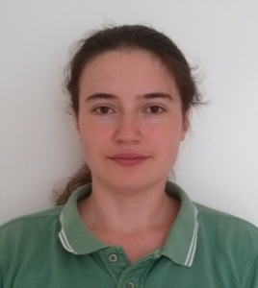
Lecturers
Main lecturers
Prof. Dr. Fabio Massacci
Office hours by appointment in class
Can try your luck by email
Ms. Katerina Labunets
Office hour by appointment via email
Others
Industry guest speakers

Slide 3
The “Usual” Course
The usual lectures/labs
Prof. does theory + Assistant does exercises
Prof. does technique + Assistant does programs
Prof+Assist = Oracles resolving all doubts
The usual exam
Prof gives well defined problem,
Students mirroring exercises/code solutions
The usual project
Developing a project (i.e. code)
Prof. knows exactly requirements
This course is not a “Usual” course

Slide 4
Why I don’t want to teach a “usual” course
Reality is very different from the usual course
Problem is not well defined
Already a big step if customers realize they have a problem
Customers don’t know the solution
Otherwise they won’t be paying you in the first place
Decision must be justified and understood by them
They won’t pay just because you found a solution in a book
They don’t read code. They paid you for that.
The course’s idea
Teach you security engineering with a process as close as possible to real life including presenting and justifying your choices
Consequence → the course is challenging (= tough)
40% hate it (too much work), 30% love it (learned a lot)
Still one of the popular courses

Slide 5
Why you don’t want me to teach a “usual” course
If you can only write programs →you’re done for
You must also be able to make decisions and communicate them to upper management
Italian Industry Assoc. ICT Salary (24-30 yrs old)
Web Developer/ IT/Network Administrator – 21-26K€
Programmer/Analyst – 29-41K€
Sys Engineer/Architect – 31-44K€
Sw Project Leader/IS Manager – 47-78K€
CIO – 98K€/year
So better write a management report…(at least once)

Slide 6
Course principles
Objective:
Learn how to secure engineer a real life problem from high level management and early security requirements down to security architecture
Methodology
Lecturers present methodology in class
Students apply it on case study
What do you have to prepare
Presentations justify the solution to the customers
And they are never happy (but you get early feedback)
Deliverable is an executive report to justify your choices
You submit it into installments as in real life (here to get feedback)
Only at the end you get the money
This year customer (not decided yet)
ePayment - Poste Italiane (IT), Remotely Operated Tower by Eurocontrol/SESAR, Digital Cinema by Technicolor

Slide 7
Cognitive Levels: why the course is tough
Knowledge
Recall things by memory (eg repeat a proof from a book)
Comprehension ← Most theory course stops here
Justify methods and procedures
Application ← Most design courses stops here
Apply concepts and principles to new situations
Analysis
Understanding relationships between parts (content & structure)
Synthesis ← This course
Ability to put parts together to form a new whole
Evaluation ← The best should arrive here
Conscious ability to judge the value of material

Slide 8
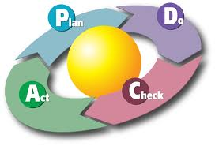
Security Management Principles
Governance, Risk Management and Compliance
Identify Threats and Risk to your assets
Mitigate those with Security Controls
Deploy the Controls
Monitor their effectiveness
Check security indicators
Revise periodically
Notes:
Security Management focuses on the identification of organization assets and on the development, documentation and implementation of policies and procedures
to protect the assets.

Slide 9
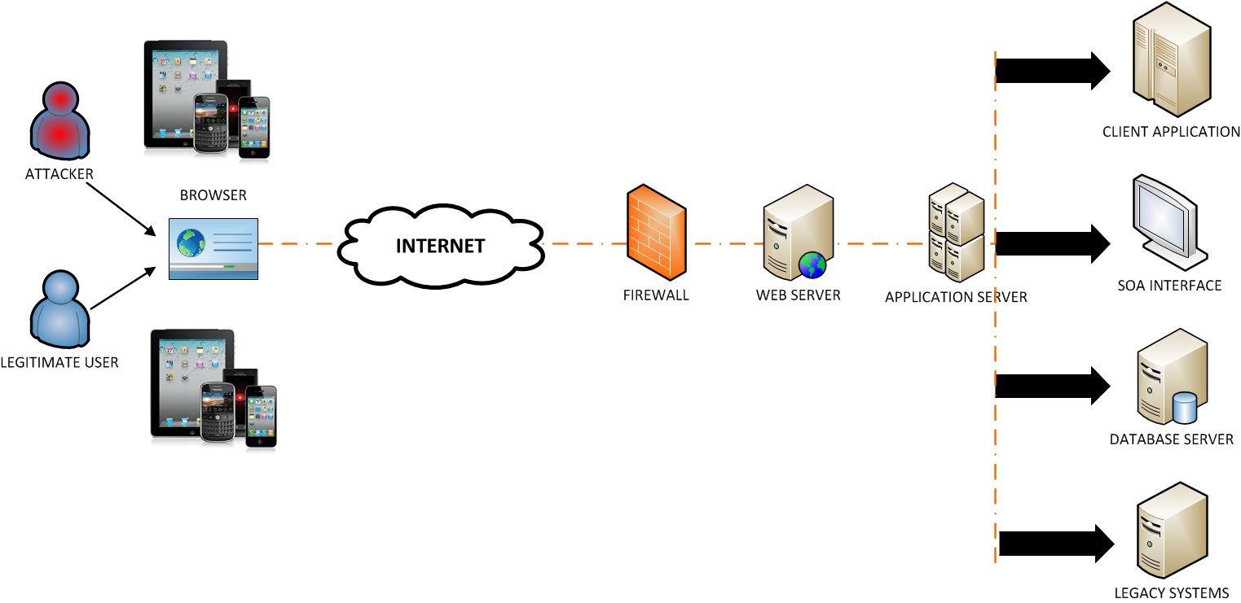
What you are protecting?
A Case study from an industrial company
ePayment - Poste Italiane (IT) or Remotely Operated Tower by Eurocontrol/SESAR, Digital Cinema
But irrespective of actual case study most modern architecture are of the form below
Notes:
Delve into the different layers of an IT system/infrastructures.

Slide 10
Specific Technologies will cover…
The following security viewpoints
Users (Database) Security
Web Application Security
Network Security
Cloud or Mobile Security
Depends on case study
A price to pay
There are only so many hours in 6 ECTS…
So we won’t cover all aspects in details

Slide 11
Users (Database) Security
We will review how data confidentiality, integrity can be broken and how to protect your privacy
Aggregation Attacks
Inference Attacks
……
Notes:
Database security is concerned with the protection of sensitive data and with providing access to this data in a controlled manner.

Slide 12
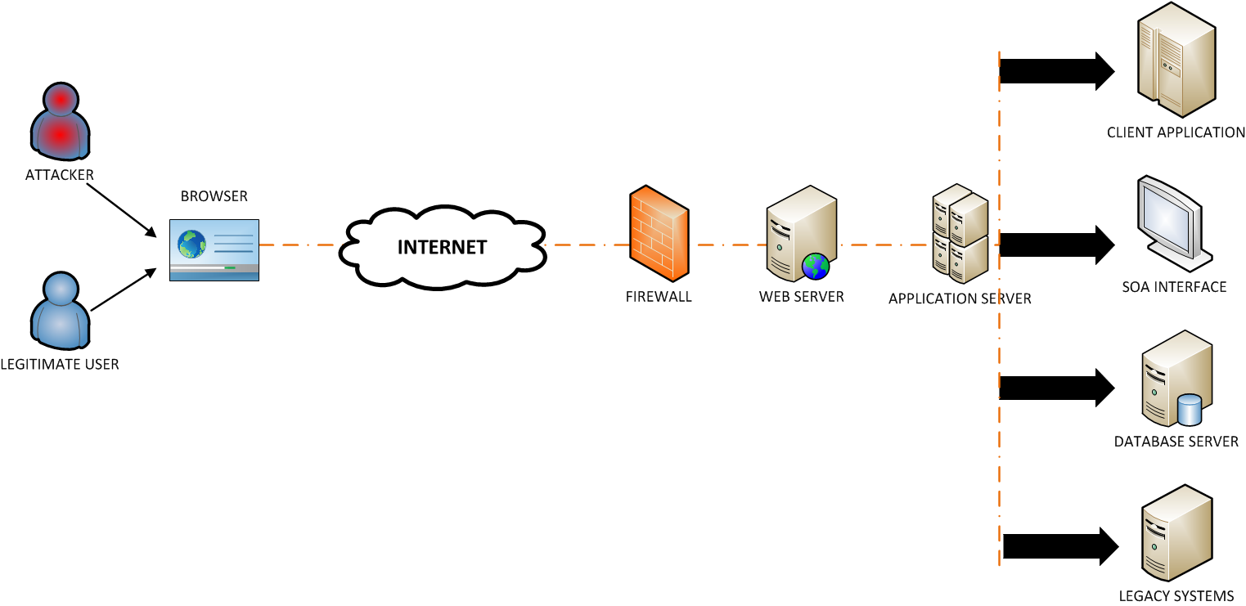
Application Security
We will review how an HTTP session can be hijacked and how you can prevent that
SQL Injection
Cross Site Scripting
Cross-Request Forgery
…..
Notes:
Web application security is concerned with attacks that exploit vulnerabilities in the browser and in the Web application code.
Most frequent attacks to web application layers are SQL Injection and Cross Site Scripting.
A good source of information about Web application security is the OWASP that every 2 years
publishes a top ten list of the most frequest and severe web application attacks and suggest
best practices to mitigate these kind of attacks.

Slide 13
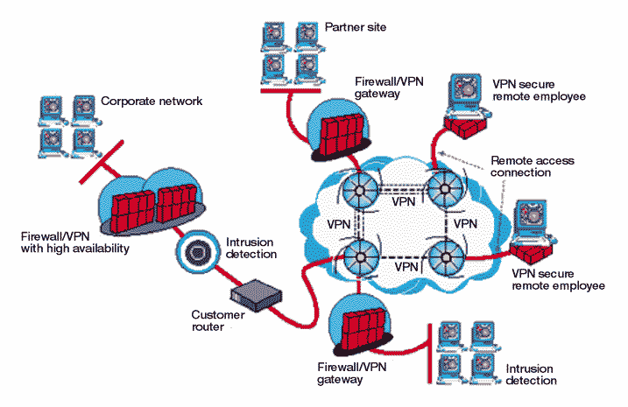
Infrastructure Security
We will review how your network can be attacked and how you can protect against that
Denial of service
Traffic Analysis
Replay
Packet Sniffing
…..
Notes:
Network security is concerned with attacks that target the network layer of an IT infrastructure. We have mainly to kind of attacks
that can affect this layer : passive attacks like traffic analysis that only to obtain information to attack the network while active attacks
aim to modify or read message content. To mitigate this attacks is possible to adopt prevent contermeasures like firewalls or you can adopt
detective contermeasures like intrusion detection systems.

Slide 14
Mobile Security (bonus if we have time)
We will review the attacks that can target your mobile devices and how to prevent them
Malware
Spyware
Phishing Scam
Browser exploits
Wi-Fi Sniffing
…..
Notes:
Mobile security is concerned with attacks that exploits Android platform or Symbian vulnerabilities like malware and spyware.

Slide 15
Activity
Apply two methods for risk assessment CORAS and SecRAM to the case study scenario
Cover three levels
user/Database Security, Web Application Security, Network Security
For every type of technology
Identify the security threats and security controls that mitigate the threats
Document the application of the methods and the results
Report them
in written form by a short report
By making a presentation in class

Slide 16
How to report your work: Report
Structure of the report
Target of Evaluation
Users Threats & Controls
Application’s T&C
Infrastructure’s T&C
Delivery
In installment
Download template from Web

Slide 17
Course Logistics
Basic course
12 weeks of 4 hours of lectures
2 weeks of 4 hours of students’ presentations
Practice work
Students’ presentations
Students’ intermediate reports
Final Exam in January
Final report
Final Presentation (with a industry customer)

Slide 18
Grading
Final report is the sum of the intermediate reports
Final report determine the bulk of your vote
Final presentation of the work is around 20%
This is given by an industry person who will review your threats and security controls for relevance and appropriateness
His/her judgement is what counts
Intermediate Deliveries
You can ignore them and submit everything at the end.
This is always your right as a student taking any course
Statistics says you are not going to make the grade
Intermediate reports are mandatory

Slide 19
Evaluating your own methods…
You will help us to evaluate CORAS and SecRAM with respect to
Actual efficiency
Actual effectiveness
Easy of use, usefulness, intention to use
You will provide us feeback on the methods through
Post-Task Questionnaire
Individual Interviews
Honest feedback are important to us!!!

Slide 20
Rule of the game
Real life is not built out of 2 hours classes spread across 14 weeks semester
Attending lectures is optional but well-advised
Delivering class’ presentations is optional but well-advised
Delivering reports as scheduled is mandatory
Attending final exam is mandatory
On “I took this text from a collegue of mine”
Remember I have been a student myself, thinking “he is not going to find it” is not going to be easy
If you are able to have people working for you and can sell their work as yours only as if they didn’t existed, great, you’ll be the next Steve Jobs
In all other cases (statistics is against you on) that’s called plagiarism and is forbidden.
You will fail the class and that’s it.

Slide 21
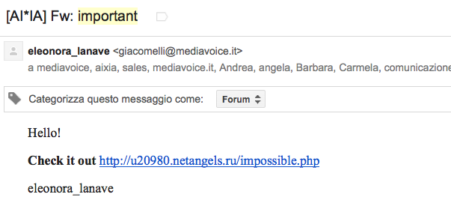
Rules of Engagement
Asking questions in class is always the best policy
Your colleagues may be interested in the answer
Things are easier to explain
The prof gets hundreds email per day…
Today 9am – 14 am (66 emails and counting)
Do your homework first
“I can’t bother to find the answer, I will ask the prof.”
Q: “I don’t remember to whom the deliverable should be submitted”
A: “read my slides”
Write with “[SecEng-2015]” in the subject
“important” is a no go
Got 57 in the last months
“urgent” is not better

Slide 22
Wednesday
Exercise will take place in Room PC201
Comprehensibility Exercise
CORAS Model
SECRAM Model
You will have to “look at a model” (for example as if you were participating to a presentation as a customer) and answer some questions
Questions are in varying level of complexity
Yes, we know that you know nothing of the models → this is the whole point of the exercise

Slide 23
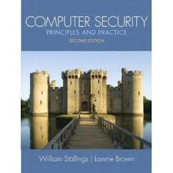
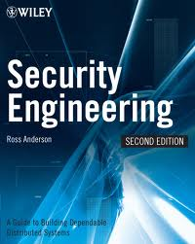
Reading Materials

