Slide 1
My software has a vulnerability, should I worry? IT Security for Decision Makers
Fabio Massacci
joint work with Luca Allodi, Vadim Kotov, Viet Nguyen, Wooyun Shim
lastname@disi.unitn.it
Siemens Research Lab
December 18, 2012

Slide 2
Outline
What is SECONOMICS?
Vulnerabilities: CIO & Research Questions
Exploit Kits – a Qualitative Study
CVSS – an Empirical Study
CVSS – a Case Controlled Study
Conclusions

Slide 3
What is SECONOMICS?
EU Project
Security meets socio-economics methodologies
Provide guidance to decision makers on [technical, legislative and regulatory] instruments best suited to emerging security threats.
Different than “traditional” IT Security Projects
Coordinator → Interdisciplinary Computer Scientist
Scientific Director → Economists
Julian Williams, Joe Swierzbinski
Partners
Sociologists
Operation Researchers
Computer Scientists
Case Study Partners
Airport, National Grid, Metropolitan Transport
Sample Pub Titles
“Crime pays if you are just an average hacker”, “The need of public policy intervention in IT Security”

Slide 4
SECONOMICS at Trento
Team Members aren’t “standard” CS team members
Group Leader
Fabio Massacci → Computer Science + IT Management
Post-doc
Woohyun Shym → Economist
PhD Students
Luca Allodi → Computer Science
Viet Hung Nguyen → Computer Science
Sarila Rana → IT Innovation
Research Associate
Martina De Gramatica → Anthropologist

Slide 5
SECONOMICS Coordinator
Academic at University
Researcher in Industry
Member of Production Group
Marketing Salesman
Maintenance scapegoat
Customer’s IT Technician
Responsible for Business Unit
“The Customer” who shells the money
2002-2009
In 2002-2009 I was parachuted Deputy Rector for ICT Procurements. 3M€++ budget and 70+ people

Slide 6
SECONOMICS Guidance
Example of effective guidance for decision maker
“if all presently unbelted drivers and right front passengers were to use … belt…, fatalities to this group would decline by 43%”
L. Evans. “The effectiveness of safety belts in preventing fatalities.” Accident Analysis & Prevention 18(3):229–241, 1986
What we would like to give:
“A risk-based approach (UK) for the protection of critical infrastructures improves security by X% over a compliance-based approach (US).”
if all unfixed high & medium risk vulnerabilities were to be … fixed…, attacks to this group would decline by X%

Slide 7
Vunerabilities: The CIO Question
What the CIO really wants to know:
I read on the news that a “security researcher” exploited a vulnerability on X to do some bad stuff.
Should we worry?
and if he listen to the gurus…
“security is only as strong as the weakest link”. B. Schneier
“One vulnerability after another has been discovered and exploited by criminals” R. Anderson
or he listen to NIST…
U.S. Government mandates all Security Management tools to use CVSS score to assess software vulnerabilities
He really should worry… but he has no guidance…

Slide 8
Vulnerabilities: The Landscape
Lots of Vulnerabilities are published daily
NVD runs at 50K
CVSS scoring system is now drafting V.3
White Market
Vendors’ “Bounty programs”
iDefender, TippingPoint acquisition program
“Responsible Disclosure” debate
Black Market
Exploit Kits provide plug&play exploit
What can the CIO do?

Slide 9
Vulnerabilities: Research Questions
What the CIO would like to know
if all unfixed high & medium risk vulnerabilities were to be … fixed…, attacks to this group would decline by X%
A clear value proposition → if we fix high vulns we decrease risk by +43%, if we fix all medium only raises to +48% → +5% more is not worth the extra money, maybe even +43% is not worth
What security researchers deliver
Analysis of complete protection against a powerful adversary
Attackers will target me in particular, intercept all my possible messages, exploit all my possible vulnerabilities, use all partners
Fix all vulnerabilities or die
Not even U.S. warfare doctrine is so demanding
Conclusion: we need data…

Slide 10
Vulnerabilities: our baseline
Our Question:
if all unfixed high & medium risk vulnerabilities were to be … fixed…, attacks to this group would decline by X%
Empirical Study running now for 4 years
6 years of data on Firefox, Chrome, Safari, IExplorer
1.5 year Analysis of various datasets of exploits
1.5 year of study of Black markets/Exploit
Let’s look at the data

Slide 11
Vulnerabilities: a closer look
“A vulnerability is discovered” has many meanings
CVE entry mentioned in NVD
somebody (vendor, researcher etc.) told NIST the software has a vulnerability
Its exploit code appears in the Exploit-DB
Somebody actually constructed a proof-of-concept code that exploits it
Mentioned in Symantec/Kaspersky Threat-Explorer
Somebody actually used the vulnerability to run an attack
Advertised in an Exploit Kit
Bad guys packaged its exploit into a “PnP” platform

Slide 12
Vulnerabilities: numbers speak
“A vulnerability is discovered” has many meanings
CVE entry mentioned in NVD - 49.624
somebody told NIST the software has a vulnerability
Exploit by sec. researchers in Exploit-DB - 8.189
Somebody constructed a proof-of-concept that exploits it
Symantec/Kaspersky Threat-Explorer - 1.289/1.321
Somebody actually used the vulnerability to run an attack
Browser/Plugins 14% – Server 22% – App. 24%
Exploit advert by bad guys in an Exploit Kit - 103
Bad guys packaged its exploit into a “PnP” platform
2/3 of client threaths according Google (2011)
Notes:
BROWSER 119 COMM 228 DEV 58 OTH_OS 58 PLUGIN 72 SERVER 297 WINDOWS 171 #VALUE! 226 (blank) BUSS 91

Slide 13
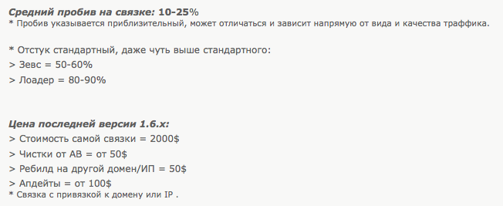
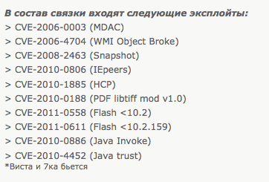
Exploit Kits Study: a closer look
Do bank robbers manufacture their own guns?
just buy them from somebody
Top threat according to Google + AV Vendors
Exploitation success rate: 10-15%
Success rate highly depends on quality of traffic
Update for version ..
Install rates, slightly higher than usual:
The package features these exploits:
Zeus = 50-60%
Loader = 80-90%
Price for latest version 1.6.x:
Package cost = 2000$
“Clean” from AV = from 50$
Rebuild on new domain/IP=50$
Update = from 100$
Package bounded to one domain or IP
Work on Vista and Win7

Slide 14
EKit Study: infection dynamics
Exploit Kit Server
Hacker/Exploit kit owner
2. HTTP Request redirected
iFrame
Popular website homepage
0. Compromise Web Site
OR
0’. Buy redirecting trafftc
3. Exploit run on browser
4. Malware downloaded by shell code
1. Visit a “Normal” Web Site
User

Slide 15
Ekits: Anatomy as Sw Artefacts
Got: 86 – Analyzed/Successfully Deployed: 33
What they do
Analyse User Agent, referrer, IP address (25)
Analyze client environment, Browser plug-ins details (15)
They have around 11 exploits in their cross-bow
Upload your own malware after exploit (all)
And of course bad guys use this browser info!
What they use it for?

Slide 16
EKits: Expectations…
Bad guys deliver high precision exploit
Remember?
Dolev-Yao model of attacker
Exploit all vulns…
Fix all or die…
Bla, Bla

Slide 17
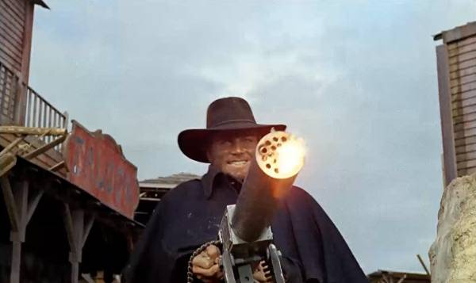
EKits: Reality
Since they only have a paltry 10-11 exploits
Just fire! - 9/33
May be Vulnerable? Ok, fire! - 18/33
One iframe at the time - 5/33
What they use the analysis for?

Slide 18
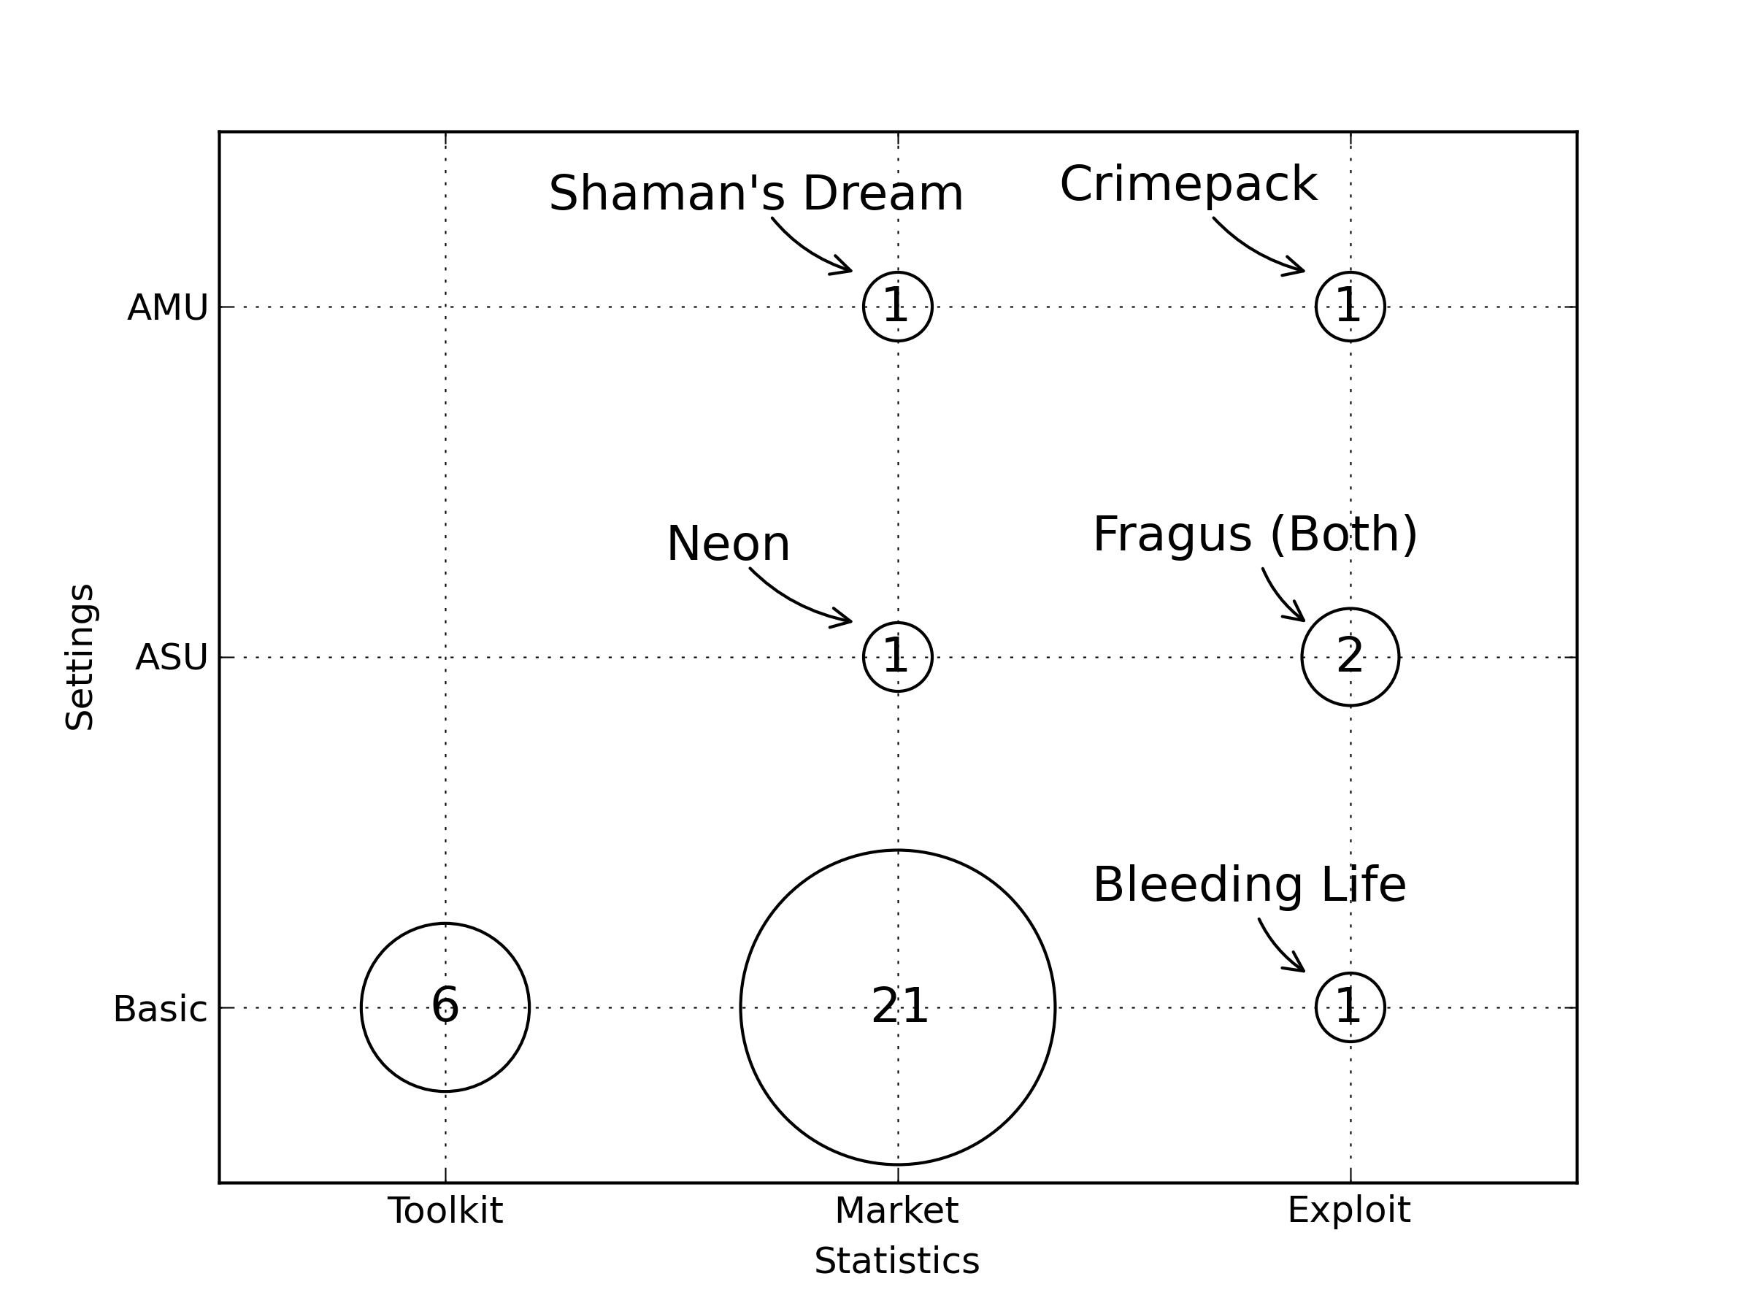
EKits: Gartner’s magic quadrant

Slide 19
EKits: Analysis is used for statistics!
Exploit kit lady is a “malware enterpreneur”
pay yearly fee (2000$ or 5% of exploited traffic)
buy traffic from countries/originating web sites etc
Use/sell infected PCs by countries/web sites etc
She is after large numbers
Fixing yet another sophisticated vulns won’t make a difference (to her) → she is happy with millions with unfixed simple ones
Next frontier → MAAS (Malware-as-a-Service)

Slide 20
The Picture So Far
What the CIO would like to know
if all unfixed high & medium risk vulnerabilities were to be … fixed…, attacks to this group would decline by X%
The “Classical” Attacker Model looks wrong
Attackers will target me in particular, …, exploit all my possible vulnerabilities, …
Fix all vulnerabilities or die → waste of money
Needs better, economical model of attacker → ongoing work
But CIO can’t wait: what do a good manager do?
Use a Security Configuration Management Product!
30+ products: Microsoft, Dell, HP, VMWare, McAfee, Symantec etc..
Based on CVSS (Common Vuln. Scoring System)
INTEL, IBM, Microsoft, Google, Apple etc. participate
CVSS High → you should worry, shouldn’t you?

Slide 21
CVSS Empirical Study: the question
High Level Question
Which Vulnerabilities are really used by bad guys?
Assumption
vuln ∈ SYM Threat explored → used by bad guys
Low Level Question
Conditional Probability that vuln ∈ Symantec given some other explanatory factors
Explanatory Factors Considered
Vuln in (NVD, EDB, EKIT), Vuln with high CVSS score, Vuln with high Impact subscore etc.

Slide 22
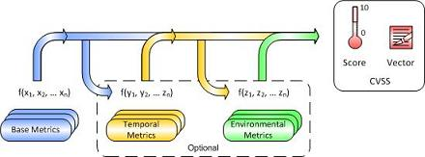
CVSS Study: Background
From Mell, Scarfone, Romanosky CVSS Complete Guide
Base Metrics
Access Vector, Access Complexity, Authentication
Impact (Confidentiality , Integrity,Availability)
Temporal Metrics
Exploitability (E)

Slide 23
CVSS Study: threats to validity
CVE entry mentioned in NVD
That’s just hearsay (good for witch hunt and government compliance)
Its exploit code appears in the Exploit-DB
It proves researcher is skilled (hire him!) but why bad guys should be using it?
Mentioned in Symantec Threat-Explorer
Somebody used the vulnerability to run an attack (may underestimate impact as they have no time to make reliable connection to CVEs)
Advertised in an Exploit Kit
Maybe bad guys are just selling junk (remember IRC credit card numbers?)

Slide 24
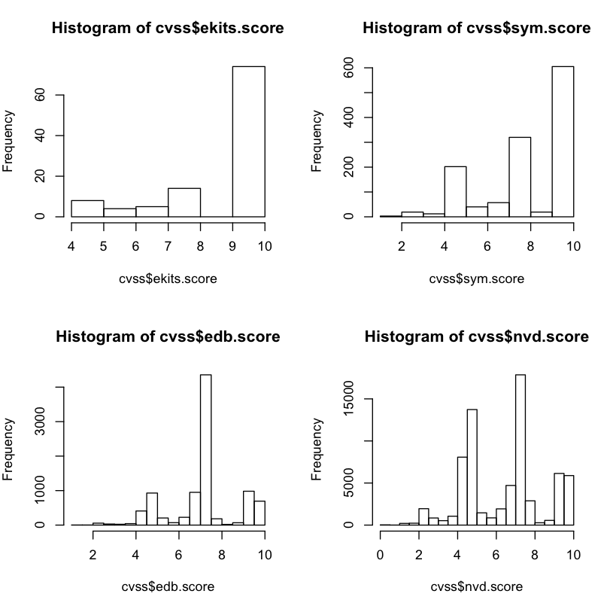
CVSS Study: Distribution of Scores
LOW: CVSS <6
MEDIUM: 6<CVSS<9
HIGH: CVSS > 9

Slide 25
Distribution of CVSS Scores (Table)
Three chunks of vulnerabilities:
LOW: CVSS <6
MEDIUM: 6<CVSS<9
HIGH: CVSS > 9
CVSS Score | EKITS | SYM | EDB | NVD
HIGH | 74 | 612 | 1.209 | 7.026
MEDIUM | 19 | 393 | 5.324 | 20.858
LOW | 10 | 272 | 1.589 | 21.715
Tot | 103 | 1.277 | 8.122 | 49.599

Slide 26
CVSS Study: distribution explained
They have different distributions!
EKITs sell mostly vulns with high scores
SYM see vulns with high scores and some wih medium scores
Recall vuln in SYM → vuln used by bad guys
NVD and EDB have lots but really lots of vulns of totally uninteresting vulns
If you are using the NVD to assess your company status (eg SCAP) → Waste Money!
CVSS scores tell something but not good enough
Only good for witch hunt - “Kill them all, God will recognize its brethren”
Notes:
« Caedite eos! Novit enim Dominus qui sunt eius » Cesario Heisterbach attributes this to Arnaud Amaury the Pope delegate to the crusade against the eretics during the siege of Béziers on the 21-22 July 1209

Slide 27
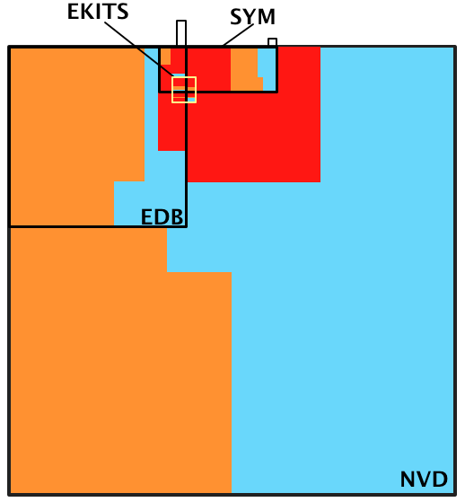
CVSS Study: Map of Vulns, AREA = #num
LOW CVSS
MEDIUM CVSS
HIGH CVSS

Slide 28
CVSS Study: Map of Vulns interpreted
WHAT IS THIS?
Wasted money in fixed vulns or updated software
that didn’t need it
LOW CVSS
MEDIUM CVSS
HIGH CVSS
WHAT IS THIS?
Scare Adverts by Security Researchers
WHAT IS THIS LITTLE SQUARE?
Most current threats to end users according Google

Slide 29
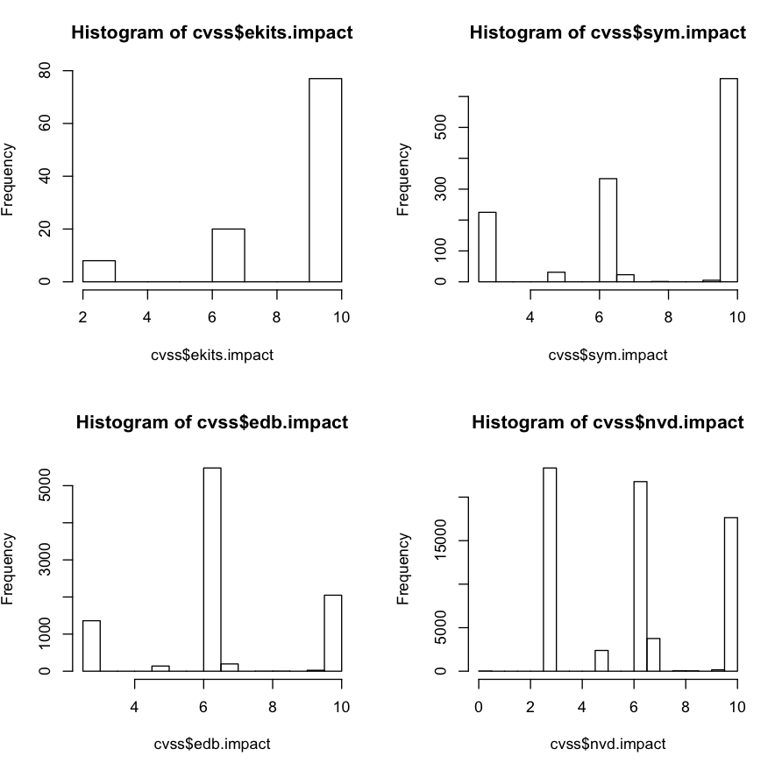
CVSS Study: Distr. of Impact scores

Slide 30
CVSS Study: impact scores expl.
Impact distributions resemble that of CVSS scores
Mostly HIGH and some MEDIUM and less LOW impact vulnerabilities exploited in the wild
EDB and NVD distributions again are different from EKITS and SYM.
CVSS Impact | EKITS | SYM | EDB | NVD
HIGH | 77 | 663 | 1.487 | 10.101
MEDIUM | 18 | 358 | 5.245 | 19.847
LOW | 8 | 256 | 1.390 | 19.651
Tot | 103 | 1.277 | 8.122 | 49.599

Slide 31
CVSS subfactors: Impact
Same picture of different databases
 |  | SYM | EKITS | EDB | NVD
confidentiality | N | 12% | 7% | 12% | 31%
 | P | 36% | 17% | 69% | 49%
 | C | 52% | 76% | 19% | 21%
integrity | N | 16% | 6% | 13% | 25%
 | P | 32% | 19% | 67% | 55%
 | C | 52% | 75% | 18% | 21%
availability | N | 13% | 5% | 12% | 30%
 | P | 33% | 20% | 68% | 47%
 | C | 53% | 75% | 20% | 24%

Slide 32
Distribution of Impact Subscores
Availability is not interesting
Integrity vs Confidentiality
compl C – and – compl I = 10.015 vulns
77 on EKITS, 659 on SYM
compl C – xor – compl I = 548 vulns
1 in EKITS, 8 in SYM
part C – and – part I = 18.768 vulns
17 in EKITS, 355 in SYM
part C – xor – part I = 13.262 vulns
3 EKIT, 156 in SYM
Once one is gone (usually) the other is gone too
So attackers prefer compromise of both confidentiality and integrity (albeit partial)

Slide 33
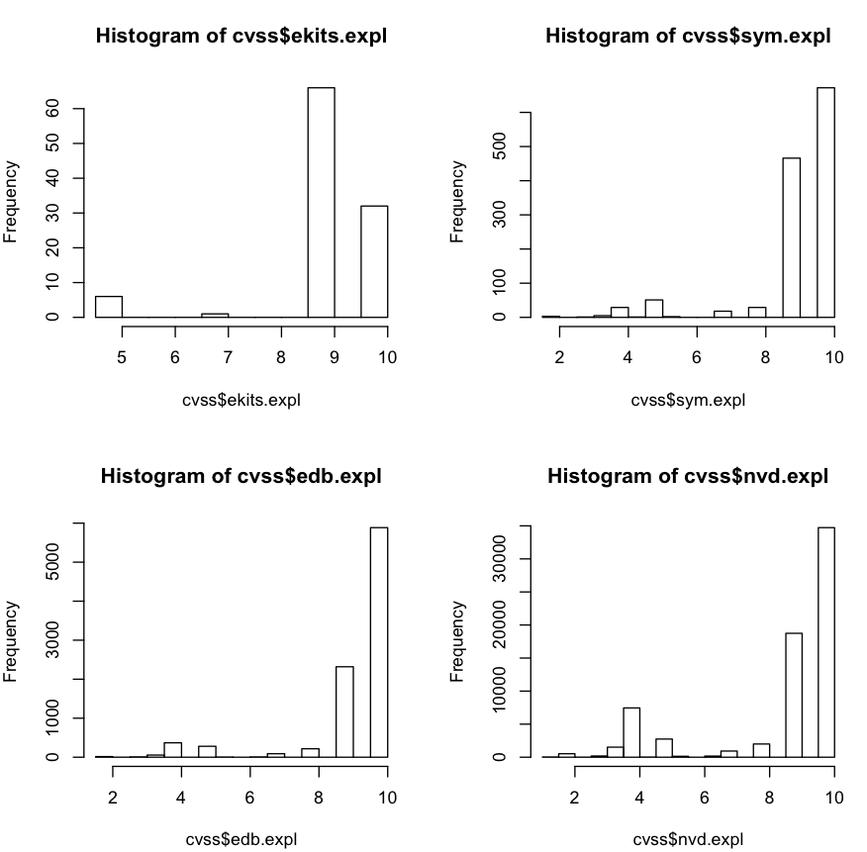
CVSS Study: distr. of exploitability

Slide 34
CVSS Study: exploitability explained
Everything is exploitable → Exploitability is not an interesting variable at all!
Looking at Bozorgi et al. SIGKDD’10
Took OVSDB (basically exploit DB) and compare SVM machine learning vs CSS exploitability
Two observations
Conferm finding → CVSS exploitability score does not correlate well to “exploits”
Bozorgi et al. used the wrong database!
They were learning “exploitability” = “Ability of security researcher to write a proof-of-concept exploit”.
NOT an actual exploit by the bad guys

Slide 35
The Picture So Far - II
The 4 databases are very different
NVD and EDB contains lots of un-interesting vulnerabilities
Some information tells little
“CVSS.Exploitability” does not mean “Exploited”
and “Exploit exists” does not mean “Exploited” either
Distinction integrity vs confidentiality wrong characteristics
Could still CVSS score be a good predictor?
Maybe it can’t predict well because EDB and NVD have been inflated by security researchers looking for glory
We need a more robust test
Case controlled study!

Slide 36
CVSS Case Controlled Experiment
Do smoking habits predict cancer?
Doll & Bradfor Hill, BMJ
You can’t ask people to start smoking so you can’t run a controlled experiment
Case controlled study
Cases: people with lung cancer
Controls (Possible confounding variables)
Age, Sex, Social Status, Location
Explanatory variable
Smoking habit
For each of the cases select another person with the same values of the control variables

Slide 37
CVSS CC Study: Experiment II
Case controlled study
Cases: vulns with exploits in the wild (SYM/KASP)
Controls (Possible confounding variables)
Access vector, access complexity, authentication
Explanatory variables
CVSS Score, Database
CVSS Score+DB as a “medical test”
Sensitivity → true positives vs all sick people
You want to capture as many sick people as possible
Specificity → true negatives vs all healthy people
You don’t want to cure people who don’t need it

Slide 38
CVSS CC Study: more medical tests
What should we expect from the tests?
Triple Blood Test Down Syndrome - Women aged 40+
NJ, Kennard A, Hackshaw A, McGuire A . “Antenatal screening for Down's syndrome.” Journal of Medical Screening 4(4):181-246, 1997.
Specificity: 69%
only 31% of women carrying a foetus with Down syndrome will not be caught by the test
Sensitivity: 95%
only 5% of healthy pregnant women would be mislead by the test to undergo additional expensive or dangerous tests
Remember: most (but really a lot of) women have healthy pregnancies
Prostate Serum Antigen - Men aged 50+
Labrie F, Dupont A, Suburu R, Cusan L, Tremblay M, Gomez JL, Emond J. “Serum prostate specific antigen as pre-screening test for prostate cancer.” The Journal of Urology 147(3 Pt 2):846-51, 1992 [discussion 851-2]
Specificity: 81%
Sensitivity: 90%
Notes:
25-30
90% = 3 persone
80% = 24

Slide 39
CVSS CC Study: “should I worry” test
Tests on a random population identically distributed to SYM
Control variables: Exploitability subscores
Sensitivity: Pr(vuln.score >= 6 | vuln in SYM)
Specificity: Pr(vuln.score < 6 | vuln in ! SYM)
DB | Sensitivity | Specificity
EKITS | 96.30% | 36.19%
EDB | 93.85% | 18.69%
NVD | 76.92% | 43.24%

Slide 40
CVSS subfactors: Exploitability
 |  | SYM | EKITS | EDB | NVD
access vector | local | 2.98% | 0.00% | 4.57% | 13.18%
 | adj | 0.23% | 0.00% | 0.12% | 0.35%
 | net | 96.79% | 100.00% | 95.31% | 87.31%
access complexity | high | 4.23% | 4.85% | 3.37% | 4.54%
 | medium | 38.53% | 63.11% | 25.49% | 30.42%
 | low | 57.24% | 32.04% | 71.14% | 65.68%
authentication | multiple | 0.00% | 0.00% | 0.02% | 0.05%
 | single | 3.92% | 0.97% | 3.71% | 5.35%
 | none | 96.08% | 99.03% | 96.27% | 95.45%
These are our control variables to sample populations identically distributed to SYM

Slide 41
Security Rating as “Generate Panic” test
Sensitivity: is High/Med CVSS good marker for v∈SYM?
Specificity: is Low CVSS good marker for v∉SYM?
DB | Sensitivity | Specificity
EKITS | 96 % | 36%
EDB | 94% | 19%
NVD | 77% | 43%
3BT: Down Syndrome | 69% | 95%
PSA: Prostate Cancer | 81% | 90%
Notes:
NJ, Kennard A, Hackshaw A, McGuire A . “Antenatal screening for Down's syndrome.”
Journal of Medical Screening 4(4):181-246, 1997.
Labrie F, Dupont A, Suburu R, Cusan L, Tremblay M, Gomez JL, Emond J. “Serum prostate specific antigen as pre-screening test for prostate cancer.” The Journal of Urology 147(3 Pt 2):846-51, 1992 [discussion 851-2]
25-30
90% = 3 persone
80% = 24

Slide 42
CVVS CC study: more medical tests
What really matters is change in relative probabilities
Most people are healthy → absolute percentage does not make sense
Example = Usage of Safety Belts
Few people actually die in car crashes vs #crashes
G. Evans, General Motors Lab, 1986
Pr(Death x Safety Belt on) – Pr(Death x Safety Belt off)
43% improvement of chances of survival
Pr(Attack x CVSS High) – Pr(Attack x CVSS Low)
If I fixed all vulns with CVSS =HIGH would this decrease the attacks (as seen by the AV)?
I could avoid AV or could ask AV rule if I don’t want to update

Slide 43
Relative probabilities on samples
EKITS |  |  | P-value (Fisher)
 | CVSS HIGH or MEDIUM | CVSS LOW | p < 2.2⁻¹⁶
vuln in SYM | 859 (81.03%) | 33 (22.45%)
vuln !in SYM | 201 (18.96%) | 114 (77.55%)
EDB
 | CVSS HIGH or MEDIUM | CVSS LOW | p < 0.0359
vuln in SYM | 60 (5.83%) | 6 (2.46%)
vuln !in SYM | 970 (91.17%) | 238 (97.54%)
NVD
 | CVSS HIGH or MEDIUM | CVSS LOW | p < 0.0006
vuln in SYM | 30 (4.21%) | 6 (1.07%)
vuln !in SYM | 683 (95.79%) | 555 (98.93%)

Slide 44
Relative probabilities on samples - II
 | Pr(H+M)-Pr(L) | Pr(H+M)/Pr(low)
EKIT
vuln in SYM | +59% | 3.6x
vuln !in SYM | -59% | 1/4.1x
EDB
vuln in SYM | +3% | 2.4x
vuln !in SYM | -6% | 1/1.1x
NVD
vuln in SYM | +3% | 3.9x
vuln !in SYM | -3% | 1/1.0x

Slide 45
CVSS as “should I worry” test - II
For NVD and EDB by column
Very few exploited vulns = total chances negligible
EKIT by row
The CVSS high/medium score split the two cases apart (59%) and yields an almost 3-4x increase in chances
For NVD and EDB by row
Only minor difference in the probability (3-6%) of getting a score appropriate to the vulnerability
No chances of ruling out false negatives (which are the whole lot) because ratio is basically 1.
Graphical understanding → look back at Venn Diagram

Slide 46
WHAT THE CIO WANTED!
if all unfixed high & medium risk vulnerabilities were to be … fixed…, attacks to this group would decline by X%
X% is here!
 | Pr(H+M)-Pr(L) | Pr(H+M)/ Pr(L)
EKIT
v∈AV | +59% | 3.6x
v∉AV | -59% | 1/4.1x
EDB
v∈AV | +3% | 2.4x
v∉AV | -6% | 1/1.1x
NVD
v∈AV | +3% | 3.9x
v∉AV | -3% | 1/1.0x
Notes:
L. Evans. “The effectiveness of safety belts in preventing fatalities.” Accident Analysis & Prevention 18(3):229–241, 1986.
Evans was from General Motors Laboratory…

Slide 47
The Picture So Far - III
What the CIO really wants to know:
I read on the news that a “security researcher” exploited a vulnerability on X to do some bad stuff.
Should we worry?
The Question…
if all unfixed high & medium risk vulnerabilities were to be … fixed…, attacks to this group would decline by X%
The Answers…
A security researcher published a proof of concept exploit?
decline by 3% → delete email, life is too short
An exploit kit has marketed it and it has a CVSS high score?
decline by 59% → ask antivirus company or upgrade software, post a huge notice on the web site customers should update sw

Slide 48
Preliminary Conclusions
Where should we look for “real” exploits?
EDB, NVD are the wrong datasets.
Should we worry? Rarely
Sensitivity is high only for EKITS dataset
If vuln sold in black market AND scores high CVSS, better fix it (or ask a AV rule for it)
No datasets shows high Specificity:
CVSS doesn’t rule out “un-interesting” vulns
Integrity, confidentiality, exploitability look bad as well
How to improve is research challenge ahead

