Slide 1
Security EngineeringMSc in Computer Science EIT Master on Security and Privacy
Lecture 07 – Risk Assessment with SecRAM
Federica Paci

Slide 2
Lecture Outline
SecRAM Methodology
Key Terminology
Risk Assessment Process
Step 0 – Is a Risk Assessment Required?
Step 1 – Define the Scope of the System
Step 2 – Assess Impact of a Successful Attack
Step 3 – Estimate Likelihood of a Successful Attack
Step 4 – Assess Risks
Step 5 – Define and Agree Management Options

Slide 3
Who is an Air Navigation Service Provider?
An air navigation service provider (ANSP) is a body that manages flight traffic on behalf of a company, region or country
ANSPs in the world
ENAV Italy
DSNA France
DFS Germany
NATS United Kindom
….

Slide 4
SecRAM Methodology
Methodology used in ATM to conduct risk assessment
Applied to determine the feasibility of new projects conducted by Air Navigation Service Providers
Focus on the identification, assessment and mitigation of risks

Slide 5
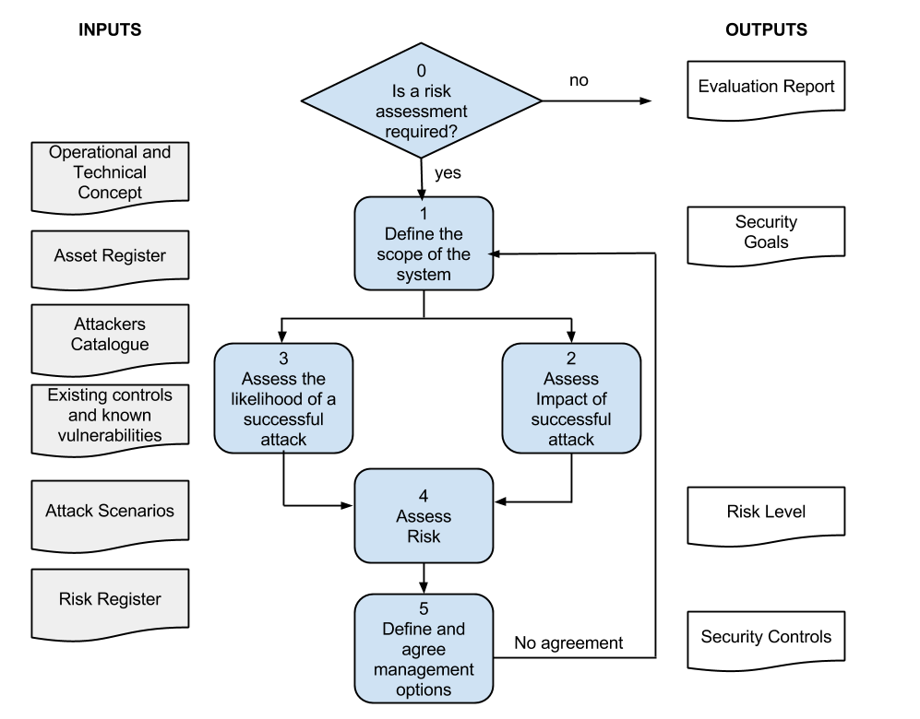
SecRAM Overview

Slide 6
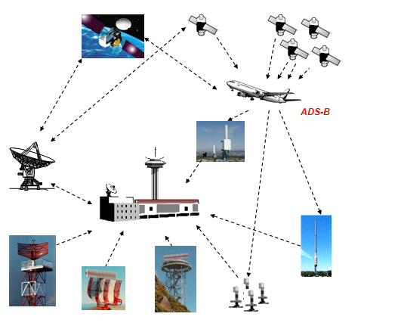
An Example
ENAV decides to deploy a new surveillance system at Verona Airport
SATELLITES
CONTROL TOWER
RADARs

Slide 7
Risk Model – Key Terminology
Asset
Anything that has value to the organization
Asset register
Record of assets with their age, cost, supplier, responsibility and use
Threat Agent
The source of a threat – person, entity, organization- with or without malicious intent
Attacker
A person, entity or organization causing a threat with malicious intent
Threat
A potential cause of an unwanted incident
Threat action
The action taken by a threat agent
Impact
An evaluated consequence of a particular event
Likelihood
The chance of something happening

Slide 8
Risk Model – Key Terminology
Security Risk Level
Magnitude of risk expressed as impact and likelihood
Inherent Security Risk
Organization exposure to risk before any mitigation strategy
Residual Risk
The security risk remaining after risk treatment
Security Risk Appetite
The total amount of risk that an ANSP is prepared to retain
Management Option
A means to address security risks
Security Risk Register
Record of identified security risks and management options

Slide 9
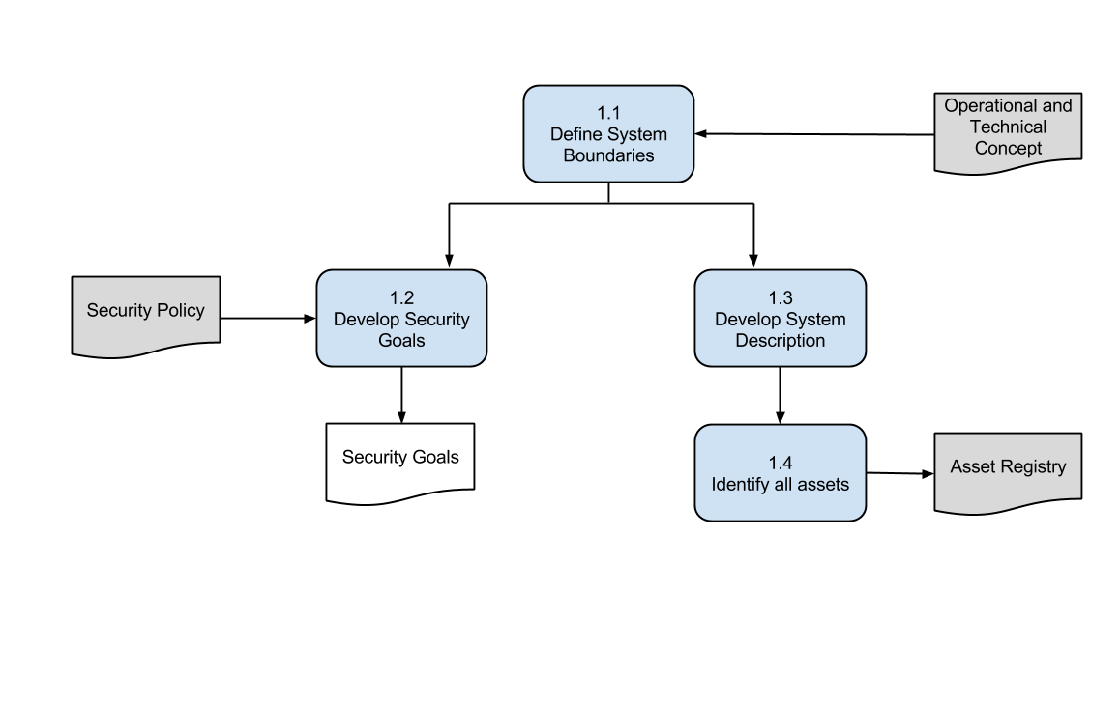
Define Scope of the System

Slide 10
Define System Boundaries
Input: Operational and Technical Concept (OTC)
People Involved: Project Team
Identify System Boundaries
Larger system with all the assets
Identify Boundaries of Control
Parts of the system under direct influence of ANSP
Output: OTC updated with system boundaries
Notes:
The Operational and Technical Concept describes the new ATM system the ANSP would like to deploy.
The project team has to identify those parts of the Operation and Technical Concept that are within the scope of the risk assessment and those parts that are outside the project control.
This means to identify the System Boundaries and the Boundaries of Control.

Slide 11
Define System Boundary
Boundary of Control
Primary and Secondary Radars
Surveillance Data Processing and Distribution System (SDPD)
Control Center
Surveillance Data
System Boundaries
Components in the Boundary of Control
Surveillance Data from remote ASNPs
Equipment Maintainer
Air Traffic Controlles and Controller Working Position
Third Party Contractor for SDPD Maintenance
OTC

Slide 12
Develop Security Goals
Input: Security Policy of ANSP, EU 2096/2005
People Involved: Security Experts
Security goals in Security Policy further refined in project specific goals
Security Goals should be SMART
Specific - Goals should specify what they are to achieve
Measurable – Goals should be associated with metrics
Achievable – Are the goals achievable and attainable?
Reliastic – Are the goals achievable w.t.r available resources?
Time-Bound – When is the team going to achieve the goals?
Output: Security Goals
Notes:
EU 2096:2005 lays down common requirement for the provision of air navigation services.

Slide 13
Develop Security Goals
Security Goal | Maximum Impact | Description
Provide accurate and timely air situation picture for safety | Very High | Ensuring safety of air traffic by providing controller the information needed to maintain separation between aircraft in flight, and between aircraft and the ground
Provide accurate and timely air situation picture for flow and capacity management | High | Ensure that flow and capacity are maintained
Complying with law and regulation | Medium | Complaying with national and European statutory and regulatory requirements
Efficient use of ANSP assets | Low | The cost of maintaining the service provided by this system is a significant factor in the efficiency and overall financial performance of the ANSP
Confidentiality of military air traffic | Low | Aircrafts tracks released to staff with appropriate national security cleareance

Slide 14
Develop System Description
Input: Operational and Technical Concept
People Involved: Project Team
System Model that allows threat identification
Actors and their Roles
Physical Elements
Supporting Services and Infrastructures
Services Provided
Communications Systems
Information and Data
Assumptions
Output: Updated Operational and Technical Concept

Slide 15
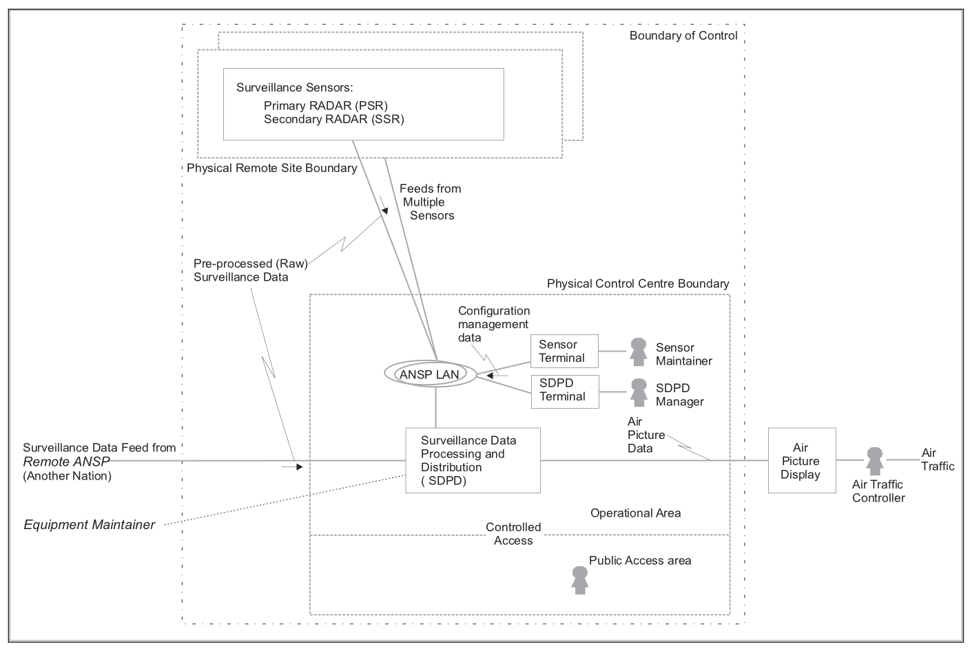
Develop System Description

Slide 16
Develop System Description
Local ANSP | Description
Local ANSP | The ANSP that owns the surveillance data system to be assesed
Remote ANSP | A remote provider of real-time surveillance data
Equipment Maintainer | The maintainer of Radars, networks, and SDPD
Equipment Supplier | The supplier of Radars, networks, and SDPD
Aircraft Operator | Responsible for aircraft
Aircraft Manufacturer | Delivers aircraft to Aircraft operator
NSA | Approves the operation of the system according to EC 2096/2005

Slide 17
Develop System Description
User Role | Description
Air Traffic Controller | User of the Air Picture generated by the SDPD system
Sensor Maintainer | Remote Maintainer of RADAR sensors
SDPD Manager | Manager of the surveillance processing system
Staff | ANSP staff not working with Radar or SDPD system
Security Staff | Responsible for visitor access control
Facilities Staff | cleaner
Security Manager | Accountable for the security of the entire system
Engineering Staff | Responsible for implementing the systems and their technical operations
Equipment Supplier | Delivers and install all equipment
Equipment Maintainer | Maintains equipment
Security Risk Assessor | Coordinates security risk assessment
Pilot | Responsible for safe flight

Slide 18
Identify all Assets
Input: Asset Registry (optional)
People Involved: Security Experts
Identify Assets
Physical Assets
Human Assets
Communication Systems
Information and Data
ANSP Assets
Output: Updated Asset Registry

Slide 19
Identify All Assets
Asset | Description
Surveillance Sensor | Initial data processing, formatting real-time surveillance data
Own Raw radar data | Radar data supplied by own systems
Foreing Raw radar data | Radar data supplied by foreign systems
SDPD processor | It receives and distributes surveillance data and provides consolidated air picture
SDPD Control Terminal | Terminal used to configure the SDPD
ANSP Communications | LAN and point-to-point communications to provide data and control SDPD
Sensor Maintenance Terminal | Terminal used to configure Surveillance Sensors
Air Picture Data | Data used to represent air picture
Control centre | Building housing the equipment and staff
SDPD Manager | Manager of SDPD
Engineering staff | Responsible for implementing the systems and its operation
Equipment staff | Maintains equipment
Transponder | Provides aircrafts accurate position

Slide 20
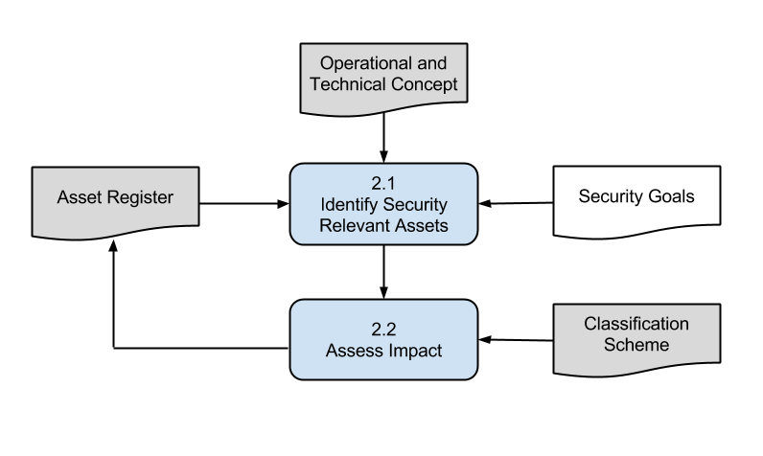
Assess the Impact of a Successful Attack

Slide 21
Identify Security Relevant Assets
Input: Asset Register, Security Goals, Operational and Technical Concept
People Involved: Security Experts
Identify assets that if comprised undermine security goals
What is the impact to a goal if an asset is
Destroyed or stolen
Corrupted and not detected
Corrupted and detected
Degraded (in performance)

Slide 22
Identify Security Relevant Assets
Asset | Goal | Description
Surveillance Sensor | 1,2 | Loss or corruption of radar data resulting in safety concerns or revenue loss
Own Raw radar data | 1,2,3,4,5 | Loss or corruption of radar data resulting in safety concerns or revenue loss
Foreing Raw radar data | 1,2,3,4,5 | Loss or corruption of radar data resulting in safety concerns or revenue loss
SDPD processor | 1,2 | Loss or corruption of radar data resulting in safety concerns or revenue loss
SDPD Control Terminal | 1,2 | If compromised possible entry point into the system
ANSP Communications | 1,2,4,5 | If compromised possible entry point into the system
Sensor Maintenance Terminal | 1,2,4,5 | If compromised possible entry point into the system
Air Picture Data | 1,2,3,4,5 | If compromised the potential safety concerns or revenue loss
Control centre | 1,2,3,4,5 | Protection of facilities
SDPD Manager | 3 | Protection of staff
Engineering staff | 3 | Protection of staff
Equipment staff | 3 | Protection of staff
Transponder | 1,2,4,5 | If compromised could result in loss of aircraft or corrupted data

Slide 23
Assess Impact
Input: Security Policy – Impact Classification Scheme, Asset Register
People Involved: Security Experts, Project Team, Operational Staff (e.g pilots)
Identify possible security impacts on assets
Evaluate the criticality of security impacts based on classification scheme in the security policy
Output: Updated Asset Register with impacts

Slide 24
Assess Impact
Impact | Very High | High | Medium | Low | No Effect
Human | Multiplie fatalities | Few fatalities Serious injuries | Minor injuries | Discomfort | No effect
Material | Loss of aircraft Large damage to structures | Aircraft unusable for significant time | Aircraft unusable for short time | Damage to non-essential equipment | No effect
Operation | Trasport impossible | Trasportation impossible locally for short time | Re-routing for flight interrupted of some aircraft | Delay of some aircraft | No effect
Economic (ANSP) | Bankruptcy or loss of all income | Serious loss of income (>50%) | Large loss of income (>25%) | Minor loss | No effect
Economic (society) | Impact on worldwide economy | Sever impact on regional basis | Minor impact on regional economy | Localized impact economy | No effect
Public Opinion | Extensive loss of confidence in air traffic security | Distrust by many of air traffic security Disclosure of security data | Distrust by some of air traffic security Disclosure of airline operation data | Doubt by some of the security of an airport or airliner | No effect
Information | N/A | N/A | Theft, deletion or change to operational data | N/A | No effect

Slide 25
Assess Impact
Asset | Impact | Description
Loss of Transponder | Very High | Ability to fly undetected
Destruction of Control Center | Very High
Undetected Corrupted Air Picture Data | High | Possible safety impact
Compromised SDPD Manager | High | Possibility to deliberatly cause corrupted air situation picture. Extract confidential information
Compromised Sensor Maintainer | High | Possibility to delibereately cause corrupted air situation picture. Extract confidential information
Undetected Corruption of Own Raw radar data | High | Possible inaccurate air situation picture resulting in safety impact
Loss of Surveillance Sensor | Medium | Only very high if all sensors are lost
Loss of SDPD | Medium | Re-routing or flight interrupt, revenue impact
Loss of LAN | Low | No immediate impact
Loss of SDPD Control Terminal | Low | No immediate impact

Slide 26
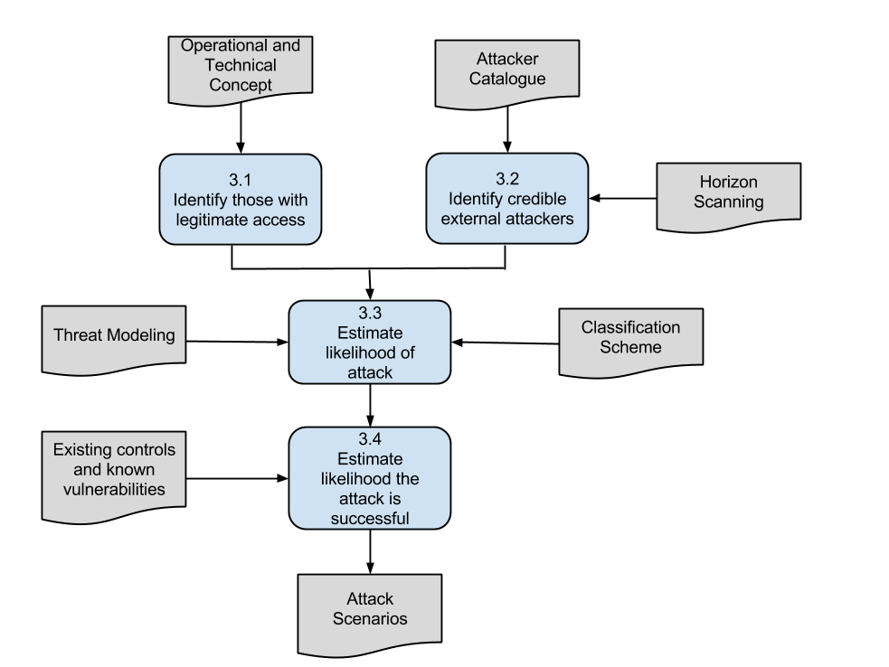
Estimate the Likelihood of a Successful Attack

Slide 27
Identify Users with Legitimate Access
Input: Operational and Technical Concept
People Involved: Security experts
Identify entities with legitimate access to the ATM system
Administrators
Legitimate users
Other users
Services or infrastructure
Examine their capabilities

Slide 28
Identify Users with Legitimate Access
User Role | Description
Air Traffic Controller | User of the Air Picture generated by the SDPD system
Sensor Maintainer | Remote Maintainer of RADAR sensors
SDPD Manager | Manager of the surveillance processing system
Security Staff | Responsible for visitor access control
Security Manager | Accountable for the security of the entire system
Engineering Staff | Responsible for implementing the systems and their technical operations
Equipment Supplier | Delivers and install all equipment
Equipment Maintainer | Maintains equipment
Security Risk Assessor | Coordinates security risk assessment
Pilot | Responsible for safe flight

Slide 29
Identify Credible External Attackers
Input: Attacker Catalogue, Asset Register
People Involved: Security experts and Project Team
Possible external attackers
Terrorists or criminal attackers
Equipment failure
Journalists
Competitors
Other States
Weather and Natural Disasters
Match attack scenarios with asset list
Update the Asset Register with pairs Asset-Attack

Slide 30
Identify Credible External Attackers
External Threat | Description
Staff
Visitors
Facilities staff
Natural event | Fire, flood, earthquake, lightning,weather systems
Criminal Terrorist | Terrorits, seeking publicity, destructio, death, or injury
Criminal-Organized Crime | Well-motivated and resourced attacks with financial motives, including blackmail, fraud and extortion
Criminal-Petty | Opportunistic attacks, including theft of material, and vandalism

Slide 31
Estimate Likelihood of attack
Input: Classification Scheme
People Involved: Security Experts and Project Team
Estimate for each attack the likelihood that the attack will be initiated
Likelihood of Initiation is defined based on attacker’s
Means
Motive
Opportunity
Estimate likelihood using the qualitative scale used in the classification scheme

Slide 32
Estimate Likelihood of Attack
Likelihood | Frequent | Probable | Occasional | Remote | Not Credible
Skills | No Limitations | Engineering Knowledge | Specialist Knowledge | Expert Knowledge | Inside Information
Means | No Limitations | Publicly available | Available with difficulty | Hard to obtain | Extremely scarce
Opportunity | Always | Frequently | Regularly | Seldom | Never
Profit | Large | Significant | Fair | Little | None
Attention | Worl-wide media attention | Regional Media Attention | Fair attention of local media | Little attention of local media | No media attention
Impunity | No-chance of punishment | Little change of punishment | Fair chance of punishment | High chance of punishment | Certainty of punishment
Detection | Not possible to predict or detect | Detection due to chance | Fair chance of beign caught | High change of detection | Certainty of detection

Slide 33
Estimate Likelihood of attack
Threat Agent | Asset attacked | Attack Likelihood | Justification
Compromised Sensor Maintainer | Sensor | Probable | If staff are compromised then there is a high probability of an attack
Compromised SDPD Manager | SDPD | Probable | If staff are compromised then there is a high probability of an attack
Compromised Pilot | Transpoder | Probable | If staff are compromised then there is a high probability of an attack
Natural or environmental event | Control Center | Remote
Criminal - Terrorist | Theft of asset | Probable
Criminal -Petty | Any asset on the ground | Occasional

Slide 34
Estimate Likelihood of successful attack
Input: Esisting controls and vulnerabilities, classification scheme
People involved: Security Experts and Project Team
Identify vulnerabilities in the ATM system
Identify deployed security controls
Estimate using a qualitative scale

Slide 35
Estimate Likelihood of successful attack
Threat Agent | Type of attack | Success Likelihood | Justification
Compromised Sensor Maintainer | Electronic | High | Access and knowledge to cause damage
Compromised SDPD Manager | Electronic | High | Access and knowledge to cause damage
Compromised Pilot | Physical Damage | Low | ATC procedures should detect rogue aircraft
Natural or environmental event | Physical | High
Criminal - Terrorist | Any means | Medium
Criminal -Petty | Theft | Low | Access control and security procedure should prevent access to critical systems
Success Likelihood | Physical | People | Electronic
High | Physical access possible | Can introduce or engineer staff | Normal Function or known vulnerability
Medium | Physical barriers in depth | Access control, staff checking and training | Well isolated & access controlled
Low | Protection + inspection & audit | Include separation polices & audit | Internal barriers, regular assessment

Slide 36
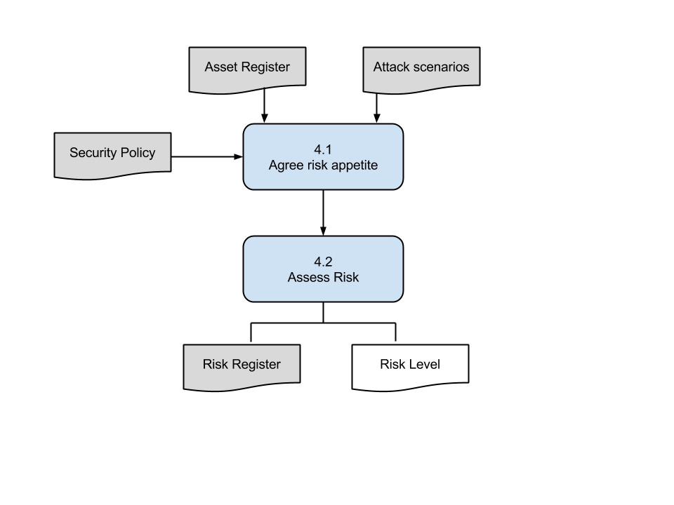
Assess Security Risks

Slide 37
Agree Risk Appetite
Inputs: Asset Register, Attack Scenarios, Security Policy
People Involved: Security Experts, Project Manager
Decide which risks the project is willing to endorse among the ones in the security policy

Slide 38
Assess Risk
Input: Asset Register, Risk Register
People Involved: Security Experts
For each pair asset-attack
Place the value for likelihood and impact on the risk matrix
Produce a list of risk levels prior of the implementation of management options

Slide 39
Assess Risk
Threat Agent | Likelihood | Impact | Security Risk
Compromised Sensor Maintainer | Very Likely | Medium | High
Compromised SDPD Manager | Very Likely | High | High
Compromised Pilot | Unlikely | Very High | Medium
Natural or environmental event | Unlikely | Very High | Medium
Criminal - Terrorist | Likely | High | High
Criminal -Petty | Unlikely | High | Medium
Impact\Likelihood | Very Unlikely | Unlikely | Likely | Very Likely
Very High | Medium | Medium | High | High
High | Low | Medium | High | High
Medium | Low | Low | Medium | High
Low | Negligible | Low | Medium | Medium
Negligible | Negligible | Negligible | Low | Medium

Slide 40
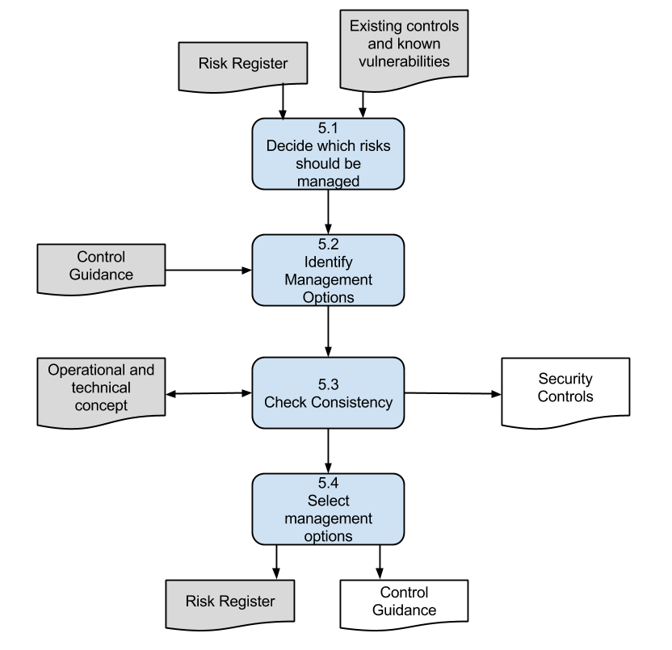
Define and Agree Management Options

Slide 41
Decide Risks to be managed
Input: Risk Register
People Involved: Security Experts and Project Manager
Decide which risks can be tolerated
Do Nothing About it

Slide 42
Identify Management Options
Input: Risk Register
People Involved: Project Team with support of Security Experts
Identify if risks have to be
Terminated
Transferred
Mitigated
Identify management options to mitigate the risks
Corporate Direction and Policy
Organization, Culture and Management
Human Resources
Physical & Environmental Security
Operation of ICT Systems
Technical Mechanisms & Infrastructures
Acquisition & Development
Monitoring & Audit
Compliance

Slide 43
Check Consistency
Input: Operational and Technical Concept
People Involved: Security Experts, Project Team
Verify that the mitigation options
Do not introduce new risks
Do not interfere or reduce ANSP security performance

Slide 44
Select Management Options
Output: List of controls
People Involved: Project Manager
Select which Management Options should be implemented based on:
Acceptable to alla stakeholders
Feasible
Cost-effective
Balance between acceptability, feasibility and cost
Balance between security and system functionalities
Balance against other security risks

Slide 45
Defines and Agree Management Options
High and Medium Security Risks has to be managed
Thus, all the security risks need to be treated
Let’s focus on the threat agent Compromised Sensor Maintainer

Slide 46
Decides Risks to Be Managed and Identify Management Options
Organization, Culture and Management
2.12 A management authorization process for all new operational/ data processing facilities, based on security risk assessment, shall be defined and implemented
2.20 All employees, contractors and third party users of information systems and services shall be required to note and report any observed or suspected security weaknesses or malfunctions in systems or services
2.25 Agreements with third parties involving accessing, processing, communicating or managing the organization's operational or data processing facilities, or adding products or services to data processing facilities shall cover all relevant security requirements.
Human Resources
3.3 As part of their contractual obligation, employees, contractors and third party users with access to critical systems shall agree and sign the terms and conditions of their employment contract, which shall state their and the organisation’s responsibilities for information security.
Operation of ICT Systems
5.5 There shall be procedures in place for the management of removable media. Media shall be disposed of securely and safely when no longer required
5.9 Users shall be required to follow good security practices in the selection and use of passwords and shall ensure that unattended equipment has appropriate protection

Slide 47
Decides Risks to Be Managed and Identify Management Options
Technical Mechanism and Infrastructure
6.1 Detection, prevention, and recovery controls to protect against malicious code in all systems and appropriate user awareness procedures shall be implemented.
6.16 Validation checks shall be incorporated into critical applications to detect any corruption of information through processing errors or deliberate acts.
Acquisition and Development
7.2 There shall be procedures in place to control the installation of software on operational systems, with critical function.
Monitoring and Audit
8.2 System administrator and system operator activities on critical systems shall be logged.
8.5 Access to information systems audit tools used for critical systems shall be protected to prevent any possible misuse or compromise.

Slide 48
Material Available
SecRAM Guidance Material
Individual copy available upon signature of two copies of a non disclosure agreement
1 copy is for us and another one signed by the Head of Department will be returned to you
ISO 27002:2005 Information Technology, Security Techniques, Code of practice for information security management

