Slide 1
Security Engineering
Model-Driven Risk Analysis:
The CORAS Approach
Le Minh Sang Tran
tran@disi.unitn.it
Università degli
Studi di Trento

Slide 2
Lecture’s objective
Provide you with the models and tools of the CORAS approach to successfully prepare the Presentation and Deliverables

Slide 3
Outline
What is CORAS?
The CORAS approach
Central concepts
Steps of risk analysis in CORAS
Tool support and Demo
Summary

Slide 4
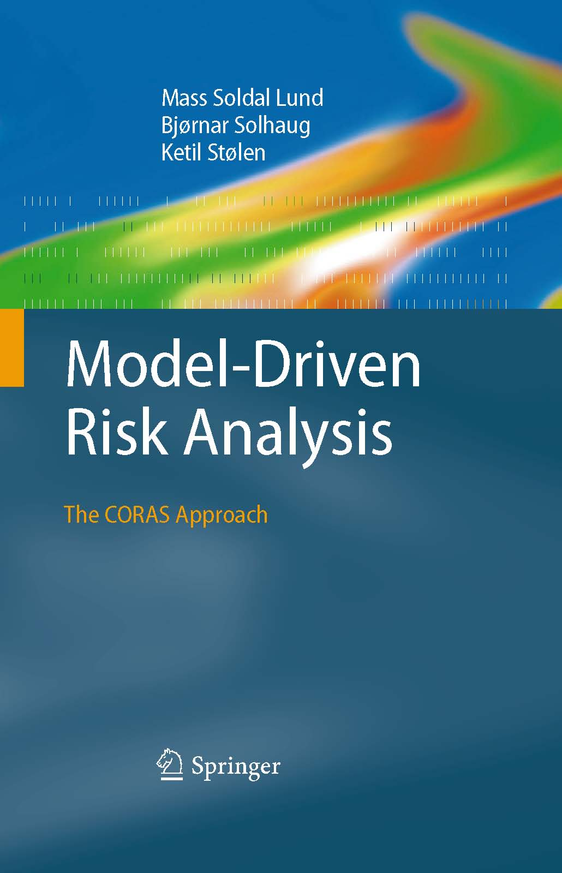
What is CORAS?
The CORAS approach:
A language for risk modeling
A tool to support the risk analysis process
A method for risk analysis
A stepwise, structured and systematic process
Asset-driven
Concrete tasks with practical guidelines
Model-driven
Models as basis for and input to analysis tasks
Models for documentation of results
Based on internationally established standards (ISO 31000)
Book: http://www.springer.com/computer/swe/book/978-3-642-12322-1

Slide 5
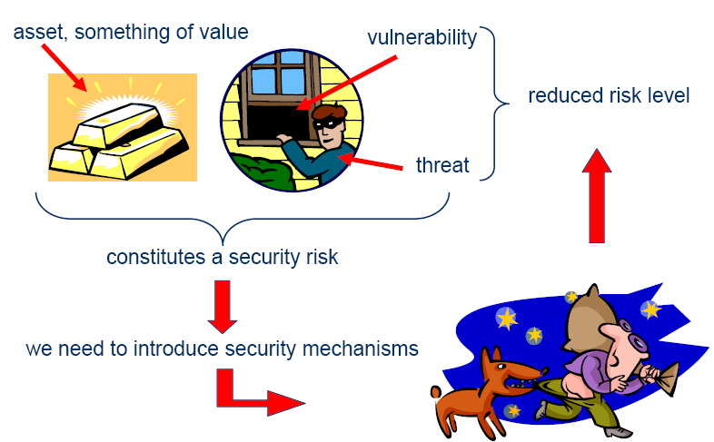
Terms

Slide 6
Central Concepts
Vulnerability
Party
Asset
Threat
Treatment
Unwanted incident
Likelihood
Risk
Consequence

Slide 7
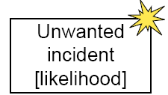
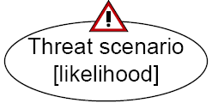
CORAS Modeling Concepts
Party:
An organization, company, person, group or other body on whose behalf a risk analysis is conducted
Asset:
Something to which a party assigns value and hence for which the party requires protection
Unwanted incident:
An event that harms or reduces the value of an asset
Vulnerability:
A weakness, flaw or deficiency that opens for, or may be exploited by, a threat to cause harm to or reduce the value of an asset
Threat:
A potential cause of an unwanted incident
Threat scenario:
A chain or series of events that is initiated by a threat and that may lead to an unwanted incident
Treatment (Treatment Scenario):
An appropriate measure to reduce risk level
Risk:
The likelihood of an unwanted incident and its consequence for a specific asset

Slide 8
Risk modeling
The CORAS language consists of five kinds of diagrams
Asset diagrams
Threat diagrams
Risk diagrams
Treatment diagrams
Treatment Overview diagrams
Each kind of diagram supports specific steps of the risk analysis process

Slide 9
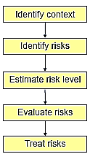
The CORAS process
Risk management process based on ISO 31000: Risk Management – Principles and Guidelines
Provides processes and guidelines for risk analysis

Slide 10
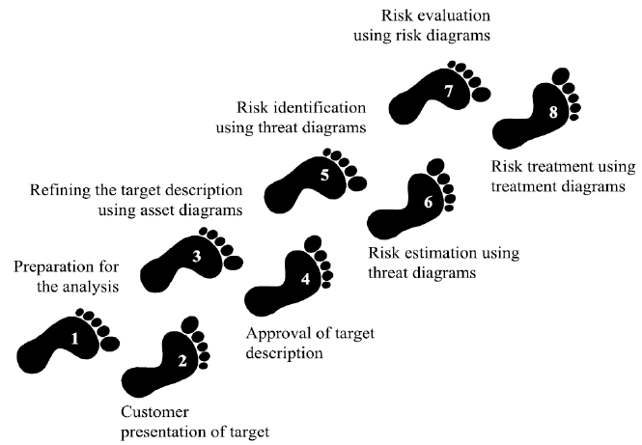
The eight steps of a CORAS risk analysis

Slide 11
The eight steps of a CORAS risk analysis
Preparation for the analysis
Customer presentation of the target
Refining the target description using asset diagrams
Approval of the target description
Risk identification using threat diagrams
Risk estimation using threat diagrams
Risk evaluation using risk diagrams
Risk treatment using treatment diagrams

Slide 12
Step 1: Preparation for the analysis
Objective: do the necessary initial preparations prior to the actual startup of the analysis
Tasks:
Contact the customer for the case study
Roughly setting the scope and focus

Slide 13
Example: AutoParts
AutoParts is a company. Its business is to sell spare parts and accessories for a wide range of car makes and vehicle models.
AutoParts has an automated online store.
AutoParts is distributing catalogues by mail that present its products and is usually shipping the goods to the customers by cash on delivery mail.
AutoParts has decided it wants to do a risk analysis of the system.
Of particular concern for the management is:
the web application that connects to both their customer database, their inventory database and their online store.

Slide 14
Step 2: Customer presentation of the target
Objective: achieve an initial understanding of the target of risk analysis
Tasks:
Customer presentation on the target
Target to be understood by risk analysts
Set the focus of the analysis
Artifact to be produced:
Description of the target:
The overall goals of the analysis
The target that wishes to have analyzed

Slide 15
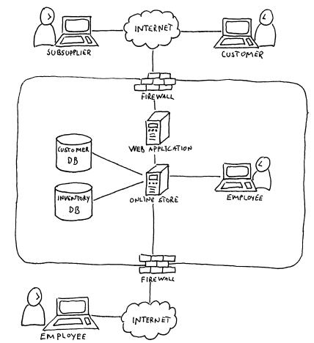
Example: Customer presentation on the target
Understand customer’s goals and target:
Of particular concern for the management is:
the web application that connects to both their customer database, their inventory database and their online store.

Slide 16
Step 3: Refining the target description using asset diagrams
Objective: ensure a common and more precise understanding of the target analysis, including its scope, focus, and main assets
Task:
The target is understood by the risk analysts
Identify the parties and assets
Conduct a high-level analysis:
The first threats, vulnerabilities, threat scenarios and unwanted incidents are identified.
Artifacts to be produced:
Asset diagram
High-level analysis: preliminary list of Unwanted incidents

Slide 17
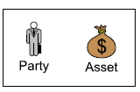
Identify asset
Identify involving parties
Identify assets of each party intends to protect:
The “THINGS” that are valuable
Notions to be used in Asset Diagram

Slide 18
Example: Identify Party and Asset
Party:
AutoParts company
Asset:
Inventory DB
Customer DB
Online store
Compliance
Company reputation
Customer satisfaction
Supplier’s trust

Slide 19
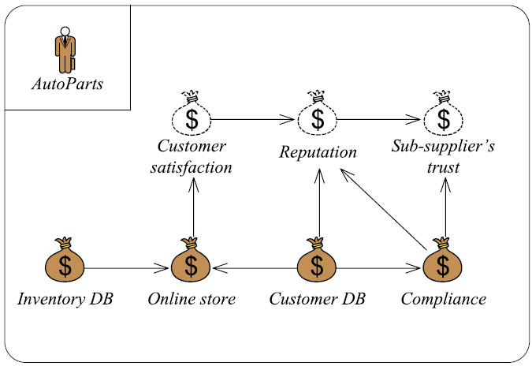
Example: Asset diagram
Relations between assets
Harm in one asset might harm also other assets.
Party
Indirect asset
Harm relation
Asset

Slide 20
High level Risk analysis
Preliminary list of Unwanted Incidents
Who/ What is the cause? | How? What may happen? What does it harm? | What makes this possible?
… | … | …..
…. | …. | …..

Slide 21
High level Risk analysis
Who/ What is the cause? | How? What may happen? What does it harm? | What makes this possible?
Hacker | Breaks into system and compromises integrity or confidentiality of databases | Use of web application and remote access; insufficient access control
Hacker | Attack compromises integrity or confidentiality of personal data causing loss of compliance with data protection laws | Use of web application and remote access; insufficient access control
Hacker | Introduces virus to the system that compromises integrity or confidentiality of databases | Insufficient virus protection
Hacker | DoS attack causes online store to go down | Use of web application; insufficient DoS attack prevention

Slide 22
Example: High level Risk analysis
Who/ What is the cause? | How? What may happen? What does it harm? | What makes this possible?
System failure | Online store goes down because of failure of web application or loss of network connection | Immature technology; loss of network connection
Employee of AutoParts | Collection and processing of personal data diverge from data protection laws | Lack of competence on data protection laws; insufficient routines for processing personal data
Employee of AutoParts | Sloppiness compromises integrity or confidentiality of databases | Lack of competence; work processes not aligned with policy

Slide 23
Step 4: Approval of the target description
Objective: decide a ranking of the assets; establish scales for estimating risks and criteria for evaluate risks
Tasks:
Define:
Likelihood scale and its description
Consequence scale for each direct asset
Risk function is determined
Agree on Risk evaluation criteria
Artifacts to be produced:
Likelihood and Consequence scales
Risk function
Risk evaluation criteria

Slide 24
Define Likelihood scale
Likelihood: the frequency or probability of something to occur
Example of Likelihood scale
Likelihood | Description
Certain | Five times or more per year
Likely | Two to five times per year
Possible | Once a year
Unlikely | Less than once per year
Rare | Less than once per ten years

Slide 25
Define Likelihood scale
Example of Likelihood scale
Likelihood | Description
Rarely | A very high number of similar occurrences already on record; has occurred a very high number
Sometimes | A significant number of similar occurrences already on record; has occurred a significant
Regularly | Several similar occurrences on record; has occurred more than once
Often | ….
… | ….

Slide 26
Define Consequence scale
Consequence: The impact of an unwanted incident on an asset in terms of harm or reduced asset value
Example of Consequence scale (for direct asset: Inventory DB)
Consequence | Description
Catastrophic | Range of [50%,100%] of records are affected
Serious | Range of [20%,50% of records are affected
Moderate | Range of [10%,20% of records are affected
Minor | Range of [1%,10% of records are affected
Insignificant | Range of [0%,1% of records are affected
Notes:
Consequence:
The impact of an unwanted incident on an asset in terms of harm or reduced asset value

Slide 27
Define Consequence scale
Example of Consequence scale (for direct asset: Online Store)
Consequence | Description
Catastrophic | Downtime in range [1 week,∞>
Serious | Downtime in range [1 day, 1 week>
Moderate | Downtime in range [1 hour,1 day>
Minor | Downtime in range [1 minute, 1 hour>
Insignificant | Downtime in range [0, 1 minute>
Notes:
Consequence:
The impact of an unwanted incident on an asset in terms of harm or reduced asset value

Slide 28
Define Consequence scale
Example of Consequence scale (for direct asset: Customer DB)
Consequence | Description
Catastrophic | Range of [50%,100%] of records are affected
Serious | Range of [20%,50% of records are affected
Moderate | Range of [10%,20% of records are affected
Minor | Range of [1%,10% of records are affected
Insignificant | Range of [0%,1% of records are affected
Notes:
Consequence:
The impact of an unwanted incident on an asset in terms of harm or reduced asset value

Slide 29
Define Consequence scale
Example of Consequence scale (for direct asset: Compliance)
Consequence | Description
Catastrophic | Chief executive officer is sentenced to jail for more than 1 year
Serious | Chief executive officer is sentenced to jail for up to 1 year
Moderate | Claim for indemnification or compensation
Minor | Fine
Insignificant | Illegal data processing is ordered to cease
Notes:
Consequence:
The impact of an unwanted incident on an asset in terms of harm or reduced asset value

Slide 30
Example: Risk Function and evaluation criteria
Determine level of risk as a function of likelihood and consequence
Risk Function (Inventory DB)
Consequence/ Likelihood | Insignificant | Minor | Moderate | Serious | Catastrophic
Rare
Unlikely
Possible
Likely
Certain
 | Acceptable
 | Monitor
 | Need to be treated

Slide 31
Example: Risk Function and evaluation criteria
Determine level of risk as a function of likelihood and consequence
Risk Function (Online Store)
Consequence/ Likelihood | Insignificant | Minor | Moderate | Serious | Catastrophic
Rare
Unlikely
Possible
Likely
Certain
 | Acceptable
 | Monitor
 | Need to be treated

Slide 32
Example: Risk Function and evaluation criteria
Determine level of risk as a function of likelihood and consequence
Risk Function (Customer DB)
Consequence/ Likelihood | Insignificant | Minor | Moderate | Serious | Catastrophic
Rare
Unlikely
Possible
Likely
Certain
 | Acceptable
 | Monitor
 | Need to be treated

Slide 33
Example: Risk Function and evaluation criteria
Determine level of risk as a function of likelihood and consequence
Risk Function (Compliance)
Consequence/ Likelihood | Insignificant | Minor | Moderate | Serious | Catastrophic
Rare
Unlikely
Possible
Likely
Certain
 | Acceptable
 | Monitor
 | Need to be treated

Slide 34
Step 5: Risk Identification using Threat diagrams
Objective: Identify and document risks through the identification and documentation of unwanted incidents, threats, threat scenarios and vulnerabilities
Tasks:
Identify risk that might harm clients’ assets
How a threat exploits a vulnerability to cause an unwanted incident that harms the client’s asset
(proposed) Sub steps:
Identify Assets and Threats
Identify Unwanted Incidents
Identify Threat Scenarios
Identify Vulnerabilities
Artifact to be produced:
Threat diagram
Notes:
Party: An organization, company, person, group or other body on whose behalf a risk analysis is conducted

Slide 35
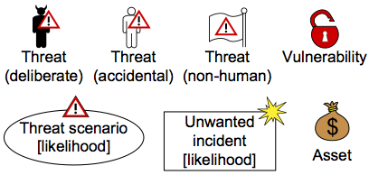
Step 5: Risk Identification using Threat diagrams
Notions to be used in Threat Diagram

Slide 36
Step 5 - sub step 1: Identify Assets and Threats
Answer the question: “What are the threats?”
Hints:
“Accidental threat”: e.g., users/ roles inside the system
“Deliberate threat”: e.g, attackers from outside
Threat
Asset

Slide 37
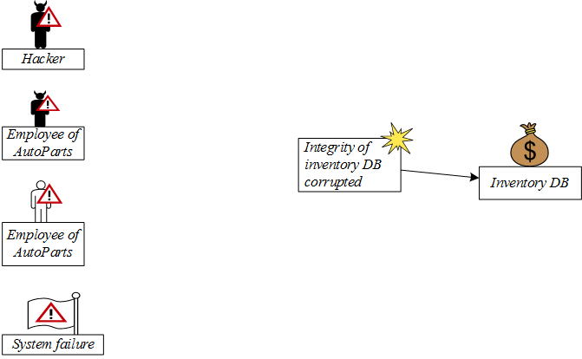
Step 5 - sub step 2: Identify Unwanted Incidents
Answer the question:
What (unwanted incidents) do we fear will happen?
Unwanted Incident
Impact relation
Impact relation
Notes:
Invetory DB

Slide 38
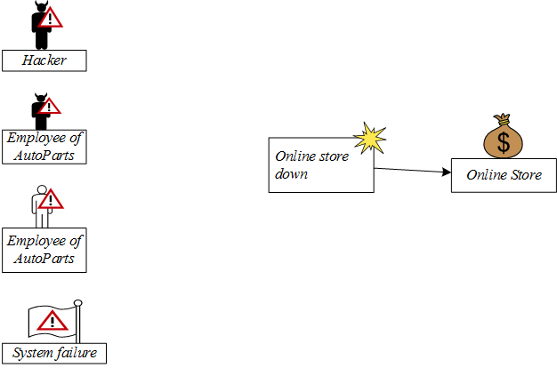
Step 5 - sub step 2: Identify Unwanted Incidents
Answer the question:
What (unwanted incidents) do we fear will happen?
Unwanted Incident
Impact relation
Notes:
Online store

Slide 39
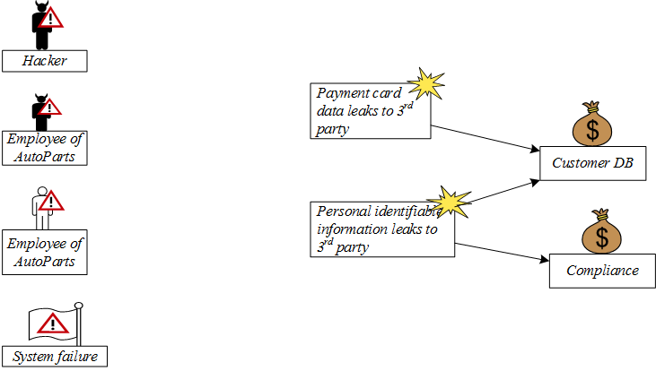
Step 5 - sub step 2: Identify Unwanted Incidents
Answer the question:
What (unwanted incidents) do we fear will happen?
Unwanted Incident
Impact relation
Notes:
Customer DB

Slide 40
Step 5 - sub step 3: Identify Threat Scenarios
Answer the question:
How does it happen? It happens by which threat scenarios?
Notes:
Inventory DB
Interact with student (how the integrity of a DB is corrupted?)

Slide 41
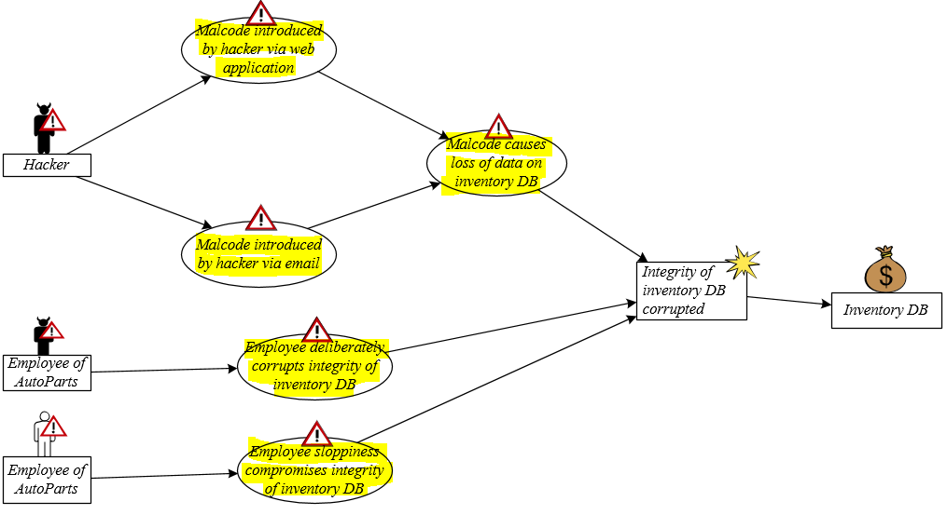
Step 5 - sub step 3: Identify Threat Scenarios
Answer the question:
How does it happen? It happens by which threat scenarios?
Threat Scenario
Notes:
Inventory DB

Slide 42
Step 5 - sub step 3: Identify Threat Scenarios
Answer the question:
How does it happen? It happens by which threat scenarios?
Threat Scenario
Impact relation
Leads-to relation
Initiates relation
Notes:
Inventory DB

Slide 43
Step 5 - sub step 3: Identify Threat Scenarios
Answer the question:
How does it happen? It happens by which threat scenarios?
Notes:
Inventory DB

Slide 44
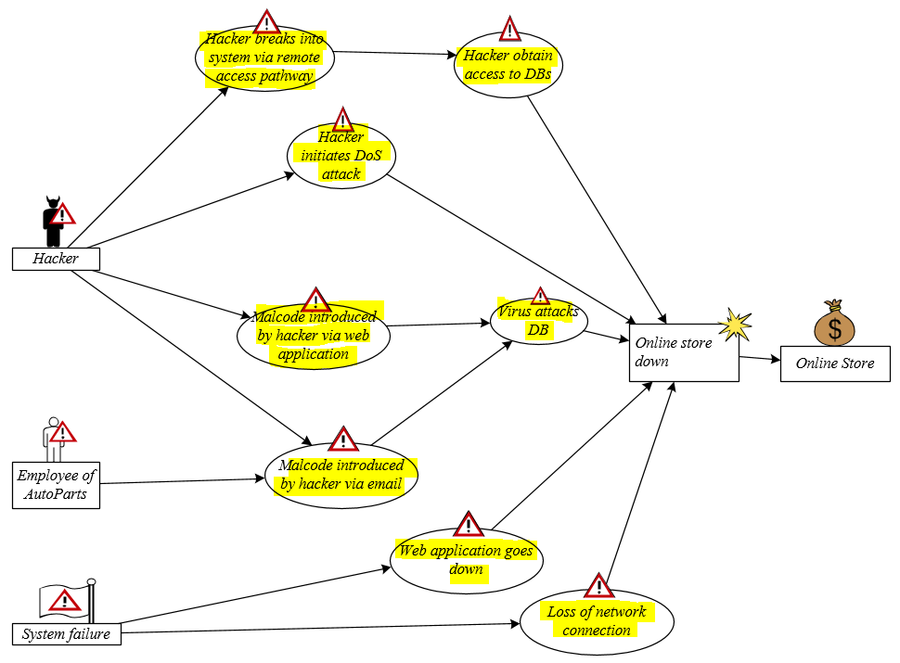
Step 5 - sub step 3: Identify Threat Scenarios
Notes:
Online store

Slide 45
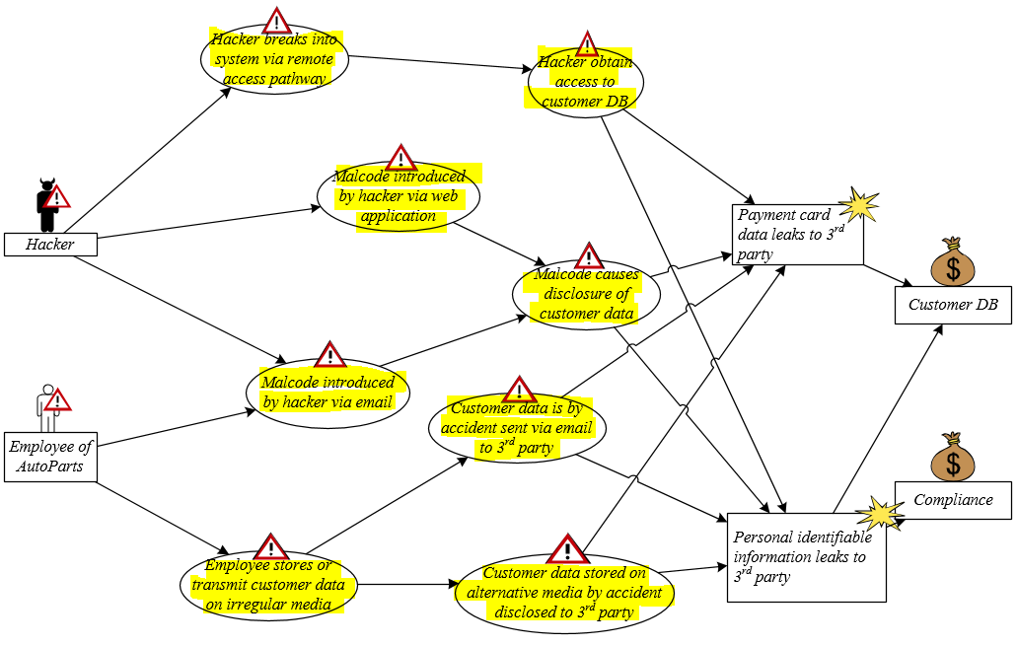
Step 5 - sub step 3: Identify Threat Scenarios
Notes:
Customer DB and Compliance

Slide 46
Step 5 - sub step 4: Identify Vulnerabilities
Answer the question:
Which vulnerabilities make this possible?
Notes:
InventoryDB – INTERACT with student
Note: Vulnerability is a weakness. It means, event the Threat Scenario (condition) happens, but without the weakness, then the Attack cannot be happened.

Slide 47
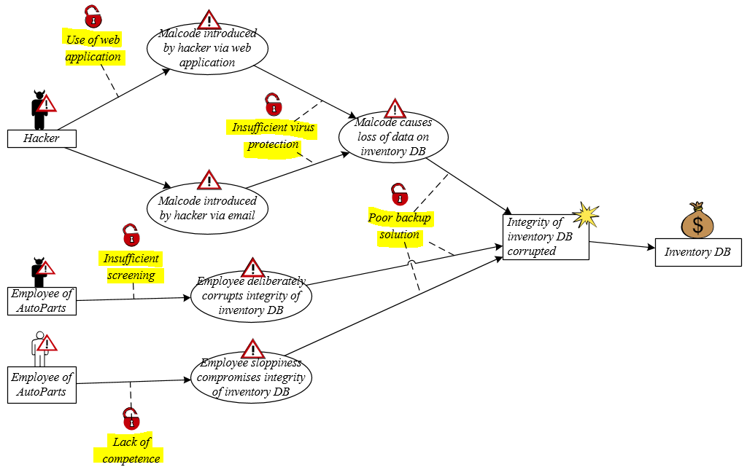
Step 5 - sub step 4: Identify Vulnerabilities
Answer the question:
Which vulnerabilities make this possible?
Vulnerability
Vulnerability target relation
Notes:
InventoryDB
Note: Vulnerability is a weakness. It means, event the Threat Scenario (condition) happens, but without the weakness, then the Attack cannot be happened.

Slide 48
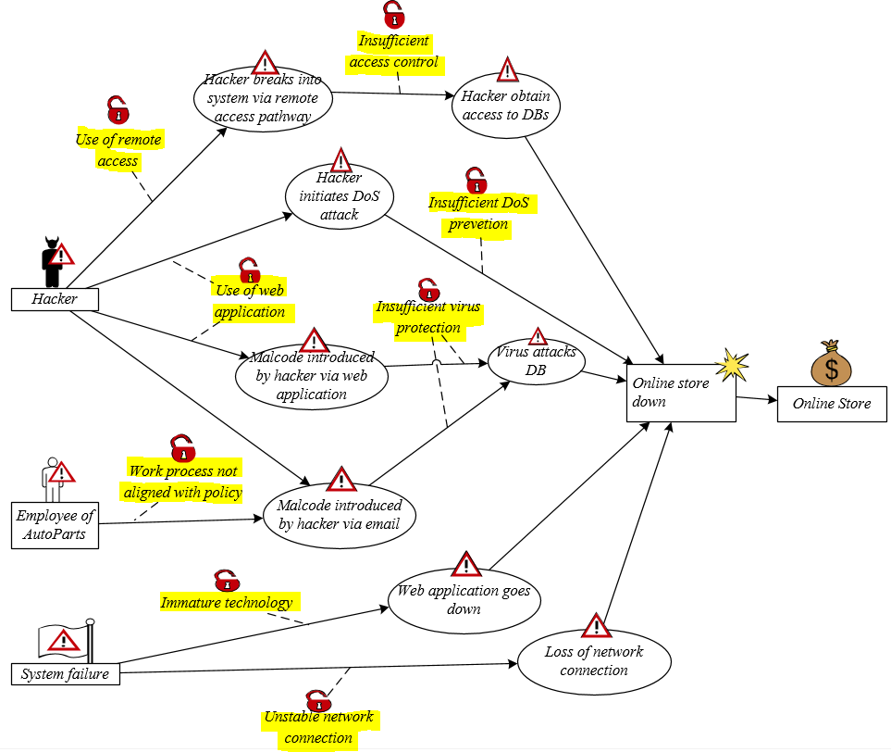
Step 5 - sub step 4: Identify Vulnerabilities
Notes:
OnlineStore

Slide 49
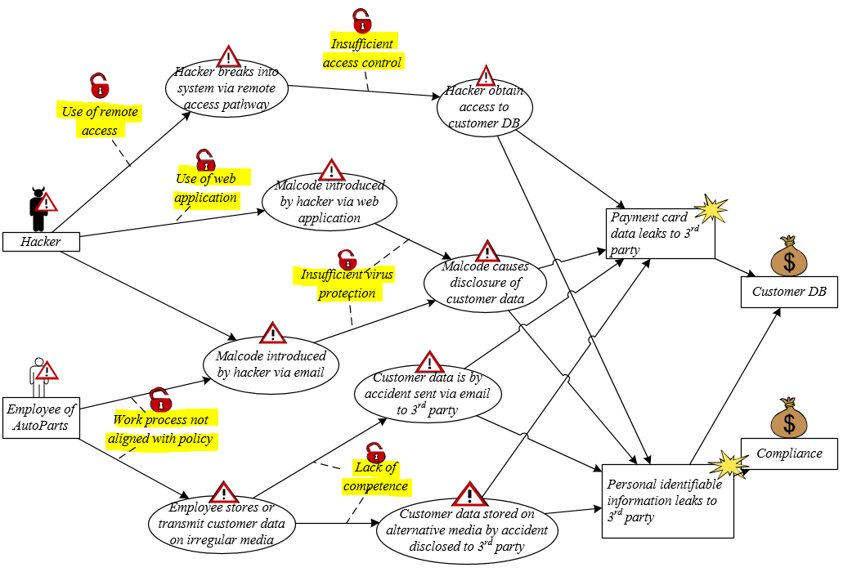
Step 5 - sub step 4: Identify Vulnerabilities
Notes:
CustomerDB and Compliance

Slide 50
Step 6: Risk estimation using threat diagrams
Objective: determine risk level of the identified risks
Tasks: base on likelihood and consequence scale approved in Step 4
Assign likelihood estimated for each Threat Scenario
Assign likelihood estimated for each Unwanted Incidents
Assign consequence caused by each Unwanted Incidents on each Asset (the consequence is denoted on “impact” relation
Artifacts to be produced:
Completed Threat diagrams with likelihood and consequences assigned
Notes:
Party: An organization, company, person, group or other body on whose behalf a risk analysis is conducted

Slide 51
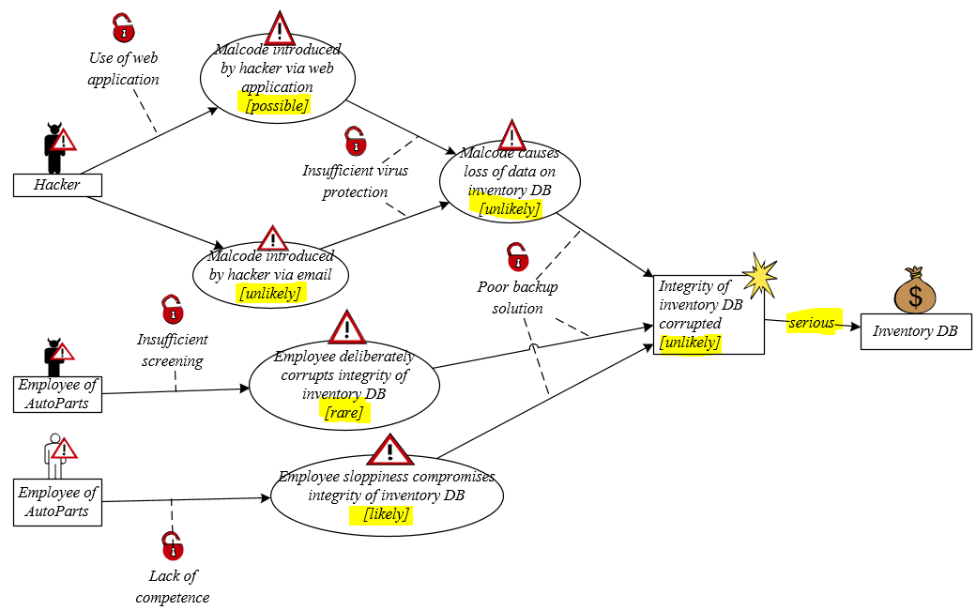
Example: Assign Likelihood and Consequence

Slide 52
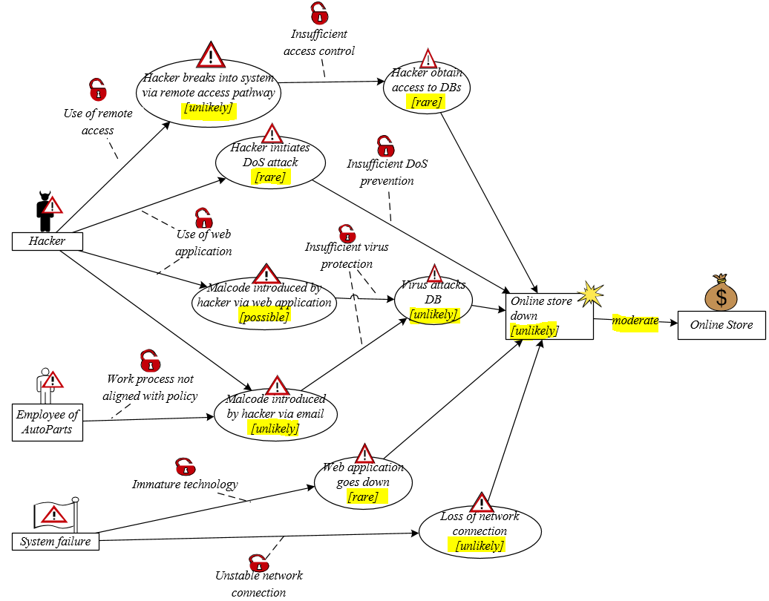
Example: Assign Likelihood and Consequence

Slide 53
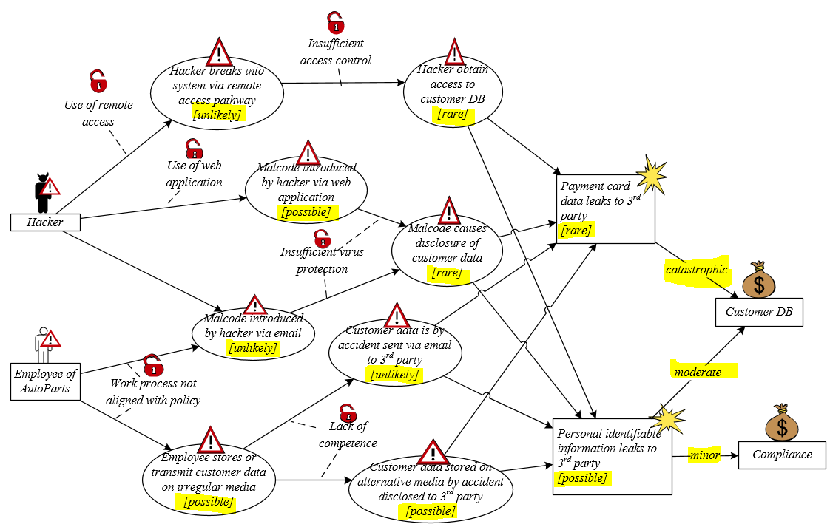
Example: Assign Likelihood and Consequence
Notes:
CustomerDB - Compliance

Slide 54
Step 7: Risk evaluation using Risk diagram
Objective: decide which of the identified risks are acceptable and which must be further evaluated for possible treatment
Tasks:
Evaluate the identified risks:
Enter the risks into the Risk Function (from step 4)
Evaluate which risks are acceptable and which are not
Summarize the risk picture by Risk Diagram
Artifacts to be produced:
Completed Risk Function
Risk Diagram with evaluation result
Notes:
Party: An organization, company, person, group or other body on whose behalf a risk analysis is conducted

Slide 55
Example: Completed Risk Function
Risk Function (Inventory DB)
Consequence/ Likelihood | Insignificant | Minor | Moderate | Serious | Catastrophic
Rare
Unlikely |  |  |  | R1:Integrity of inventory DB corrupted
Possible
Likely
Certain
 | Acceptable
 | Monitor
 | Need to be treated

Slide 56
Example: Completed Risk Function
Risk Function (Online Store)
Consequence/ Likelihood | Insignificant | Minor | Moderate | Serious | Catastrophic
Rare
Unlikely |  |  | R2:Online store down
Possible
Likely
Certain
 | Acceptable
 | Monitor
 | Need to be treated

Slide 57
Example: Completed Risk Function
Risk Function (Customer DB)
Consequence/ Likelihood | Insignificant | Minor | Moderate | Serious | Catastrophic
Rare |  |  |  |  | R3: Payment card data leaks to 3rd party
Unlikely
Possible |  |  | R4: Personal identifiable information leaks to 3rd party
Likely
Certain
 | Acceptable
 | Monitor
 | Need to be treated

Slide 58
Example: Completed Risk Function
Risk Function (Compliance)
Consequence/ Likelihood | Insignificant | Minor | Moderate | Serious | Catastrophic
Rare
Unlikely
Possible |  | R5: Personal identifiable information leaks to 3rd party
Likely
Certain
 | Acceptable
 | Monitor
 | Need to be treated

Slide 59
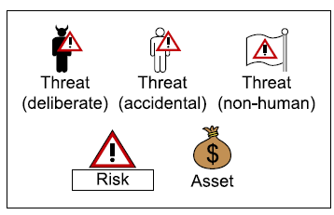
Summarizing the Risk picture
We use Risk diagram to show how Threats pose Risks to the Assets
Notions to be used in Risk diagram:

Slide 60
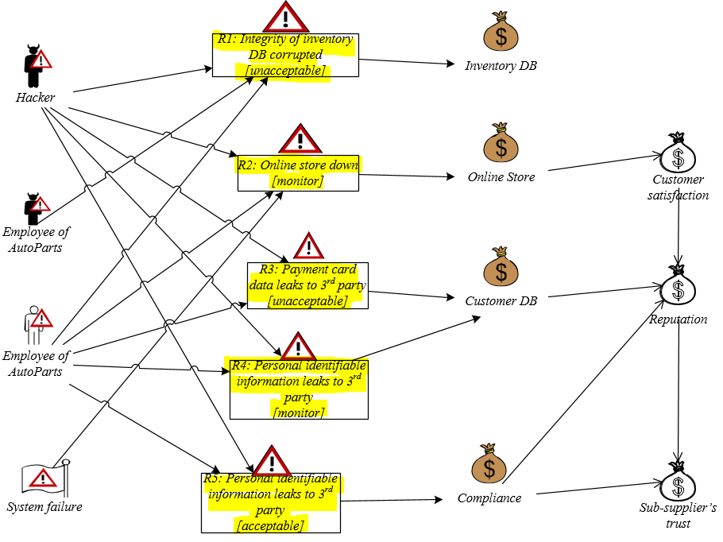
Example: Risk diagram

Slide 61
Step 8: Risk treatment using Treatment diagram
Objective: identify cost effective treatments for the unacceptable risks
Task:
Identify Treatment Scenario for unacceptable risks:
What can we do to reduce the risks to an acceptable (or monitor) level?
Create Treatment diagram
Summarize by Treatment Overview diagram
Evaluate treatment: estimate the cost-benefit of each treatment, and decide which ones to implement
Artifacts to be produced:
Treatment diagram (=Threat diagram with Treatment added)
Treatment Overview diagram
Treatment evaluation
Notes:
Party: An organization, company, person, group or other body on whose behalf a risk analysis is conducted

Slide 62
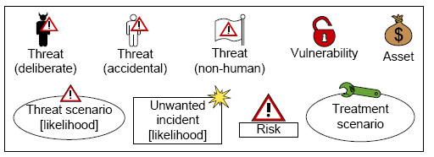
Step 8: Risk treatment using treatment diagram
Notions to be used in Treatment Diagram

Slide 63
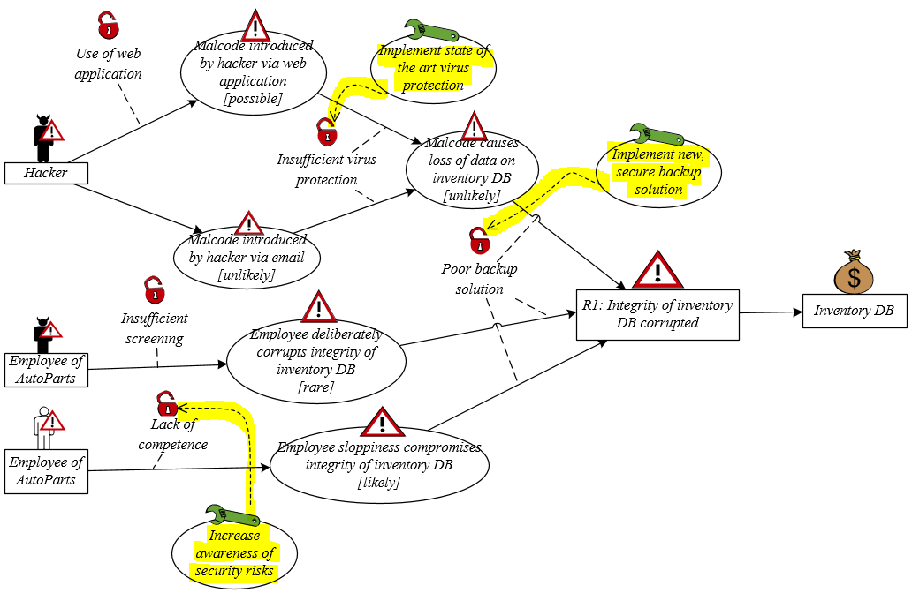
Example: Treatment Diagram
Treatment Scenario
Treat relation

Slide 64
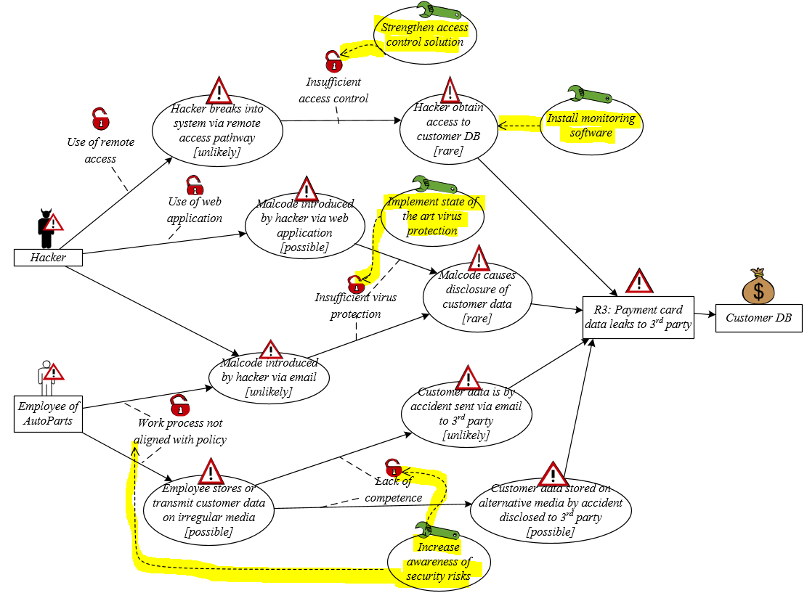
Example: Treatment Diagram

Slide 65
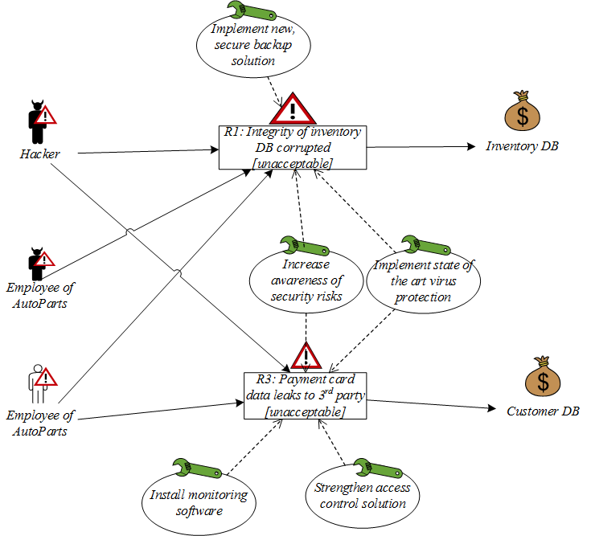
Example: Treatment Overview Diagram

Slide 66
Treatment Evaluation
Estimate the cost-benefit of each treatment and decide which ones to implement
Treatment | Cost | Risk | Risk reduction | Select to implement
…. | … | … | … | …
… | … | … | … | …
… | … | … | … | …

Slide 67
Example: Treatment Evaluation
Treatment | Cost | Risk | Risk reduction | Select to implement
T1: Implement new, secure backup solution | High | R1 | R1: Unacceptable to Acceptable | No
T2: Increase awareness of security risks | Low | R1 | R1: Unacceptable to Monitor | Yes
 |  | R3 | R3: Unacceptable to Acceptable
T3: Implement state of the art virus protection | Low | R1 | R1: Unacceptable to Monitor | Yes
 |  | R3 | R3: Unacceptable to Monitor
T4: Install monitoring software | Medium | R3 | R3: Unacceptable to Acceptable | Yes
T5: Strengthen access control solution | High | R3 | R3: Unacceptable to Monitor | No

Slide 68
Example: Treatment Evaluation
Treatment | Cost | Risk | Risk reduction | Select to implement
T1: Implement new, secure backup solution | High | R1 | R1: Unacceptable to Acceptable | No
T2: Increase awareness of security risks | Low | R1 | R1: Unacceptable to Monitor | Yes
 |  | R3 | R3: Unacceptable to Acceptable
T3: Implement state of the art virus protection | Low | R1 | R1: Unacceptable to Monitor | Yes
 |  | R3 | R3: Unacceptable to Monitor
T4: Install monitoring software | Medium | R3 | R3: Unacceptable to Acceptable | Yes
T5: Strengthen access control solution | High | R3 | R3: Unacceptable to Monitor | No
Final recommendations to customer

Slide 69
Tool Support and Demo
The CORAS tool is a diagram editor
Support for making all kinds of CORAS diagrams
Design for on-the-fly modeling during structured brainstorming at analysis workshops
Ensures syntactically correct diagrams
Used during all steps of the risk analysis
Input to the various tasks
Gathering and structuring of information during the tasks
Documentation of analysis results
Available for download: http://coras.sourceforge.net/

Slide 70
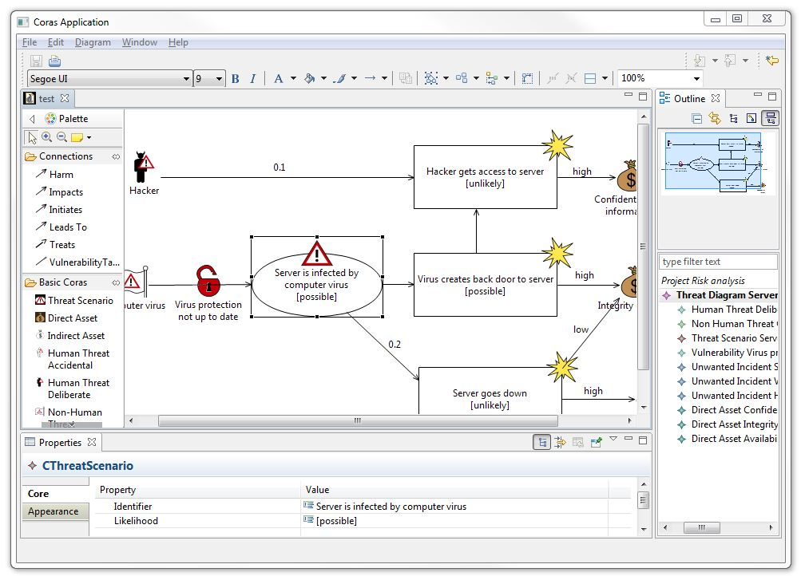
Tool Support: Screenshot
Tool bar
Pull-down menu
Palette
Outline
Canvas
Properties window

Slide 71
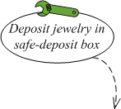
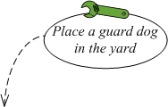
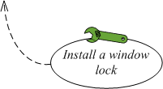
Summary
CORAS risk model in a nutshell
Remove threat
Reduce consequence
Threat scenario (initiated by threat)
Vulnerability
Unwanted incident
(leaded by threat scenario)
Threat
Remove vulnerability

Slide 72
Summary
CORAS consists of three parts
Method
Language
Tool
Model-driven and asset-driven
Concrete guidelines for how to conduct risk analysis in practice
Based on a well-established and precisely defined conceptual framework
Based on internationally established standards
Book: http://www.springer.com/computer/swe/book/978-3-642-12322-1
CORAS tool demo: http://coras.sourceforge.net/coras-tool-demo.htm
Download:
Tool:http://coras.sourceforge.net/downloads.html (CORAS editor v1.1)
Microsoft Visio stencil for the CORAS Language: http://coras.sourceforge.net/downloads.html (see CORAS_visio_stencil_20060714.vss) (recommended)

Slide 73
Credits
M.Lund, B.Solhaug, K.Stolen, Model-Driven Risk Analysis: The CORAS approach. Springer 2011.
Heidi E.I.Dahl, ESSCaSS 2008, NODES Tutorial.
Atle Refsdal, ERISE 2011 tutorial.

