Slide 1
Requirements Engineering for Security: An Argumentation-based approach
NESSOS E-RISE Challenge
University of Trento, 8th May 2012
Thein Tun
The Open University UK
t.t.tun@open.ac.uk

Slide 2
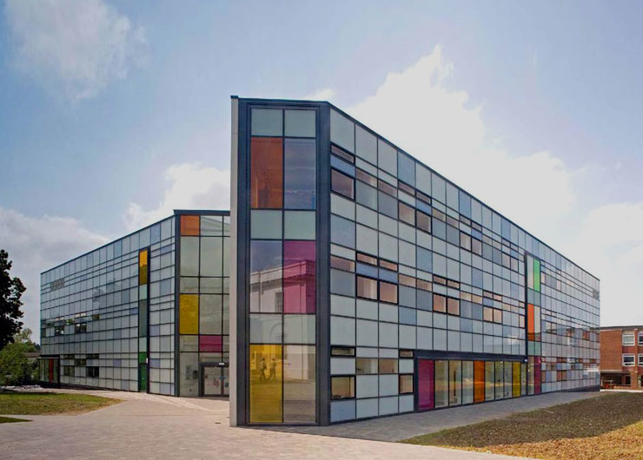

Slide 3
Acknowledgement
Papers
Charles Haley, Robin Laney, Jonathan Moffett, and Bashar Nuseibeh. 2008. Security Requirements Engineering: A Framework for Representation and Analysis. IEEE Trans. Softw. Eng. 34, 1 (January 2008), 133-153. DOI=10.1109/TSE.2007.70754 http://dx.doi.org/10.1109/TSE.2007.70754
Thein Than Tun, Yijun Yu, Charles Haley, and Bashar Nuseibeh. 2010. Model-Based Argument Analysis for Evolving Security Requirements. In Proceedings of the 2010 Fourth International Conference on Secure Software Integration and Reliability Improvement (SSIRI '10). IEEE Computer Society, Washington, DC, USA, 88-97. DOI=10.1109/SSIRI.2010.36 http://dx.doi.org/10.1109/SSIRI.2010.36
Tool & Wiki
http://sead1.open.ac.uk/openpf/
http://computing-research.open.ac.uk/trac/openre/wiki

Slide 4
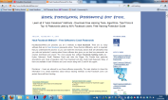
Computer Security: Problems
WiFi
Smart Phones
Social Networking Websites
Financial Systems
Emails
Cars
Nuclear plants
Have you experienced other security problems?
We’ve heard a lot of problems with computer security. The situation may not get better soon. We have a lot of work to do!

Slide 5
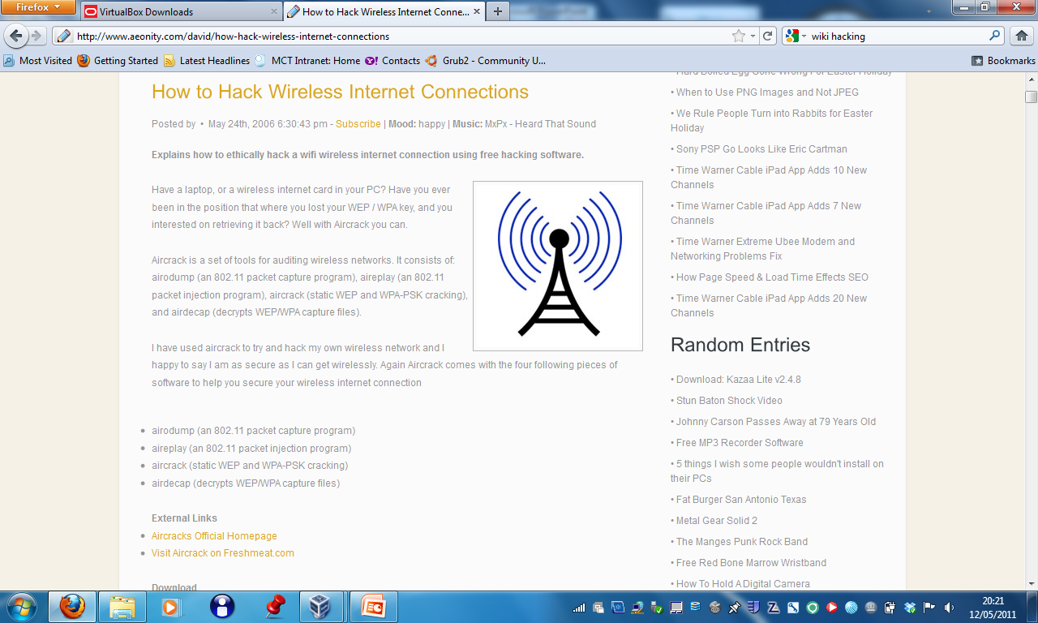

Slide 6
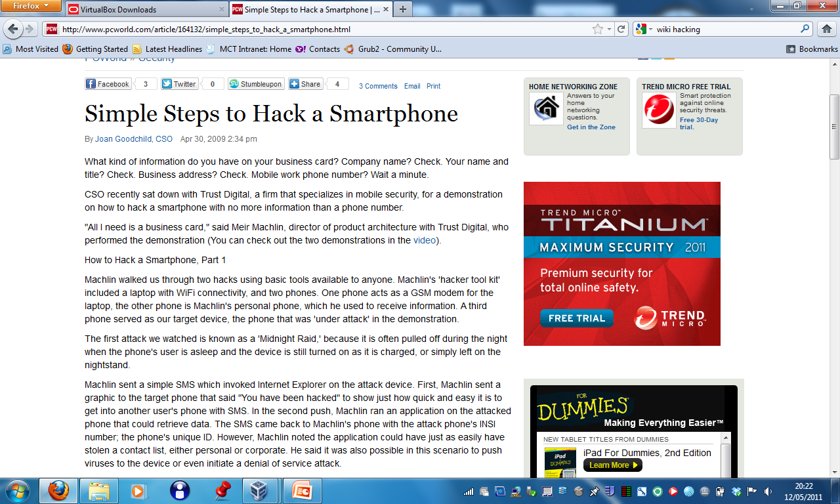

Slide 7
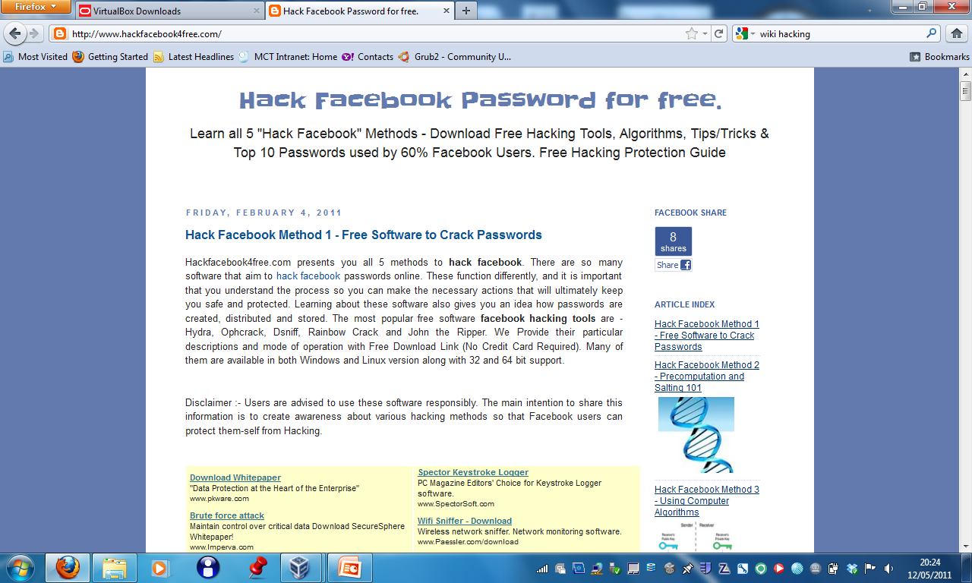

Slide 8
Computer Security: Problem Nature
Security issues can be found at multiple levels
Hardware: theft, tampering ...
Operating System: Buffer overflow, data leak ...
Network & Communication Protocols: Weak encryption
Application Software: Access control policies, data storage policies
Composition: when two subsystems that are independently secure are brought together...
Human: Phishing, forgetting, ...

Slide 9
Computer Security: Solution Nature
Solutions are available for different kinds of problems
Hardware Security
Secure OS, Secure Coding
Encryption
Verification, testing
Training

Slide 10
Our Focus: Requirements
100% security is not feasible
The statement “the system must be secure under all conditions” is a nonsense
Security has to be selective
Critical security conditions have to be identified and addressed
Objectives that need to be achieved
Assets that need to be protected
Assumed capabilities of an attacker

Slide 11
Security Requirements: Some Difficulties
“requirements”: we tend to think about properties the system must have
Car doors should be locked when the car is in motion
“security requirements”: we tend to think about properties the system must not have, e.g., non-interference
Don’t allow thieves access to my car
We tend to formulate the negative properties as stronger positive properties
Allow only the car owners to drive

Slide 12
Security Requirements: Is it worth it?
Is it worth focusing on requirements?
It is know that many of the system errors are down to requirements
When errors are removed at the requirements level it is cheaper
Same observation may apply specifically to security
Security vs Safety vs Privacy

Slide 13
Security Requirements: Many Approaches
UML-based approaches
Goal-oriented approaches
Problem Frames approach
Risk-based approach
Argumentation-based approach
Haley et al (2008) in particular

Slide 14
Security Requirements
Adequate Security Requirements
If the requirements are respected, security goals are satisfied
System
Software, hardware, people

Slide 15
Security Requirements: Three Criteria
Security Requirements have three criteria
Definition: what are the requirements?
Assumption: what we think how the system components will behave?
Satisfaction: Does security requirement satisfy security goal? Does the system satisfy the security requirements?

Slide 16
C1: Definition of Security Requirements
Stakeholders have resources that should be protected from harm
Resource: Tangible/Intangible Assets
What are the goals and requirements of the stakeholders?
Security requirements are Non-Functional Requirements
“Prevent ...” – negative properties
Little/No tolerance for failure
Limited Resources: cost/benefit trade-offs

Slide 17
C1: Security Requirements: Context
Security Goals & Requirements are bound by context
An executive working with sensitive data on spreadsheet
Maintain Confidentiality of Data
Context: Access to room – lock
Context: Computer – authorisation encryption
Bad if the executive reads the data aloud and attacker can hear
Bad if the attacker can hear and decode the keystrokes
...

Slide 18
C2: Incorporate Assumptions
Not practical to consider everything as context
Trust Assumption: explicit or implicit choices to trust that a domain will behave as expected
Compilers, a security threat?
Execution environments, a security threat?

Slide 19
C3: Satisfaction of Security Requirements
How can we show that the system satisfies security requirements?
Proofs
Arguments
Proofs/Arguments have to rely on trust assumptions
Validity of trust assumptions may call for sub-arguments

Slide 20
Framework
Security goals/requirements aim to protect assets from harm
Primary security goals are operationalised into primary security requirements: Preventative
Feasibility, trade-off, conflict analysis lead to secondary security goals/requirements: Preventative or detective
Satisfaction arguments for security arguments expose and take trust assumptions into account

Slide 21
How to find security goals
CIAA – Confidentiality, Integrity, Availability, Accountability
<action, asset, harm>
<erase, customer records, loss of revenue>
What are the threats to assets? How can they be prevented or avoided?
Organisational Principles – Least privilege, Separation of duties (they may be contradictory)
Attacker’s goals
But it is a zero-sum game
Can attackers’ requirements alone provide enough security requirements?

Slide 22
From Security Goals to Security Requirements
First Iteration: Primary Goals, Primary Requirements
Feasible Realisation
Secondary Iteration: Secondary Goals, Secondary Requirements
Secondary Goals/Requirements supersede Primary Goals/Requirements

Slide 23
Development Artefacts and Dependencies

Slide 24
Development Stages

Slide 25
Stage 1: Identify Functional Requirements
This has to be identified before the process can start
Haley et al provide no methodological support for this
Can you identify an approach for this?

Slide 26
Development Stages

Slide 27
Stage 2: Identify Security Goals
Identify Candidate Assets
Resources that might have values to organisation/attackers
Select Management Principles
Organisational policies on separation of duties, least privileges, data protection etc
Determine Security Goals
Achieve <<Management Principles>> on <<Assets>>
<action, asset, harm>,Prevention of harm

Slide 28
Development Stages

Slide 29
Stage 3: Identify Security Requirements
Problem Diagrams
“The system shall provide Personnel Information only to members of Human Resources Department”
“provide Personnel Information” – functional requirement
“only to members of HR Dept” – security requirement

Slide 30
Development Stages

Slide 31
Stage 4: Verification of the System
Two-part satisfaction argument
Outer argument: formal argument showing how the security requirement is satisfied
Context is correct
Implementation is conflict-free
Inner argument: informal argument showing plausibility and consistency of assumptions

Slide 32
Iteration
Initial requirements may be
Infeasible
Inconsistent
Secondary goals/requirements should extend, not remove primary goals/requirements

Slide 33
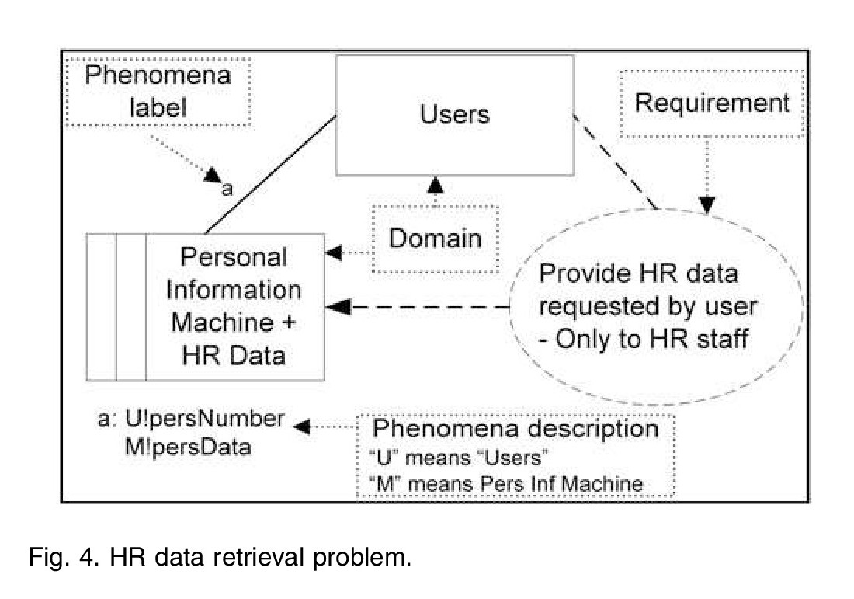
Problem Diagrams
Machines
Problem World Domains
Shared Phenomena
Requirements

Slide 34
Outer Argument
Formal
(domain behavior/properties) ├─ (security requirement(s))

Slide 35
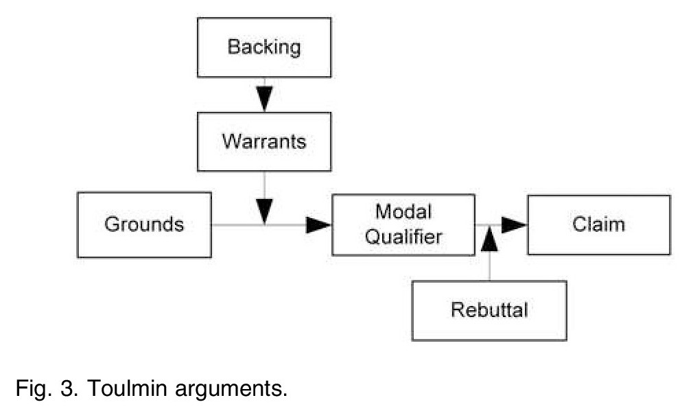
Inner Argument
Informal Toulmin Arguments

Slide 36
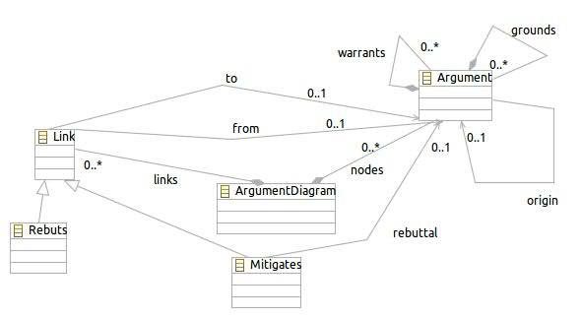
Inner Argument
Simplified Toulmin

Slide 37
HR Example
Confidentiality of personnel data implies that people in general cannot be allowed access to this information, but HR staff can be relied upon to maintain its confidentiality. Therefore, a constraint that permits HR staff, but nobody else, to access it will satisfy the security goal.

Slide 38
Outer Argument
M!persData ├─ (User member HR)
Problem!
Physical restriction
Authorisation
Trust assumption

Slide 39
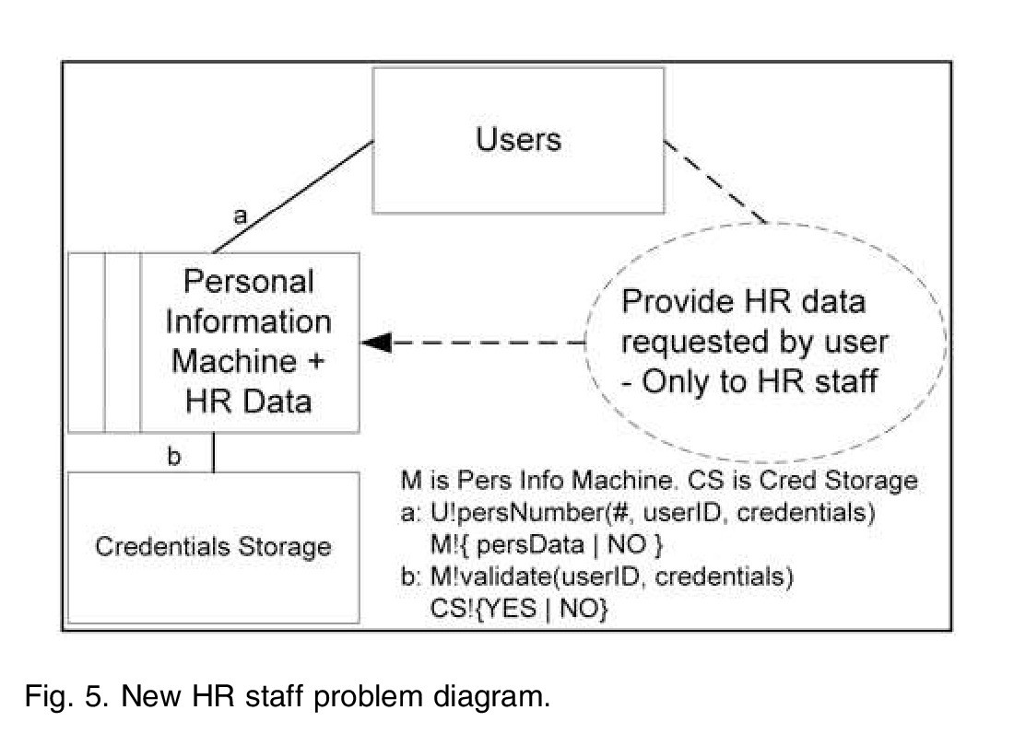
Revised problem diagram

Slide 40
Outer Argument for Revised Diagram
(P1, P2, P3, P4, D ├─ H)
Can you prove it?
What do you think of P2? Can it be false? How?

Slide 41
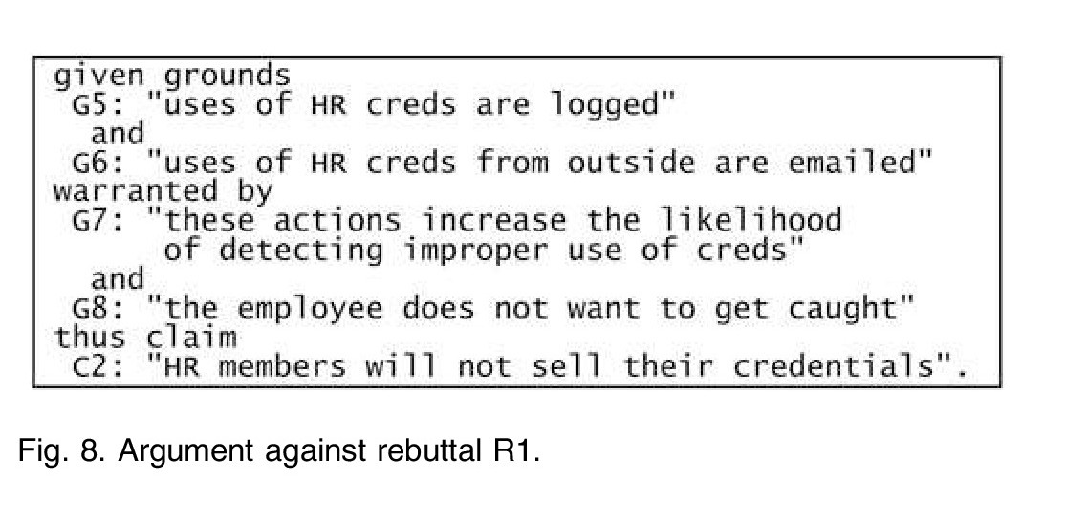
Rebuttals

Slide 42
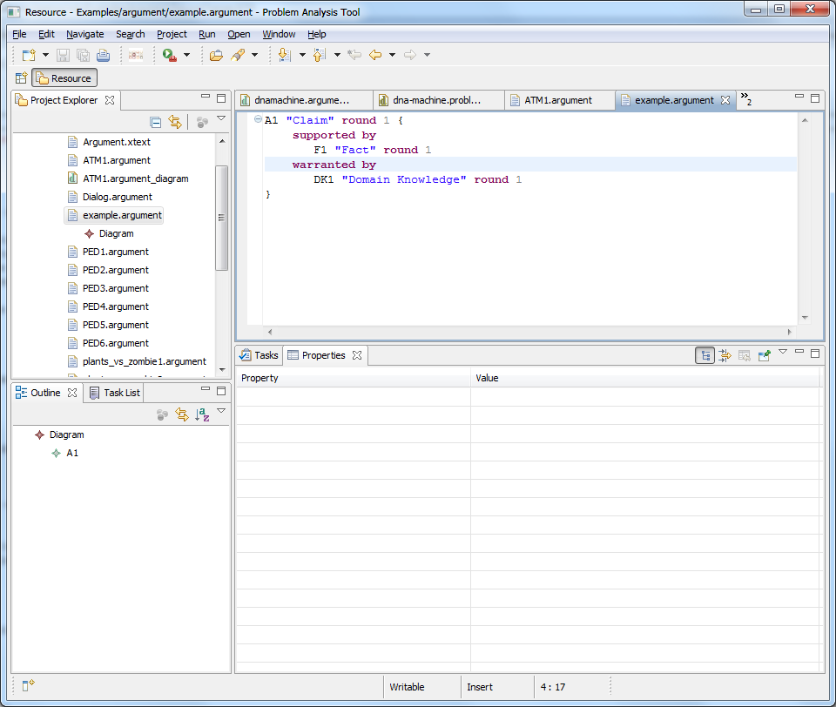
Tool Demo & Tutorial
Download/Copy the OpenPF tool
http://sead1.open.ac.uk/openpf/
Tutorial Tasks
Create arguments
Textually and graphically
Create rebuttals
Create mitigations
Formalize an argument and its rebuttal
Check the rebuttal using the reasoner
Reiterate after formalising the mitigation
Study the examples on the wiki

