Slide 1
The MalwareLab
Testing Exploits and Malware in an isolated environment
Luca Allodi – luca.allodi@unitn.it
Fabio Massacci – fabio.massacci@unitn.it
Vadim Kotov (now @ Bromium Inc., Cupertino CA ) – luca.allodi@unitn.it

Slide 2
The MalwareLab
Laboratory to measure malware as a “software artifact”
Does the malware/exploit work?
Under which circumstances?
How does it perform under different assumptions?
Disconnected from the network
At the moment located in Povo2, Floor 1
Soon to be moved and renovated

Slide 3
MalwareLab structure
VICTIM 1
VICTIM 2
VICTIM 3
Virtualizes:
XPSP0
XP SP1
XP SP2
XPSP3
Virtualizes
Vista SP0
Vista SP1 Vista SP2
Virtualizes
Seven SP0 Seven SP1
Malware Distribution Server
(MDS)

Slide 4
MalwareLab functionalities
Python infrastructure
Automatically operate on Virtual Machines
Create, delete, restore VM Snapshots
Automatically install and verify software configurations on the VMs
Configuration file contains list of software
Script pushes the software on VM, lunches silent install
Possibility to verify the install with a batch file
Firefox, Opera, Java, Quicktime, Flash, Adobe Reader
Automated mechanism to verify exploit successfulness.
Fully modularized - Easy to add functionalities / software/malware

Slide 5
Run example: testing Exploit Kits (1)
3
2
1
Requests web page to malicious server
Receives HTML exploit page
If exploit is successful, shellcode downloads malware of some sort
Computer is infected

Slide 6
Run example: testing Exploit Kits (2)
Question: How resilent are cybercrime ekits to software updates?
Exploit kits span from (2007-2011)
How we chose the exploit kits
Release date
Popularity (as reported in industry reports)
CrimePack, Eleonore, Bleeding Life, Shaman, …
Software: most popular one
Windows XP, Vista, Seven
All service packs are treated like independent operating systems
Browsers: Firefox, Internet explorer
Plugins: Flash, Acrobat Reader, Java
247 software versions
spanning from 2005 to 2013
We randomly generate 180 sw combinations (times 9 Operating Systems) to be the configurations we test

Slide 7
Experiment setup (1)
Virtualizes:
XPSP0
-Conf 1..180
XP SP1
-Conf 1..180
XP SP2
-Conf 1..180
XPSP3
-Conf 1..180
Virtualizes
Vista SP0
-Conf 1..180
Vista SP1 -Conf 1..180
Vista SP2 -Conf 1..180
Virtualizes
Seven SP0 -Conf 1..180
Seven SP1 -Conf 1..180
Exploit kit 1
Exploit kit 2
..
Exploit kit 10
Malware Distribution Server
(MDS)

Slide 8
Configuration example
One configuration for: Windows XP Service Pack 2
Firefox 1.5.0.5
Flash 9.0.28.0
Acrobat Reader 8.0.0.0
Quicktime 7.0.4.0
Java 1.5.0.7
One configuration for: Windows Seven Service Pack 1
Firefox 8.0.1.0
Flash 10.3.183.10
Acrobat Reader 10.1.1.0
Quicktime: No version
Java 6.27

Slide 9
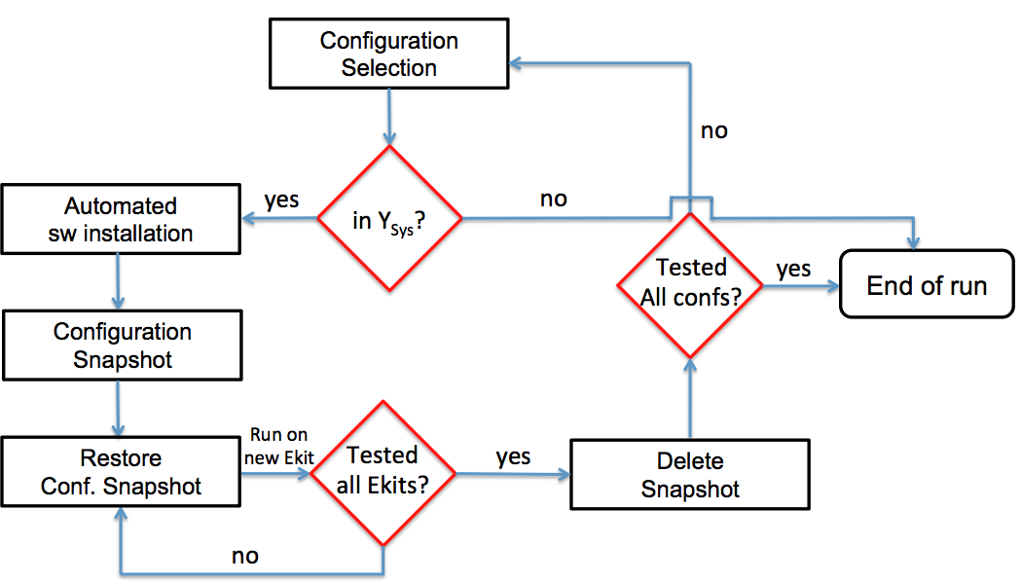
Experiment setup (2)

Slide 10
Experiment run (read: Example of MalwareLab functionalities)
VICTIM 1
Victim 2
Victim 3
Configuration Snapshot (attacked)
Configuration Snapshot
Firefox
Plugin
1
Plugin
2
Plugin
3
Plugin
4
✓
✓
✓
✓
✓
Windows XP
Service Pack 0
Lunch(VM, EKIT(1))
Saves Configuration snapshot
Pushes installers, installs software
Checks install: push batch file on VM
Restore Configuration snapshot
Lunch(VM, EKIT(x))
Restore Configuration Snapshot
Delete(“Configuration snapshot”)
Virtual Box Interface
“Lunch against Exploit Kits”
For x in 1..10:
Restore(“Configuration snapshot”)
Lunch(VM, EKIT(x))
Delete(“Configuration snapshot”)
“Install configuration 2”
….
“Install configuration 180”
….
“End”
“Install configuration 1”
Pushes installers, installs software
Checks Install: push batch file on VM
Saves Configuration snapshot
Control Scripts in Python
Malware Distribution Server
(MDS)
Linux Ubuntu

Slide 11
Assess Exploit Successfulness
VICTIM 1
VICTIM 2
VICTIM 3
If exploit is successful
-> Requests “Casper”
From MDS
Set
“Successful”= 1
In MDS table Infections
GET /Exploit Kit/ HTTP/1.1
Send Exploit
Casper
The “good-ghost-in-the-browser”
malware
Malware Distribution Server
(MDS)

Slide 12
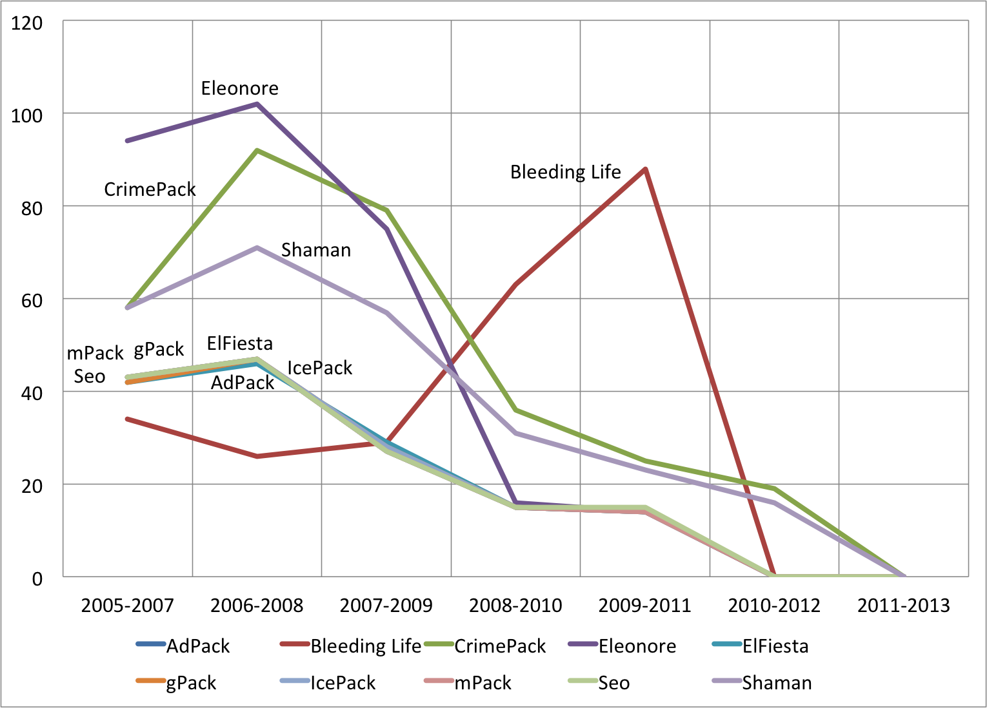
Some results

Slide 13
Useful Reads
MalwareLab & Ekits:
CSET ’13: MalwareLab: Experimentation with Cybercrime Attack Tools.
ESSoS ’13: Anatomy of Exploit Kits - Preliminary Analysis of Exploit Kits as Software Artefacts.
Exploitation 101
[BOOK] HACKING: The Art of Exploitation – Erickson
Phrack Magazine: Smashing The Stack For Fun And Profit
Advanced exploitation
Usenix ’11 – Q: Exploit Hardening Made Easy
Blackhat 2013 - JUST-IN-TIME CODE REUSE: THE MORE THINGS CHANGE, THE MORE THEY STAY THE SAME
Usenix ’14 - ROP is Still Dangerous: Breaking Modern Defenses
Usenix ‘14 - Size Does Matter: Why Using Gadget - Chain Length to Prevent Code-Reuse Attacks is Hard
IEEE Symposium on Security & Privacy ’14: Framing Signals — A Return to Portable Shellcode
Tools
Damn Vulnerable Linux
gcc, gdb
MalwareLab

Slide 14
Showtime
Exploit kit inner workings
Overview of an exploit
Acrobat Reader, CVE-2010-0188
Demo of attack

Slide 15
Buffer overflow vulnerability
Buffer overflow: a variable can grow arbitrarily big in memory
No control over its size
If the attacker can control the variable, he can write into memory outside of the variable boundaries
It is possible to hijack program execution by redirecting it to a shellcode injected by the attacker
Shellcode can execute actions such as downloading and executing malware

Slide 16
Memory layout
High memory address
RET
Return Address in stack frame
RET overfill
RET
Instruction n
….
Shellcode
Instruction 1
Memory space affected by
Buffer Overflow
NOP
NOP Sled
NOP
NOP
Variable’s first byte
First byte where the overflow starts
Low memory address

