Slide 1
Exploitation in the wild: what do attackers do, and what should(n’t) we care about.
UNIVERSITY OF TRENTO
SECONOMICS
Luca Allodi, Fabio Massacci
University of Trento, Italy.
$name.$surname@unitn.it

Slide 2
Outline
UNIVERSITY OF TRENTO
SECONOMICS
Introduction (3 slides)
Vulnerability Management guidelines: CVSS
What do the IT Sec Managers need: research question
Vulnerability landscapes (5 slides)
The good guys
Most bad guys
Our baseline: data
Reality on attacks, according to the data
Observational analysis of CVSS scores (5 slides)
CVSS distributions
Map of vulnerabilities, exploits and CVSS scores: CVSS not good
What makes the CVSS so inaccurate? (15 slides)
Inspection of CVSS subscore distributions
Case controlled study: CVSS as a test for exploitation
Relative diminishment in risk with vulnerability patching
Conclusions

Slide 3
UNIVERSITY OF TRENTO
SECONOMICS
Introduction

Slide 4
Vulnerabilities guidelines
UNIVERSITY OF TRENTO
SECONOMICS
US Government SCAP Protocol for vulnerability remediation [Scarfone 2010]
“Organizations should use CVSS base scores to assist in prioritizing the remediation of known security-related software flaws based on the relative severity of the flaws.”

Slide 5
Vulnerabilities guidelines
UNIVERSITY OF TRENTO
SECONOMICS
US Government SCAP Protocol for vulnerability remediation [Scarfone 2010]
bother with every software vulnerability, use CVSS to prioritize your work
“Organizations should use CVSS base scores to assist in prioritizing the remediation of known security-related software flaws based on the relative severity of the flaws.”

Slide 6
Don’t cite me on that (they said)
UNIVERSITY OF TRENTO
SECONOMICS
“My job is the professional nightmare: if everything goes well, I am not doing anything. If something goes badly wrong, I am fired.” – Security Manager of big Italian player in sw industry
“Just acknowledging there is a bug costs hundreds of euros” – Representative of EU leader in sw management
“You are crazy if you think I’ll install all the patches” – IT Admin of big US telecommunication company

Slide 7
Vulnerabilities: research question
UNIVERSITY OF TRENTO
SECONOMICS
What the CIO would like to know
If I follow SCAP or equivalent guidelines, how much will my final risk decrease?
A clear value proposition:
if we fix high CVSS vulns we decrease risk by +43%
if we fix all medium CVSS only raises to +48%
→ +5% more is not worth the extra money, maybe even +43% is not worth

Slide 8
UNIVERSITY OF TRENTO
SECONOMICS
Vulnerabilities: landscapes

Slide 9
Vulnerabilities: the good guys
UNIVERSITY OF TRENTO
SECONOMICS
Databases for vulnerabilities:
Lots of Vulnerabilities are published daily
NVD runs at 50K
CVSS scoring system is now drafting V.3
Databases for exploits:
Vendors’ “Bounty programs”
iDefender, TippingPoint acquisition program
“Responsible Disclosure” debate
Analysis of complete protection against a powerful adversary
Classic model of the attacker [Dolev, Schneier…]
Fix all vulnerabilities or die

Slide 10
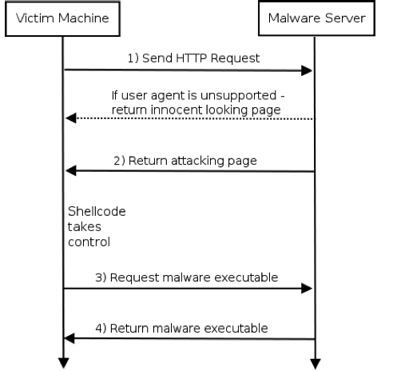
Vulnerabilities: most bad guys
UNIVERSITY OF TRENTO
SECONOMICS
Automated web attacks represent 2/3 of final threat for users [Google 2011],[Grier 2012]

Slide 11
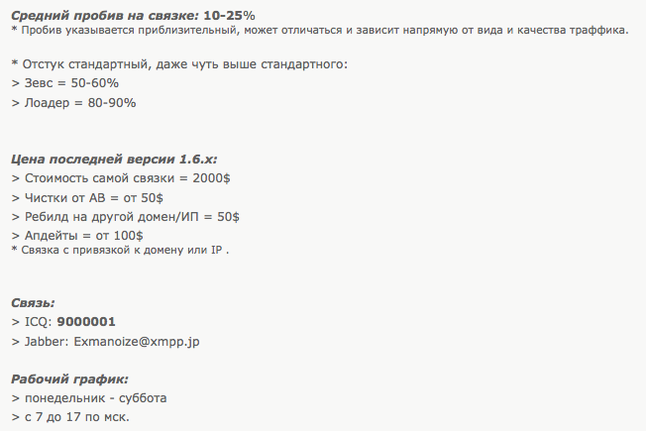
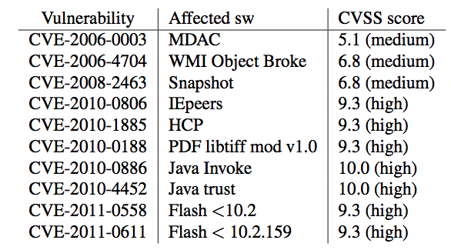
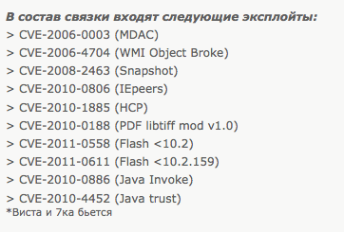
Vulnerabilities: most bad guys
UNIVERSITY OF TRENTO
SECONOMICS
Automated web attacks represent 2/3 of final threat for users [Google 2011],[Grier 2012]
Exploitation success rate
*Rate highly depends on traffic quality
Latest prices
Additional services
Vendor’s contacts
Working hours:
Monday-Saturday
7am to 5pm (Moscow time)

Slide 12
Vulnerabilities: our baseline
UNIVERSITY OF TRENTO
SECONOMICS
NVD
The universe of vulnerabilities
EXPLOIT-DB
Exploits published by security researchers
EKITS (The black markets)
1.5 years of study of the black markets
Automated monitoring of exploit kits and new CVEs
90+ exploit kits from the black markets
SYM
Vulnerabilities actually exploited in the wild
Browser/Plugins 14% – Server 22% – App. 24%
Solaris, MacOs, Linux and others are included
dataset | volume
NVD | 49.624
EDB | 8.189
EKITS | 126
SYM | 1.289

Slide 13
Reality so far
UNIVERSITY OF TRENTO
SECONOMICS
The “Classic” Attacker Model looks wrong
Few exploited vulnerabilities
Big chunk of risk from a bunch of vulnerabilities
Fix all vulnerabilities or die → waste of money?
But CIO can’t wait:
Use a Security Configuration Management Product!
30+ products: Microsoft, Dell, HP, VMWare, McAfee, Symantec etc..
Based on CVSS (Common Vuln. Scoring System)

Slide 14
UNIVERSITY OF TRENTO
SECONOMICS
Observational analysis of CVSS scores

Slide 15
CVSS Study
UNIVERSITY OF TRENTO
SECONOMICS
Remember: the SCAP protocol tells you: take a dataset of vulnerabilities, order vulnerabilities by CVSS.
We therefore look at:
Distribution of CVSS scores per dataset
Are datasets different in terms of type of vulnerabilities?
VENN diagram of datasets and scores
Are datasets interesting in terms of attacks actually delivered by the bad guys?
Notes:
Different datasets = different conclusions
If exploits are not contained in any dataset or spotted by any metric, we are in trouble

Slide 16
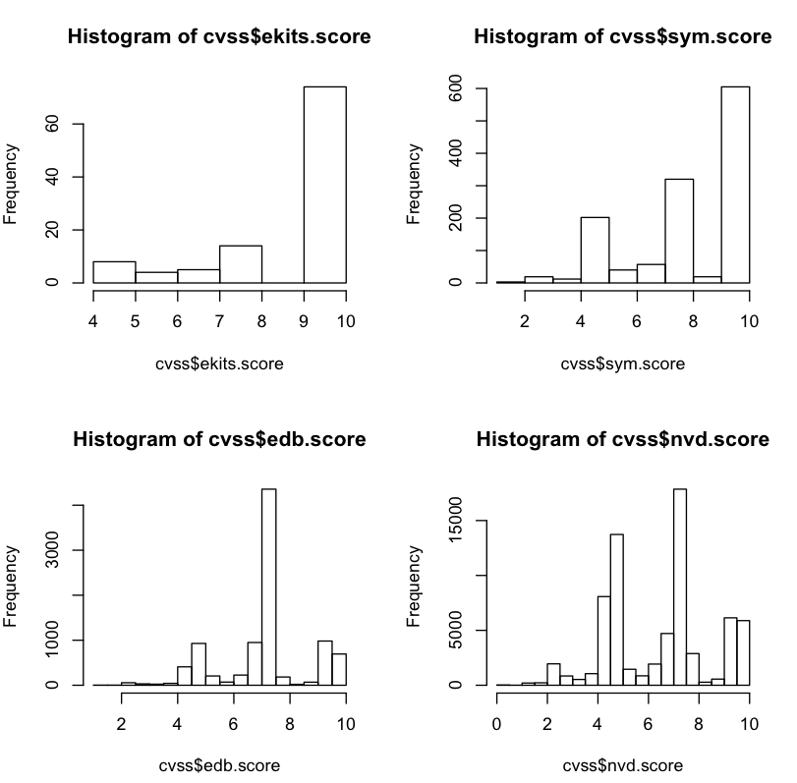
CVSS Distribution: HIST
UNIVERSITY OF TRENTO
SECONOMICS
LOW: CVSS <6
MEDIUM: 6<CVSS<9
HIGH: CVSS > 9

Slide 17
CVSS Distribution: HIST
UNIVERSITY OF TRENTO
SECONOMICS
Notes:
Using cvss score to assess which exploits are going to be used by attackers may not be a very good decision

Slide 18
CVSS Distribution: HIST
UNIVERSITY OF TRENTO
SECONOMICS
Notes:
And what about datasets?

Slide 19
CVSS Distribution: HIST
UNIVERSITY OF TRENTO
SECONOMICS
Notes:
And what about datasets?

Slide 20
CVSS Distribution: HIST
UNIVERSITY OF TRENTO
SECONOMICS
Notes:
The distributions are different:
Vulnerabilities in the two datasets are different
If you take only HIGH score vulnerabilities you will not get SYM nor EKITS
Random sampling doesn’t work either, you won’t get the right distribution
Estimating final risk by looking at NVD or EDB may be very tricky
------------------------- BASELINE: lack of a selection criteria to map NVD ->>> SYM OR EDB ->>> SYM

Slide 21
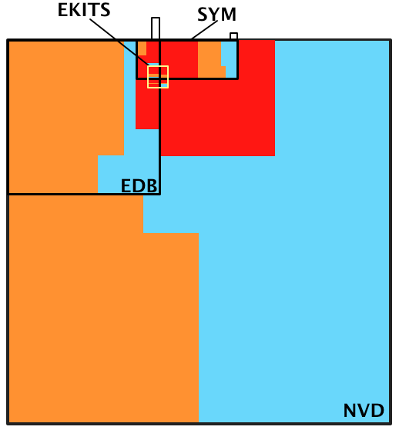
CVSS Distribution: VENN
UNIVERSITY OF TRENTO
SECONOMICS
LOW CVSS
MEDIUM CVSS
HIGH CVSS

Slide 22
Observational conclusions
UNIVERSITY OF TRENTO
SECONOMICS
Attackers choose vulnerabilities autonomously:
They do not care about every vulnerability (NVD)
They do not care about every exploit (EDB)
HIGH, MED+LOW score vulnerabilities are uniformly distributed in SYM dataset
If you take NVD and fix all HIGH score vulnerabilities first [SCAP] you will:
Waste a lot of money patching all HIGH score vulnerabilities
Have addressed only 50% of final possible threats

Slide 23
What makes the CVSS so inaccurate?

Slide 24
CVSS Metrics
UNIVERSITY OF TRENTO
SECONOMICS
CVSS measures risk in the form
Risk = Impact x Likelihood
CVSS score = Impact x Exploitability

Slide 25
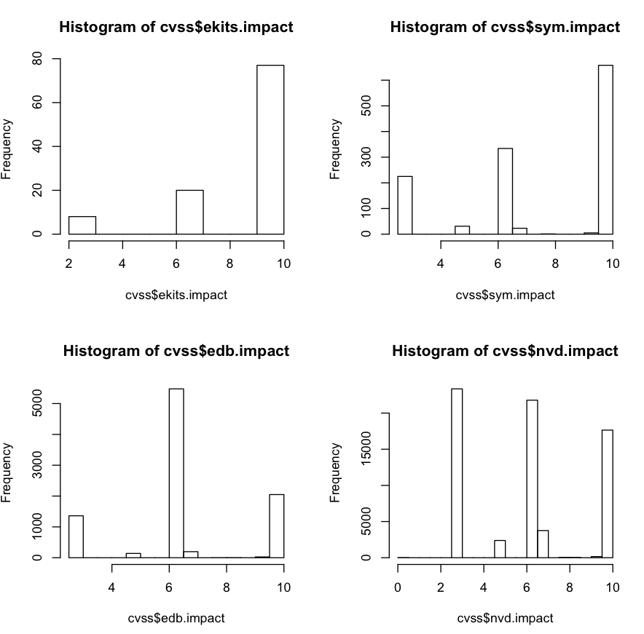
CVSS Metrics: Impact
UNIVERSITY OF TRENTO
SECONOMICS

Slide 26
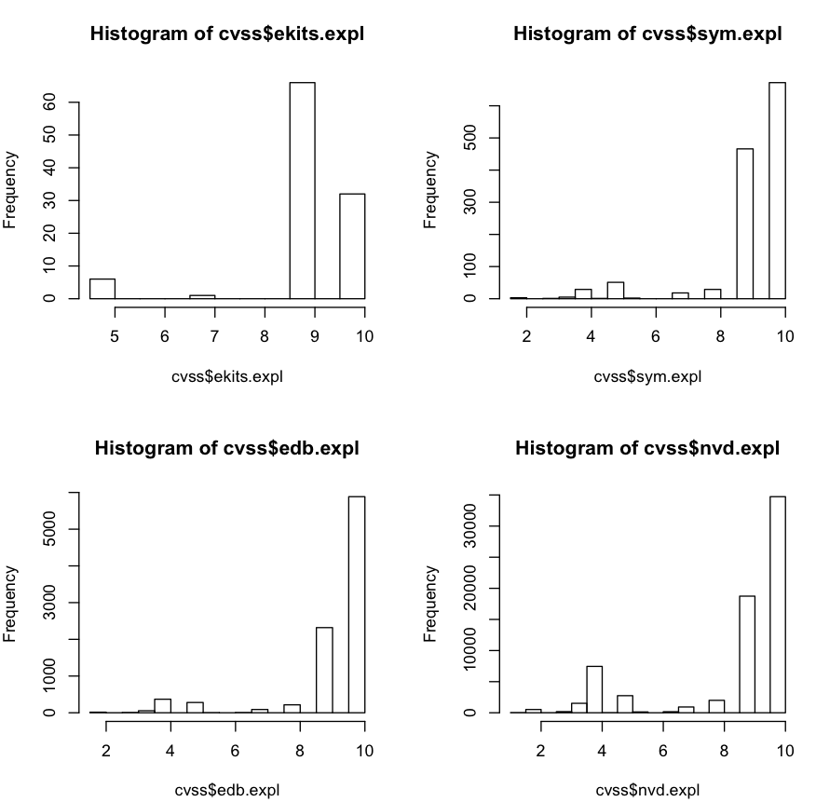
CVSS Metrics: Exploitability
UNIVERSITY OF TRENTO
SECONOMICS

Slide 27
CVSS Metrics: Exploitability explained
UNIVERSITY OF TRENTO
SECONOMICS
Everything is exploitable → Exploitability is not an interesting variable at all!
Is actually a constant
CVSS lacks of any real measure of likelihood
Based on “easiness to exploit”
Access Vector = All from Network VAR ≅ 0
Authentication = All None VAR ≅ 0
Access Complexity = Only interesting variable. VAR != 0
Let’s see what effects does this have to the final CVSS assessment

Slide 28
CVSS case controlled experiment
UNIVERSITY OF TRENTO
SECONOMICS
Do smoking habits predict cancer? [Doll & Bradfor Hill, BMJ]
You can’t ask people to start smoking so you can’t run a controlled experiment
Do high CVSS scores predict exploitation?
You can’t attack users so you can’t run a controlled experiment

Slide 29
CVSS case controlled experiment
UNIVERSITY OF TRENTO
SECONOMICS
Study | Cases | Controls (possible confounding variables) | Explanatory variable
Carcinoma of the lung | People with cancer | Age Sex Location | Smoke much Smoke some Doesn’t smoke
CVSS | Exploited vulnerabilities | Access complexity Access vector Authentication Impact type | CVSS is HIGH CVSS is LOW Vuln is in {NVD,EDB,EKITS}

Slide 30
CVSS case controlled experiment
UNIVERSITY OF TRENTO
SECONOMICS
CVSS Score+DB as a “medical test”
Sensitivity → Pr(true positives)
You want to capture as many sick people as possible
Specificity → Pr(true negatives)
You REALLY don’t want to cure people who don’t need it

Slide 31
CVSS Case Controlled Experiment
UNIVERSITY OF TRENTO
SECONOMICS
Triple Blood Test Down Syndrome - Women aged 40+ [Kennard 1997]
Sensitivity: 69%
31% of women carrying a fetus with Down syndrome will not be caught by the test
Specificity: 95%
only 5% of healthy pregnant women would be mislead by the test to undergo additional expensive or dangerous tests
Remember: most (but really a lot of) women have healthy pregnancies
Prostate Serum Antigen - Men aged 50+ [Labrie 1992]
Sensitivity: 81%
Specificity: 90%
Notes:
NJ, Kennard A, Hackshaw A, McGuire A . “Antenatal screening for Down's syndrome.” Journal of Medical Screening 4(4):181-246, 1997.
Labrie F, Dupont A, Suburu R, Cusan L, Tremblay M, Gomez JL, Emond J. “Serum prostate specific antigen as pre-screening test for prostate cancer.” The Journal of Urology 147(3 Pt 2):846-51, 1992 [discussion 851-2]

Slide 32
Security Rating as “Generate Panic” test
UNIVERSITY OF TRENTO
SECONOMICS
Sensitivity: is High/Med CVSS good marker for v∈SYM?
Sensitivity = Pr(HIGH+MED | v in SYM)
Specificity: is Low CVSS good marker for v∉SYM?
Specificity = Pr(LOW | v not in SYM)

Slide 33
Security Rating as “Generate Panic” test
UNIVERSITY OF TRENTO
SECONOMICS
DB | Sensitivity | Specificity
EKITS | 89.17% | 49.73%
EDB | 98.14% | 24.39%
NVD | 89.70% | 22.22%
3BT: Down Syndrome | 69% | 95%
PSA: Prostate Cancer | 81% | 90%

Slide 34
Security Rating as “Generate Panic” test - Explained
UNIVERSITY OF TRENTO
SECONOMICS
Sensitivity (+)
CVSS is good in marking exploitation
Specificity (-)
Peaks in NVD and EDB at less than 25%
1 out of 4 non-exploited vulnerabilities are marked LOW
3 out of 4 non-exploited vulnerabilities are marked HIGH
Remember this is a controlled study:
We are looking only at vulnerabilities representative of SYM CVSS
Let’s assume linearity of cost for number of fixed vulnerabilities
You are following US Governement SCAP Guidelines? -> You are spending up to 300% more money than you should

Slide 35
Ok, but is at least my risk decreasing?
UNIVERSITY OF TRENTO
SECONOMICS
What really matters is change in relative probabilities
Example = Usage of Safety Belts
Few people actually die in car crashes vs #crashes [Evans 1986]
Pr(Death x Safety Belt on) – Pr(Death x Safety Belt off)
43% improvement of chances of survival
Our Study = Patching High score vulnerabilities
Few vulnerabilities are actually exploited vs #vulns
Pr(Attack x CVSS High Patched) – Pr(Attack x CVSS Low Patched)
X% improvement of chances of NOT being attacked
Notes:
G. Evans, General Motors Lab, 1986
In absolute terms, doesn’t make much sense to compare percentages, as very few vulnerabilities are, apparently, actually exploited

Slide 36
Not really, no.
UNIVERSITY OF TRENTO
SECONOMICS
 | Pr(H+M)-Pr(L)
EKIT
vuln in SYM | +46.3%
vuln !in SYM | -47.28%
EDB
vuln in SYM | +14.5%
vuln !in SYM | -14.49%
NVD
vuln in SYM | +3.5%
vuln !in SYM | -3.46%

Slide 37
What does this mean?
UNIVERSITY OF TRENTO
SECONOMICS
What the CIO really wants to know:
I read on the news that a “security researcher” exploited a vulnerability on X to do some bad stuff. Should I worry?
You monitor the black markets and fix all HIGH CVSS vulnerabilities you find there?
Your risk of suffering from an attack from the black markets decreases by 46%
You use EDB or NVD to know what exploits are out there, and fix all HIGH CVSS vulnerabilities?
Diminished risk: EDB = 14%; NVD = 3%.
Arguably a bad investment

Slide 38
Preliminary conclusions
UNIVERSITY OF TRENTO
SECONOMICS
Where should we look for “real” exploits?
EDB, NVD are the wrong datasets
Should the CIO do what SCAP protocol says?
No datasets shows high Specificity:
CVSS doesn’t rule out “un-interesting” vulns
Huge over-investment
It may be possible to narrow down vulnerabilities the CIO should actually fix
Rule out 80% of risk = worth the update pain, measurable gain
We need better attacker model -> Research challange ahead

Slide 39
Questions
UNIVERSITY OF TRENTO
SECONOMICS
Thanks

Slide 40
What security researchers deliver
UNIVERSITY OF TRENTO
SECONOMICS
Analysis of complete protection against a powerful adversary
Attackers will target me in particular, intercept all my possible messages, exploit all my possible vulnerabilities, use all partners
Dolev, Schneier…
Fix all vulnerabilities or die

Slide 41
Vulnerabilities: most bad guys
UNIVERSITY OF TRENTO
SECONOMICS
We are monitoring 90+ exploit kits on the markets
Automated infrastructure that monitors new kits, new CVEs, new posts by vendors
Last entry we detected: ~20 days ago: WhiteHole, 3 exploits, 1200$/month
Security press started talking about it 7+ days later
New players pop up monthly if not weekly
2-12 exploits each
Prices from 1000/year -> 2000/month
Exploit as-a-service
Rent-an-infection-service
Pay in “traffic” or pay in dollars
“Clean” from AV
Symantec detects your exploit kit? Pay us, we’ll repack the attack
Free trials
I’m new, you don’t know me but I am good: try me

Slide 42
Vulnerabilities: reality according to data
UNIVERSITY OF TRENTO
SECONOMICS
Google: automated attacks are 70% of final risk
Symantec: 1.3k exploits out of 50k vulnerabilities
Two scenarios:
The bad guy wants you. Zero day exploit, not much you can do about it
The bad guy just wants some. Will fish from the shoal, if you happen to be there and vulnerable you should have patched.

Slide 43
CVSS distribution explained
UNIVERSITY OF TRENTO
SECONOMICS
They have different distributions!
EKITs sell mostly vulns with high scores
SYM see vulns with high scores and some with medium scores
Recall vuln in SYM → vuln used by bad guys
NVD and EDB have lots but really lots of vulns of totally uninteresting vulns
The population of exploited vulnerabilities (SYM) is different from NVD, EDB
If you are using the NVD or EDB to assess your company status (eg SCAP) → Waste Money!
CVSS scores tell something but not good enough
Only good for witch hunt - “Kill them all, God will recognize its brethren”

Slide 44
CVSS case controlled experiment
UNIVERSITY OF TRENTO
SECONOMICS
Do smoking habits predict cancer?
Doll & Bradfor Hill, BMJ
You can’t ask people to start smoking so you can’t run a controlled experiment
Case controlled study (Carcinoma)
Cases
people with lung cancer
Controls (Possible confounding variables)
Age, Sex, Social Status, Location
Explanatory variable
Smoking habit
For each of the cases select another person with the same values of the control variables

Slide 45
CVSS case controlled experiment
UNIVERSITY OF TRENTO
SECONOMICS
Case controlled study (CVSS)
Cases
vulns with exploits in the wild (SYM/KASP)
Controls (Possible confounding variables)
Access vector, access complexity, authentication
Explanatory variables
CVSS Score, Database
CVSS Score+DB as a “medical test”
Sensitivity → true positives vs all sick people
You want to capture as many sick people as possible
Specificity → true negatives vs all healthy people
You don’t want to cure people who don’t need it

Slide 46
Effects of removing High-risk Vulnerabilities
UNIVERSITY OF TRENTO
SECONOMICS
We categorized our datasets per software type
7 categories
BUSS(iness), PLUGIN, SERVER, WINDOWS, BROWSER…
Test for Effectiveness considering as confounding variables:
Year
CATEGORY

Slide 47
Effects of Removing High-risk Vulnerabilities
UNIVERSITY OF TRENTO
SECONOMICS
Classify vulnerabilities into two categories: High-risk vs. Low & Medium-risk
CVSS: CVSS (>9) vs. Low&Medium CVSS (<=9)
EDB & EKITS: In the dataset vs. Not in the dataset
Based on Evans(1986), we calculate the effectiveness of removing high-risk vulnerabilities (i.e., w/ High CVSS, in EDB, and in EKITS) in reducing the risk of vulnerability exploitation in the wild.
Effectiveness
Dataset | EFFECTIVENESS
CVSS | 82.12 ± 2.06%
EDB | 55.63 ± 5.22%
EKITS | 96.80 ± 0.58%

Slide 48
Effects of Removing High-risk Vulnerabilities (YEAR)
UNIVERSITY OF TRENTO
SECONOMICS
Estimated Effectiveness (exponential model)
Dataset | EFFECTIVENESS
CVSS | 56.77 ± 3.37%
EDB | 36.81 ± 4.69%
EKITS | 78.72 ± 3.39%

Slide 49
Effects of Removing High-risk Vulnerabilities (CATEGORY)
UNIVERSITY OF TRENTO
SECONOMICS
Estimated Effectiveness
Dataset | EFFECTIVENESS
CVSS | 39.80 ± 4.89%
EDB | 42.11 ± 4.89%
EKITS | 64.76 ± 6.03%

Slide 50
The Picture so Far
UNIVERSITY OF TRENTO
SECONOMICS
What the CIO really wants to know:
I read on the news that a “security researcher” exploited a vulnerability on X to do some bad stuff.
Should we worry?
The Answers…
A security researcher published a proof of concept exploit?
decline by 3-14% → delete email, life is too short
An exploit kit has marketed it and it has a CVSS high score?
decline by 46% → ask antivirus company or upgrade software, post a huge notice on the web site customers should update sw

