Slide 1
Vulnerability assessment
A quick exercise before we get started
Luca Allodi

Slide 2
What this session is and is not
This is an exercise to see how intuitive it is for you to evaluate vulnerability criticality
This is not an exam and will not in any way influence your final vote
I will give you a sheet of paper with 30 vulnerabilities and their description
This is what who makes the assessment has at his disposal at the start of the process
I will ask you to grade the vulns according to a number of metrics and to express
Your “gut feeling” on the severity of the vulnerablity
Your confidence with your assessment

Slide 3
Vulnerabilities
Are bugous pieces of code in a software
Can be exploited to deviate software’s execution from its designed behavior
There are of many types
Buffer overflows
Authentication
XSS
…
At this stage you are NOT required to know any of this

Slide 4
How to grade vulnerabilities? (1)
There is a standard for that: the CVSS
It is now at its third revision, under construction
CVSS is the worldwide standard used for
Credit card security
Security mangement by U.S. National Institute of Standards Technology (e.g. SCAP)
Security communication by ISO standards (e.g. ISO 29147)
….
I am one of the authors of the standard
Been working with CISCO, Intel, IBM and many others on its definition
I am thoroughly biased on its interpretation

Slide 5
How to grade vulnerabilities? (2)
I will not tell you how to interpret the metrics
I will rather just introduce you very briefly to how the CVSS works
You will do the rest by yourself
I’ll give you about 45 minutes to get at it
Then we will resume the “original” lecture
This experiment will be repeated at the end of the course
This will tell us how much a security background influences the use of the standard
In the real world, it is not security experts that do it
But rather system administrator or general IT staff (e.g. CERTs)

Slide 6
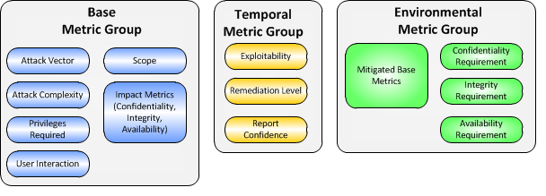
The Common Vulnerability Scoring System (1)
CVSS is based on a number of metrics
We will use the base metric group
And not all of them

Slide 7
The Common Vulnerability Scoring System (2)
Attack Vector
Network, Adjacent, Local, Physical
Attack Complexity
High, Low
Privileges required
High, Low, None
User interaction
Required, None
(Impacts on) Confidentiality, Integrity, Availability
Complete, Partial, None
Severity: 1-10 with 10 very bad, 1 not so bad
Confident? Yes=the vuln is clear to me; No= I’m not sure

Slide 8
The Common Vulnerability Scoring System (3)
It evaluates each metric relative to the vulnerable component
A vulnerability in a database must be evaluated relative to what it allows the attacker to do on the database
Example description (invented): Misconfiguration in OracleDB allows attacker to spawn a root shell on the system and gives local access to DB
The vulnerable component is the database
What does it do to the database?

